Slide 1
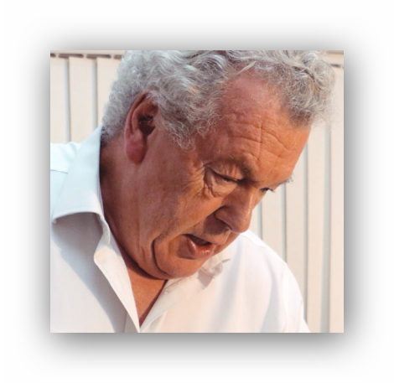
Getting Back into Practice
Being Aware of the Asymptomatic Patient. Nutrients for Post Viral Recuperation, for the Clinician and Children Back to School.
Chris Astill-Smith D.O., N.D. Diplomate ICAK
Marlow UK
chris@epigenetics@international.com

Slide 2
We are all desperate to restore our clinics and get back to our patients.
Our patients are equally desperate to make appointments to get our advice about their health issues.
If you are like me I am desperate to kick start my brain into activity again and wipe the dust off my test kits. .

Slide 3
Getting back into practice
During lockdown a lot of you have asked –
When is it safe to start again and what precautions shall I make?
How can I diagnose an asymptomatic patient?
What nutrients can I suggest for our post viral patients to restore their well being?

Slide 4
Getting back into practice
And how do I prepare for a second wave?
What do I suggest for the children going back to school in the autumn and winter?
What can I take to optimise my immune system when I return to practice?
?

Slide 5
When is it safe to start again?
When the government say so.
Realistically when professions like hairdressers and massage parlours get the go ahead to reopen. Anyone involved with physical touch of another person.
This will of course be when the level of infection has decreased to a minimal level.

Slide 6
Yesterday I treated my son’s upper cervicals. I found it nearly impossible to palpate the tissues or feel confident with treating with disposable gloves on.
I am sure my receptionist does not want to spend most of her day taking each patient’s temperature before they are allowed in, with gloves on disinfecting everything a patient touches and policing each patient coming in and going out.

Slide 7
Do I want to treat patients with a face mask on both the patient and myself and be wearing disposable gloves?
Will I need to sterilise all my test vials and diagnostic acetates?
Luckily there is available an UVc steriliser wand that will safely do this without affecting the test vials or acetates.
We recommend ones like this -

Slide 8
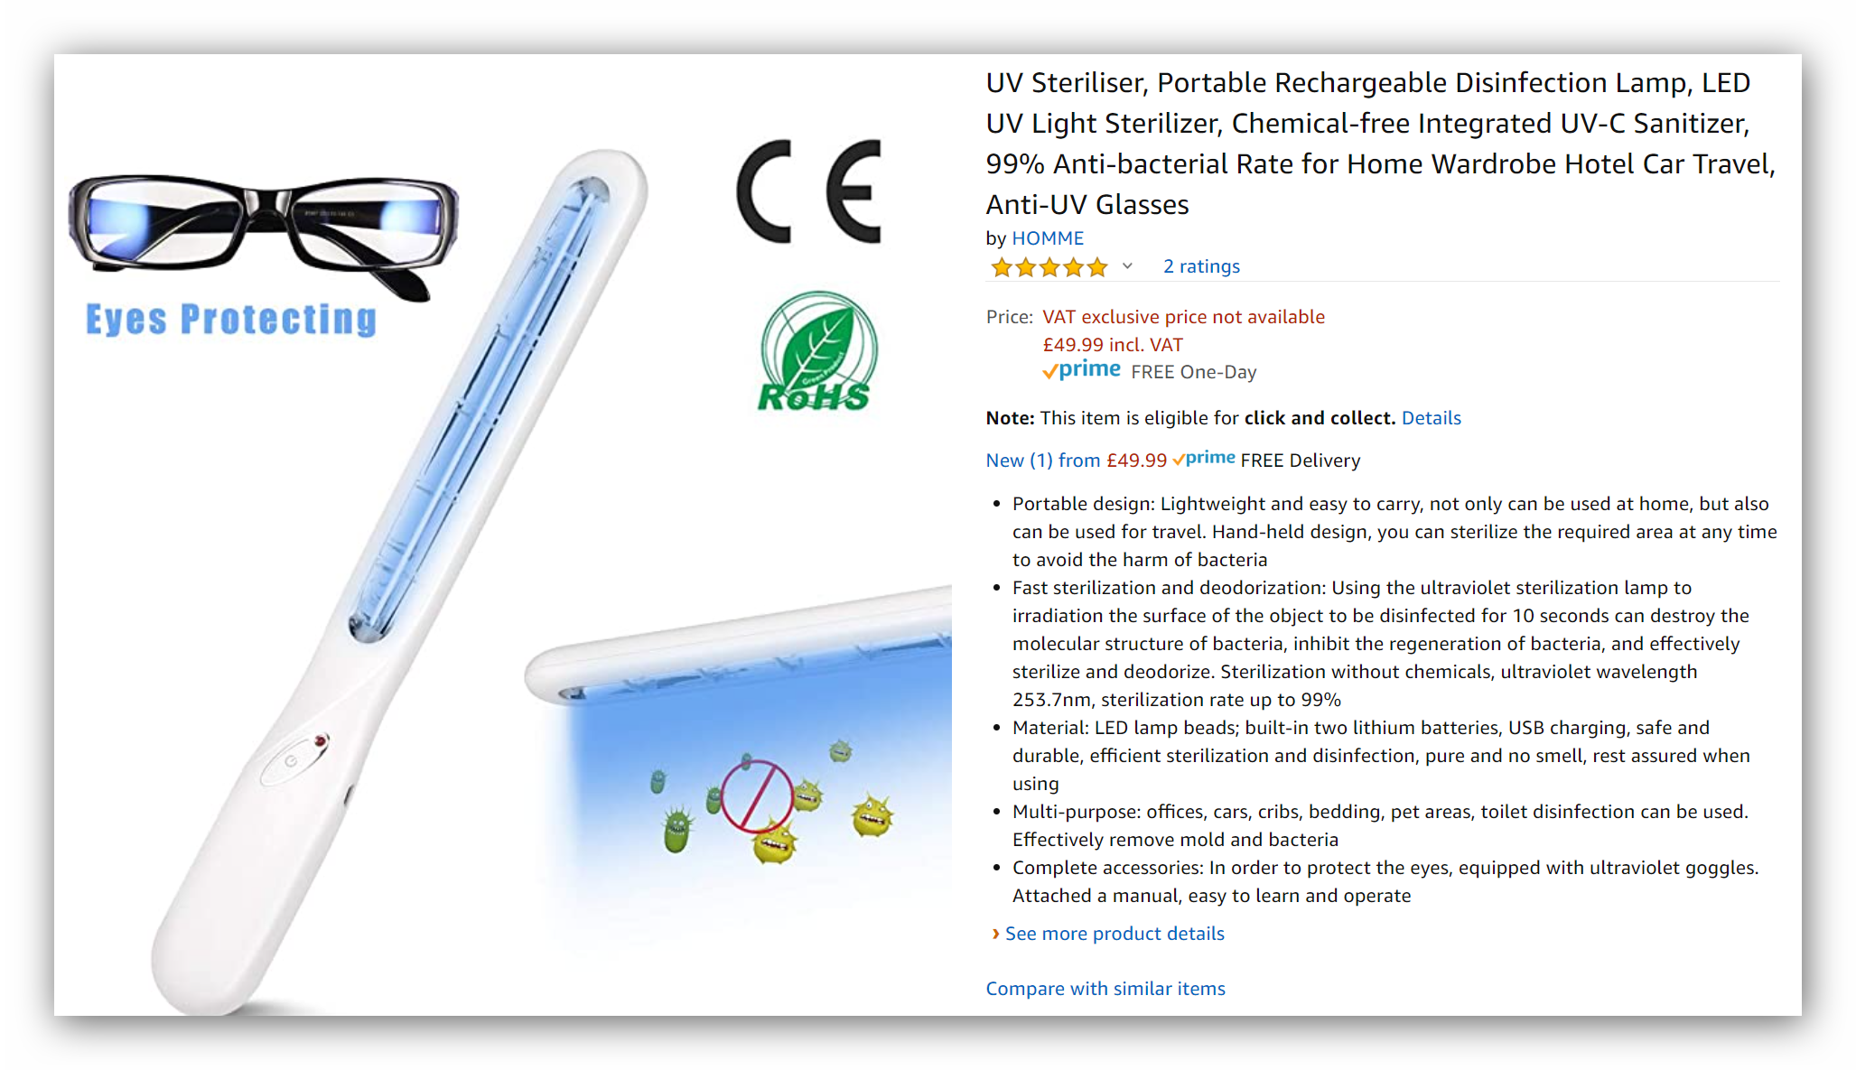
Don’t buy a cheap one

Slide 9
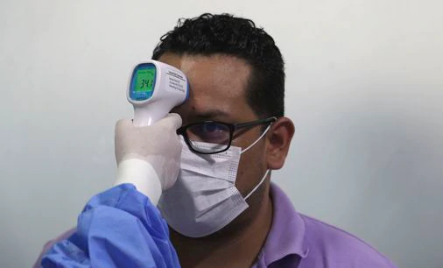
We are advised to take all patient’s temperature on their arrival.
And send them home if they are running a temperature.

Slide 10
How can I Diagnose an Asymptomatic Patient

Slide 11
The Asymptomatic Patient
When finally we are able to restart our clinics
we must be aware of potentially dangerous patients to treat in practice.
IMPORTANT QUESTIONS.
How to diagnose an asymptomatic patient carrying the virus?
Natural remedies to treat and prevent Covid-19?
Optimal innate immune system but failing to produce antibodies due to under functioning adaptive immune system?

Slide 12
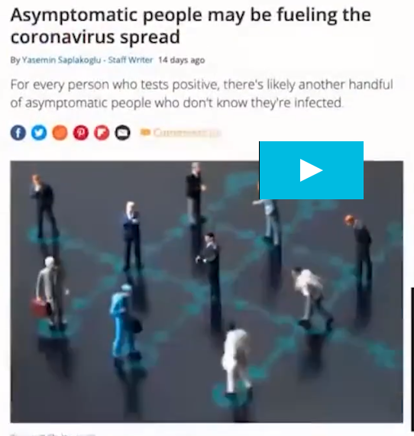
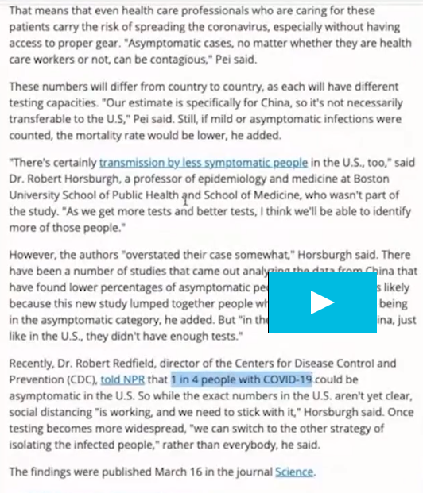
For every person who tests positive, there’s likely another handful of asymptomatic people who do not know they are infected
1 in 4 people with COVID-19 could be asymptomatic

Slide 13
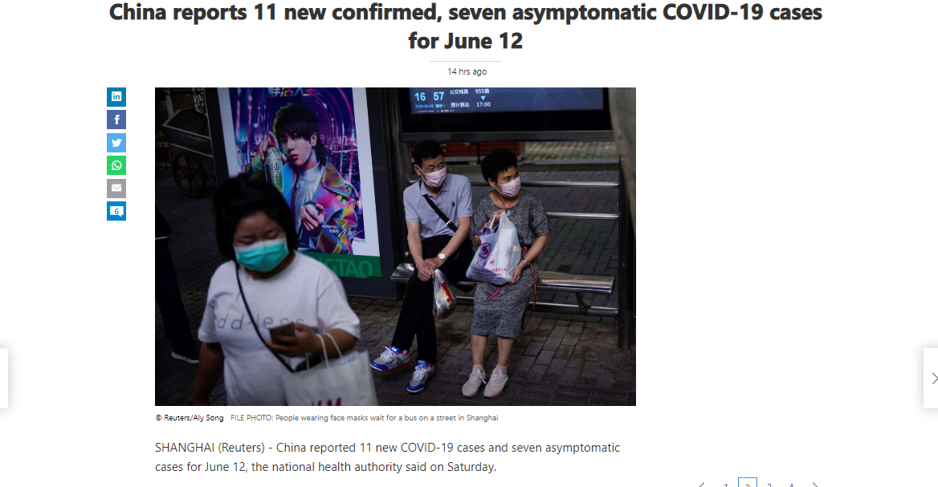

Slide 14
The Asymptomatic Patient*
Children 29-47% maybe asymptomatic or have mild Upper Respiratory Tract Infections.
Children going back to school could bring infection back into the home and also make the teachers infected.
*Asymptomatic COVID-19 Patients https://members.drbeen.com/view/asymptomatic-covid-19-patients/ryYAxjdqL

Slide 15
The Asymptomatic Patient
2. Pre-symptomatic could be as high as 57% but go on to develop symptoms later. i.e. they are in an incubation time of maybe 2-14 days with a median time of 5.1 days.
Just before symptoms develop usually about 2 days, they become active shedders of the virus.
Symptomatic
Day 0
Day 2
Day 5.1
Day 14
Day 24
Shedding

Slide 16
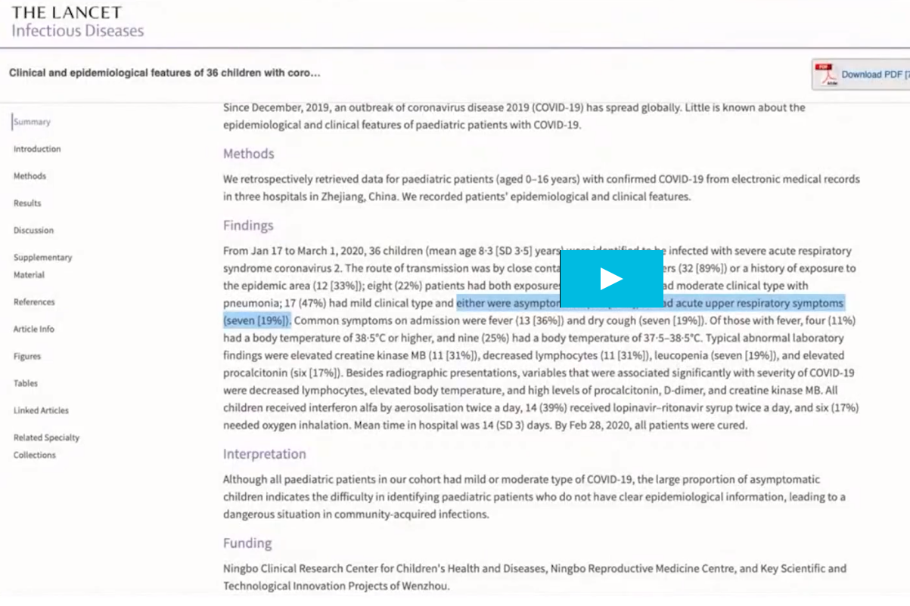
36 children exposed to Covid-19. 47% had mild clinical type symptoms and either were asymptomatic or mild upper respiratory symptoms (further 17%)*
*Asymptomatic COVID-19 Patients https://members.drbeen.com/view/asymptomatic-covid-19-patients/ryYAxjdqL

Slide 17
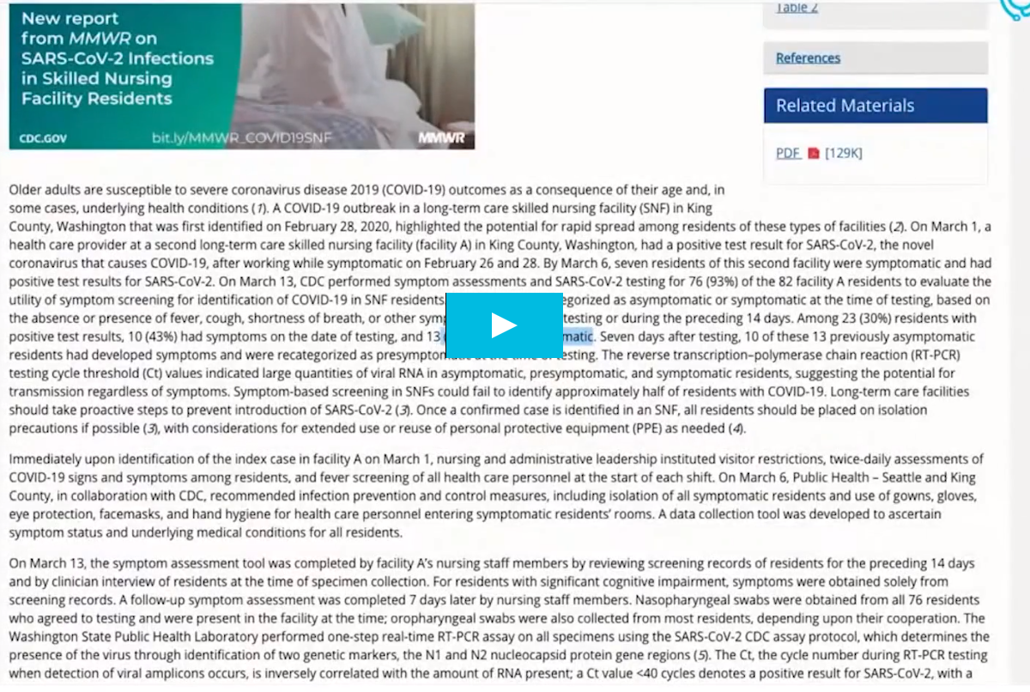
The Morbidity and Mortality Weekly Report
In this study 13 patients were asymptomatic on testing but seven days after testing 10 of the 13 previously asymptomatic residents had developed symptoms.*
*Asymptomatic COVID-19 Patients https://members.drbeen.com/view/asymptomatic-covid-19-patients/ryYAxjdqL

Slide 18
N.B. When exposed to a number of positive people it makes no difference to your ability to catch the virus. You can catch the virus from just one person or from a group.
It’s a question of your immunity.*
Why do some people develop no symptoms but do develop antibodies? GOOD QUESTION.
*Asymptomatic COVID-19 Patients https://members.drbeen.com/view/asymptomatic-covid-19-patients/ryYAxjdqL

Slide 19
The Asymptomatic Patient
3. Dys-symptomatic. These patients have symptoms but not the typical ones of Covid-19.
e.g. Headache
Skin rashes
Neuralgia
Gastrointestinal symptoms
Fatigue
Chills and fever
Anosmia
*Asymptomatic COVID-19 Patients https://members.drbeen.com/view/asymptomatic-covid-19-patients/ryYAxjdqL

Slide 20
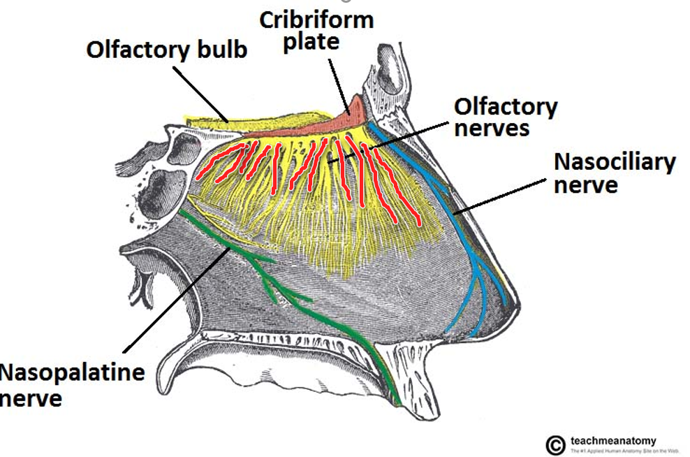
Anosmia –loss of smell and taste due to viral swelling of the olfactory nerves.
Taste involves a combination of smell and taste and so when smell is lost flavours become distorted.*
Inflammation of the Olfactory nerves
*Asymptomatic COVID-19 Patients https://members.drbeen.com/view/asymptomatic-covid-19-patients/ryYAxjdqL

Slide 21
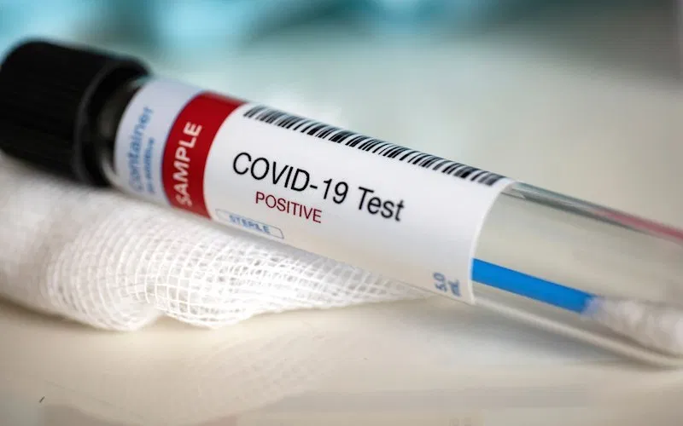
The Asymptomatic Patient*
4. Recoverers – people who have recovered from symptoms but are still carriers.
Tests maybe false positives or false negatives.
Two types of test
i) Swab which looks at viral RNA.
ii) Serum test for antibodies
*Asymptomatic COVID-19 Patients https://members.drbeen.com/view/asymptomatic-covid-19-patients/ryYAxjdqL

Slide 22
The Asymptomatic Patient*
Recoverers – are possibly people who have well functioning innate immune systems but low adaptive immune systems so fail to develop antibodies. Maybe become re-infected. Show negative to the serum antibody test.
Or possibly reactivation of the virus itself.
*Asymptomatic COVID-19 Patients https://members.drbeen.com/view/asymptomatic-covid-19-patients/ryYAxjdqL

Slide 23
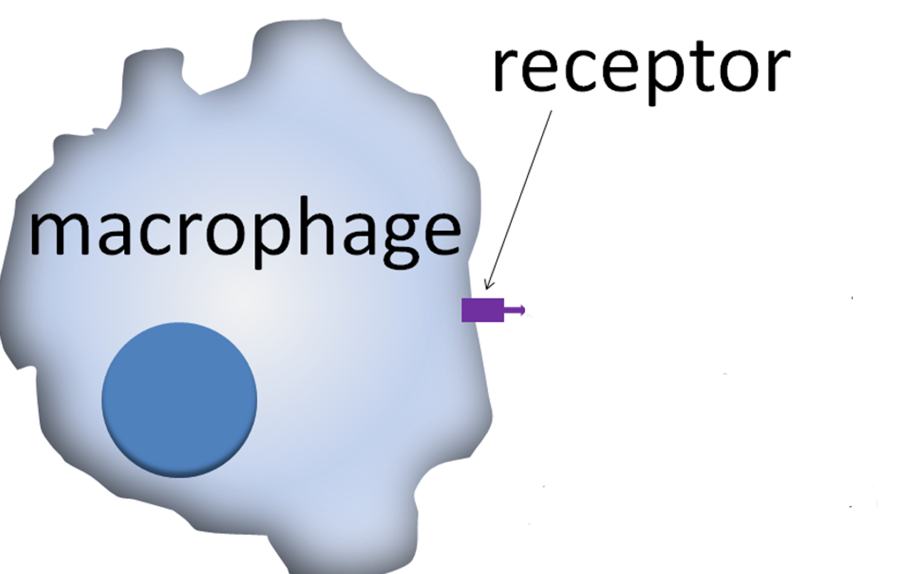
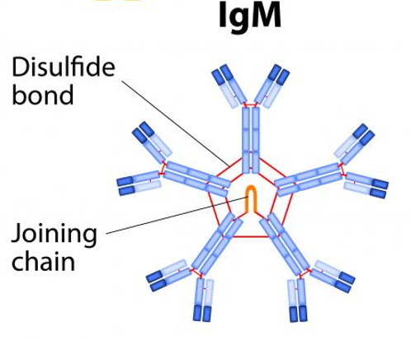
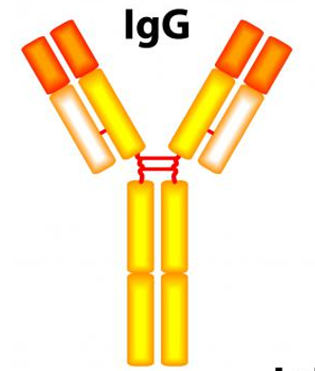
B
Cell
IL4 and IL10
T
Cell
↑TH1
↓TH2
Firstly
Secondly
Graham Colm at English Wikipedia

Slide 24
The Asymptomatic Patient*
5. Newly discharged patients who might still be shedding viral fragments. Most people who are discharged after two nasal swabs are negative.
Maybe asymptomatic but still have a lowering infectivity so can still shed for some time when out in the environment.
*Asymptomatic COVID-19 Patients https://members.drbeen.com/view/asymptomatic-covid-19-patients/ryYAxjdqL

Slide 25
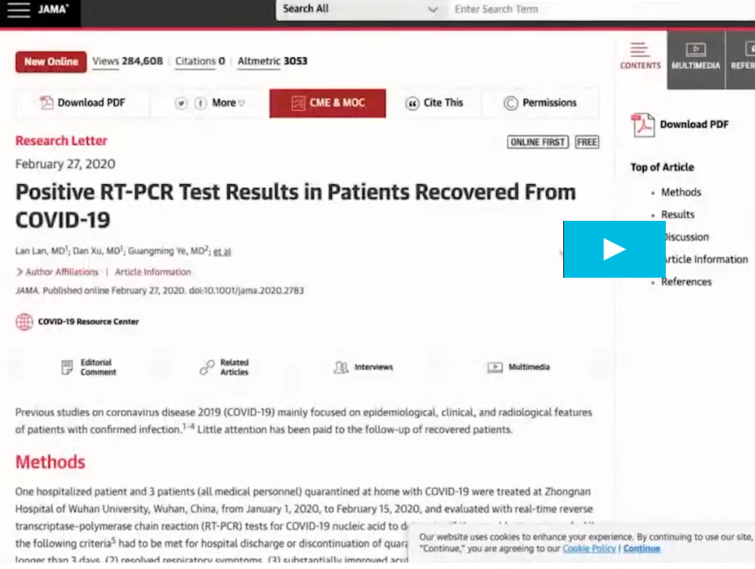
Reinfection unlikely if antibodies formed as they will remain in the system for up to 3 years.
Reactivation not normally known with corona viruses.
More likely were false positives or false negatives.
Little attention has been paid to the follow up of recovered patients
*Asymptomatic COVID-19 Patients https://members.drbeen.com/view/asymptomatic-covid-19-patients/ryYAxjdqL

Slide 26
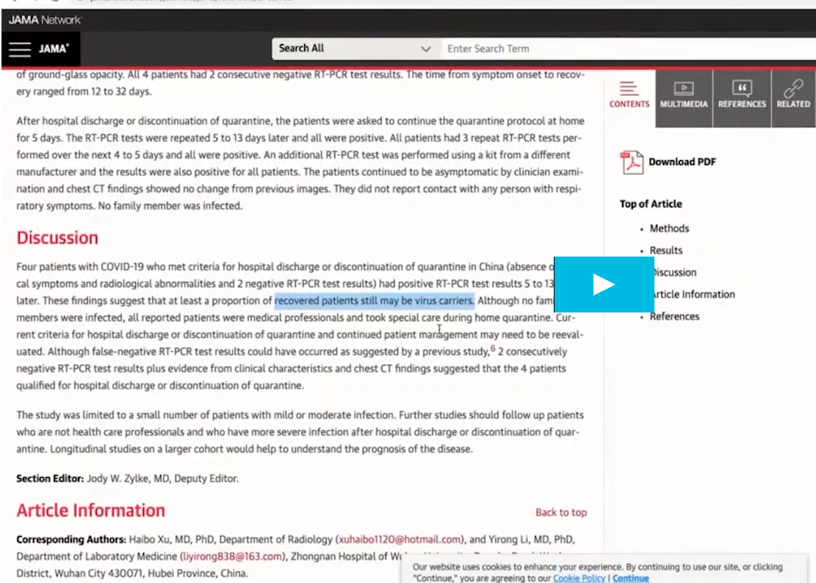
Patients asymptomatic-ally clear and no symptoms, even clear on swabs but 2 weeks later develop symptoms again and start to shred
Recovered patients may still be viral carriers.

Slide 27
The Asymptomatic patient*
The good news is that these people may help to build herd immunity. They are not dying. They are not using healthcare facilities.
The bad news is they may spread the infection to non infected people without knowing they are carriers.
Hence the importance of wearing face masks in shops, public transport etc. Could be your next patient!
*Asymptomatic COVID-19 Patients https://members.drbeen.com/view/asymptomatic-covid-19-patients/ryYAxjdqL

Slide 28
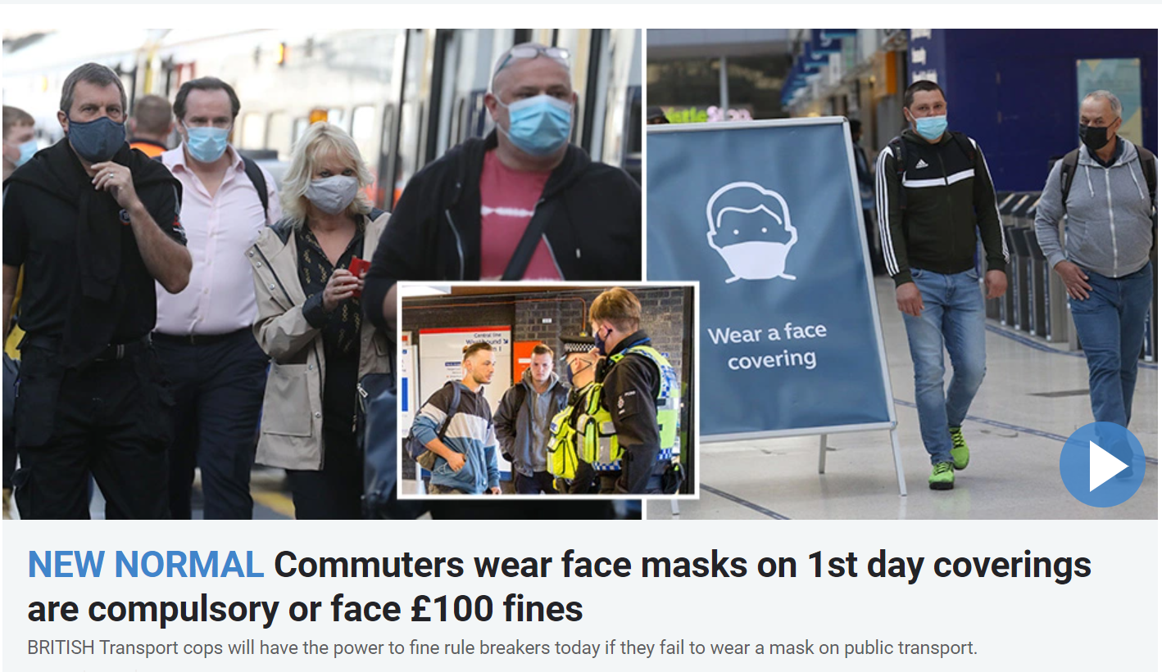
15th June 2020

Slide 29
Community dynamics*
Of the confirmed cases 81% Mild, 14% Severe, 5% Critical.
Of the total confirmed people who have had the virus and recovered there are between 50x to 80x the number of asymptomatic or mildly infected people out there with antibodies.
Makes up approximately 4% of the population. Still far too low for herd immunity. (needs to be 50-80%)
Not too worried so carry on regardless and spread virus
*Asymptomatic COVID-19 Patients https://members.drbeen.com/view/asymptomatic-covid-19-patientsneed/ryYAxjdqL

Slide 30
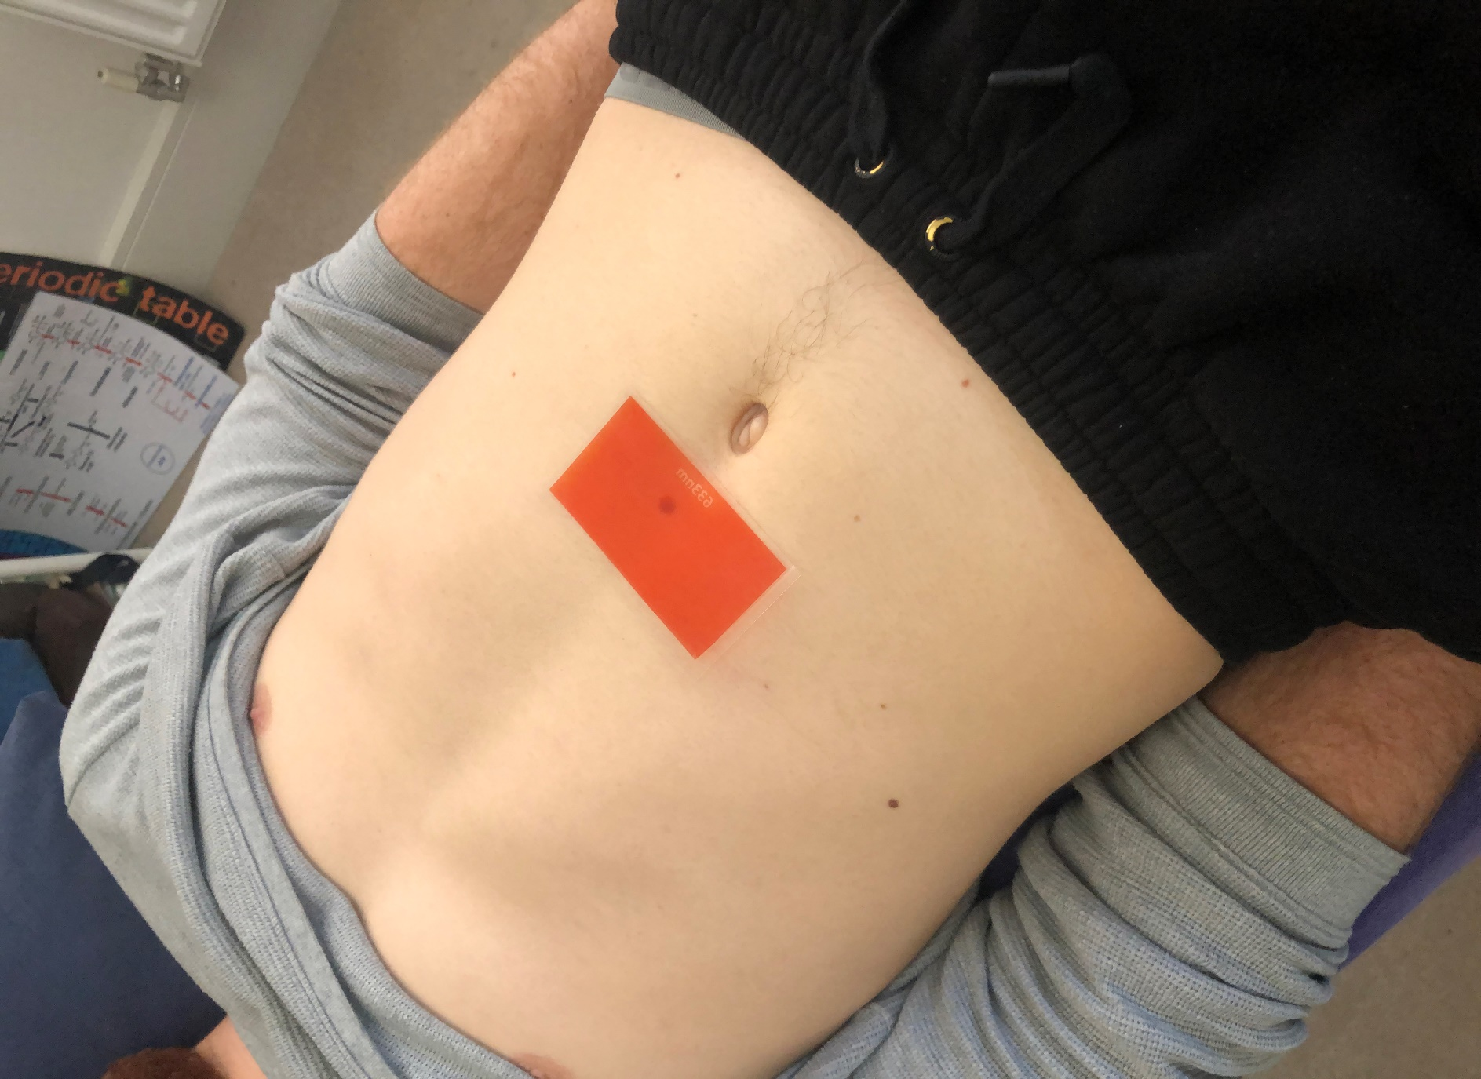
Covid-19 test. Strong muscle weakens to 633nm acetate.
You can do this directly with the patient or by surrogating using a hair sample.*
*See Optimising Your Immune System video Epigenetics website for how to do surrogate hair testing.

Slide 31
Thus if a patient weakens in the clear to this specific coloured acetate you could say that they might currently be carrying the virus even if they have no symptoms.
But of course never base a diagnosis on this finding alone.
You must follow government guidelines in such a case.
Common symptoms
Fever: 99%
Fatigue:70%
Dry cough: 59%
Loss of appetite: 40%
Body aches: 35%
Shortness of breath: 31%
Mucus or phlegm: 27%
Other symptoms
Sore throat
Headache
Chills, sometimes with shaking
Loss of smell or taste
Stuffy nose
Nausea or vomiting
Diarrheoa
Skin rash

Slide 32
My patient has had the virus but have they formed antibodies?

Slide 33
People who are not currently infectious do not weaken to the 633nm acetate.
However most people not having antibodies, do weaken when the acetate is challenged whilst therapy localising the current WON Mu time point.

Slide 34
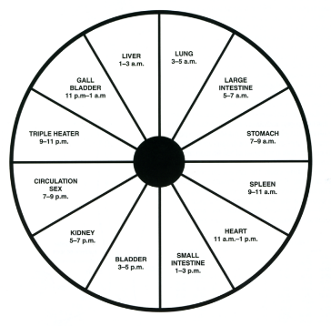
The WON Mu time point is the coupled meridian’s ALARM point to the NOW time.
NOW time WON time
Lung 4-6am LI
LI 6-8am Lung
St 8-10am Sp
Sp 10-12midday St
Ht 12-2pm SI
SI* 2-4pm Ht*
Bl 4-6pm Kid
Kid 6-8pm Bl
Cx 8-10pm TW
TW 10-12midnight Cx
GB 12-2am Liv
Liv 2-4am GB
BST Summer times

Slide 35
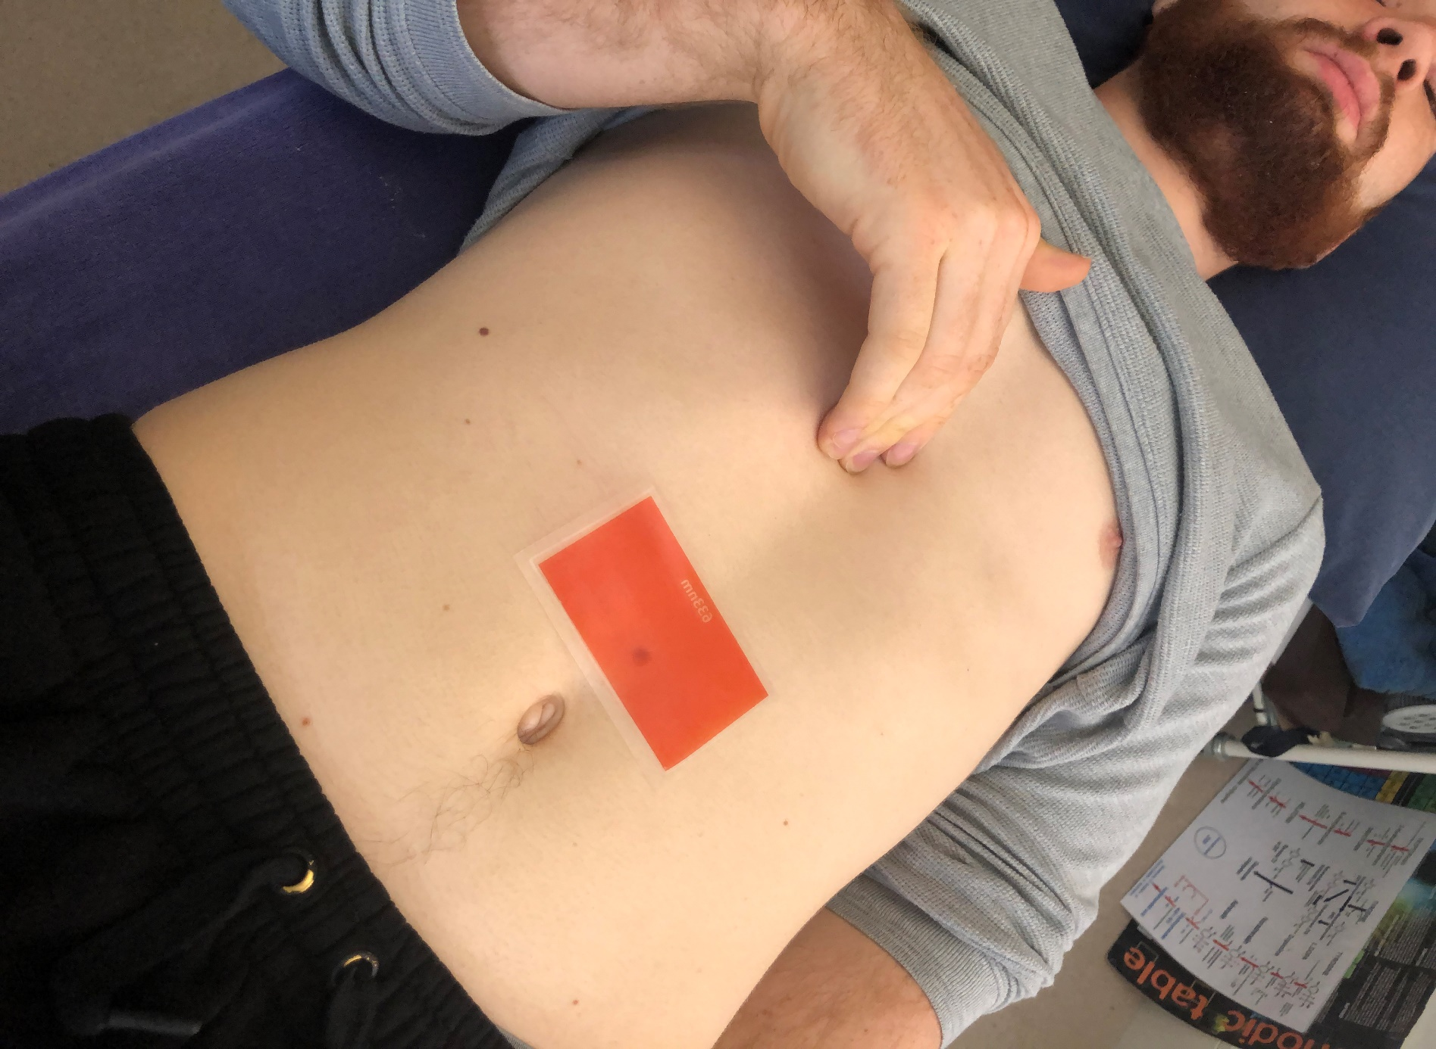
Heart Alarm point shown here is the WON time to the Small Intestine NOW time (2-4pm)

Slide 36
From this weakness you can now challenge against
IgM
IgG
Both found in Epigenetics Pain and Diagnostic test kit.

Slide 37
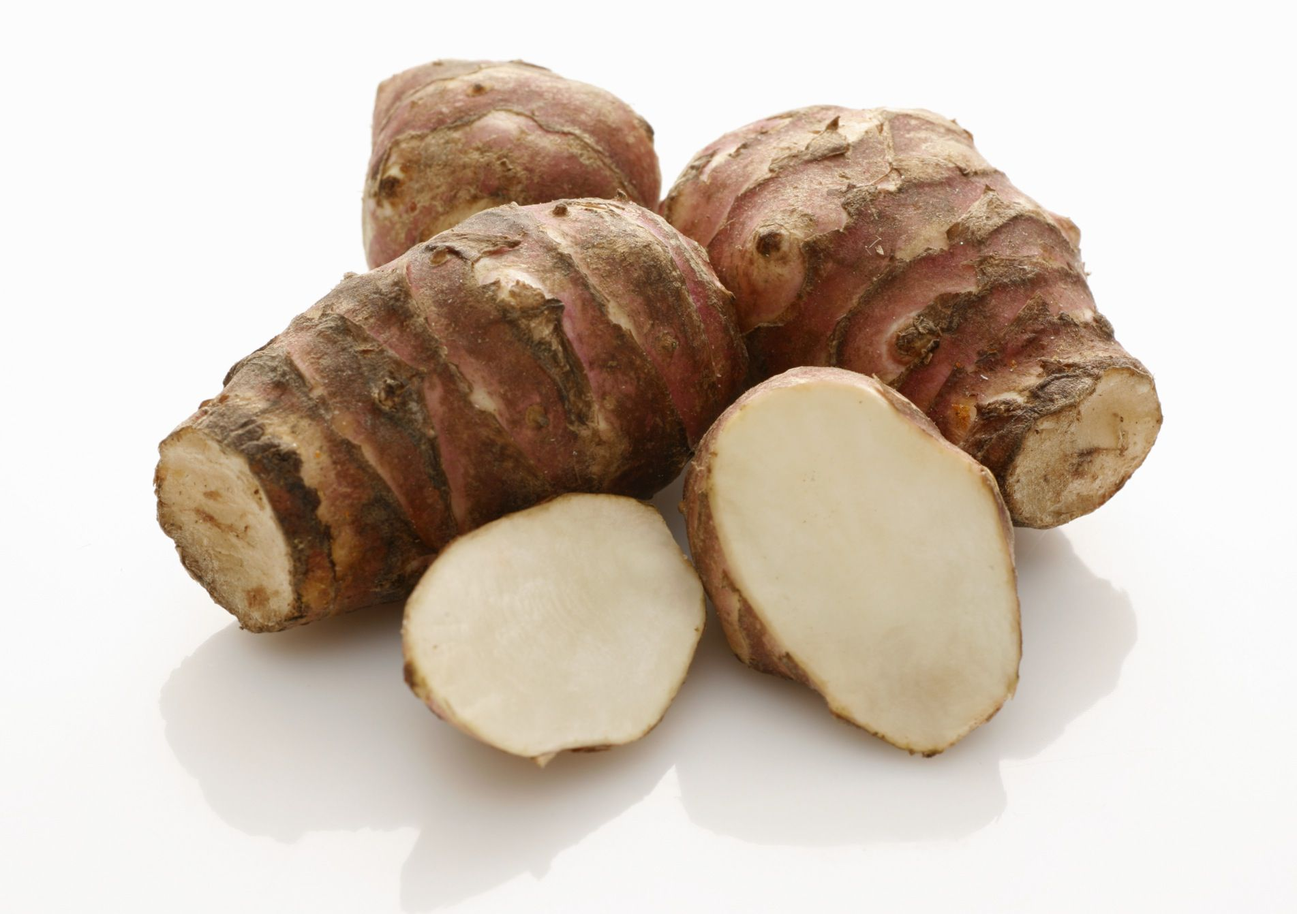
Role of Opsonins

Slide 38
An opsonin is any molecule that enhances phagocytosis by marking an antigen for an immune response or marking dead cells for recycling.*
All cell membranes have negative charges (Zeta potential) which makes it difficult for two cells to come close together.
*Barret, James (1980). Basic Immunology and its Medical Application (2 ed.). St.Louis: The C.V. Mosby Company. ISBN 978-0-8016-0495-9

Slide 39
When opsonins bind to their targets they boost the kinetics of phagocytosis by favouring interaction between the opsonin and cell surface receptors on immune cells.*
This overrides the negative charges from cell membranes.
* Roos, Anja; Xu, Wei; Castellano, Giuseppe; Nauta, Alma J.; Garred, Peter; Daha, Mohamed R.; van Kooten, Cees (2004-04-01). "Mini-review: A pivotal role for innate immunity in the clearance of apoptotic cells". European Journal of Immunology. 34 (4): 921–929.

Slide 40
Opsonin molecules include
1. Complement from the innate immune system.
2. Antibodies from the adaptive immune system.
3. Collectins, which are protein lectins that mediate attachment and binding
of bacteria, viruses, and fungi to their intended targets i.e. immune cells. *
* Roos, Anja; Xu, Wei; Castellano, Giuseppe; Nauta, Alma J.; Garred, Peter; Daha, Mohamed R.; van Kooten, Cees (2004-04-01). "Mini-review: A pivotal role for innate immunity in the clearance of apoptotic cells". European Journal of Immunology. 34 (4): 921–929.

Slide 41
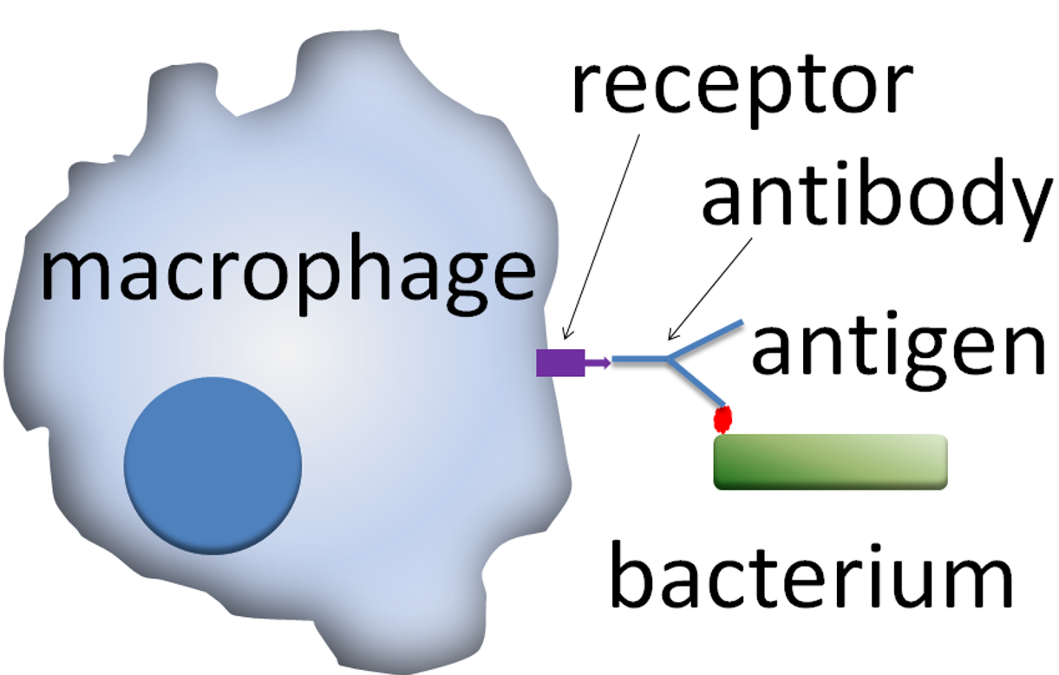
Action of opsonins: a phagocytic cell recognises the opsonin on the surface of an antigen.
opsonin
COVID-19
Graham Colm at English Wikipedia

Slide 42
Collectins form a family of collagenous Ca²⁺-dependent defence lectins. Their function is to bind to oligosaccharide structure or lipids that are on the surface of microorganisms.
Binding of collectins to microorganisms may trigger elimination of microorganisms by aggregation, complement activation, opsonization, activation of phagocytosis, or inhibition of microbial growth.

Slide 43
The Diagnostic Visible Wavelength (DVW) acetate of 633nm resonates with the saccharide Glucuronic acid.
633nm

Slide 44
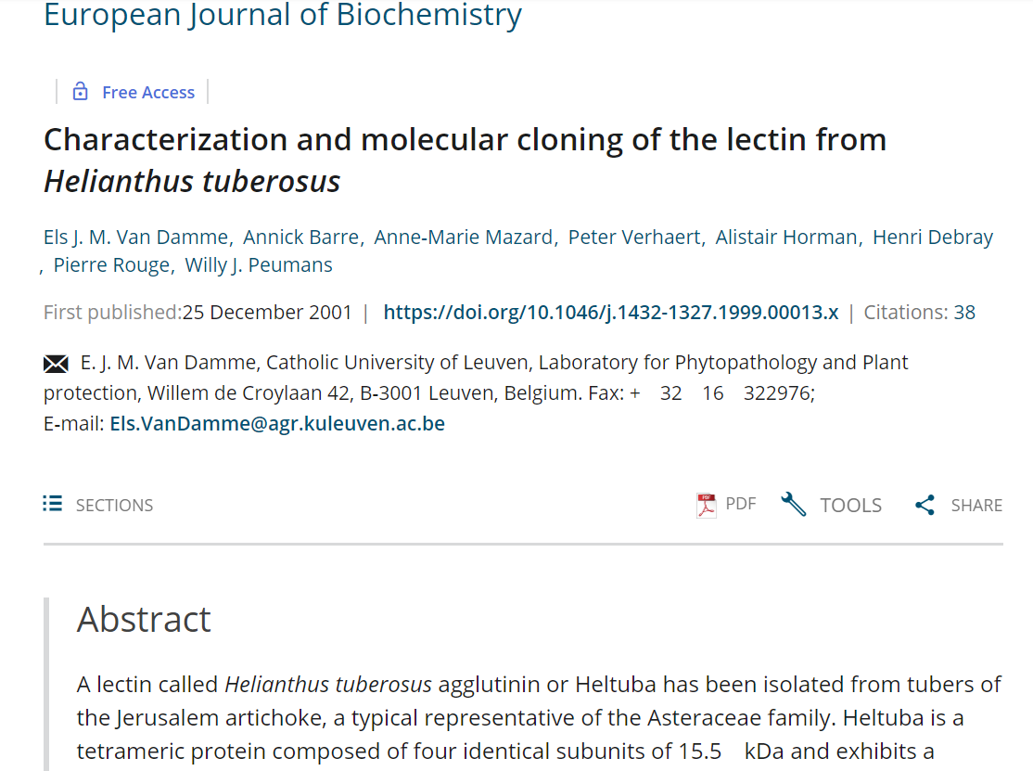
Glucuronic acid is rich in Jerusalem artichoke (Helianthus tuberosus) along with the oligosaccharide inulin and the Helianthus lectin.

Slide 45
Heltuba, a tuber lectin from the Jerusalem artichoke Helianthus tuberosus, belongs to the mannose-binding subgroup of the family of jacalin-related plant lectins.
Heltuba is highly specific for the disaccharides Mannose alpha 1-3Man or Mannose alpha 1-2Man, two carbohydrates that are particularly abundant in the glycoconjugates exposed on the surface of viruses, bacteria and fungi, and on the epithelial cells along the gastrointestinal tract.*
*Helianthus Tuberosus Lectin Reveals a Widespread Scaffold for Mannose-Binding Lectins
Y Bourne ¹, V Zamboni, A Barre, W J Peumans, E J Van Damme, P Rougé. 1999 Dec 15;7(12):1473-82. doi: 10.1016/s0969-2126(00)88338-0.

Slide 46
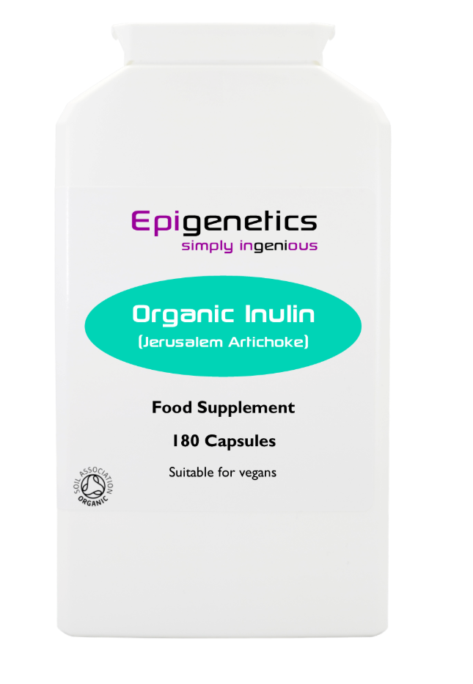
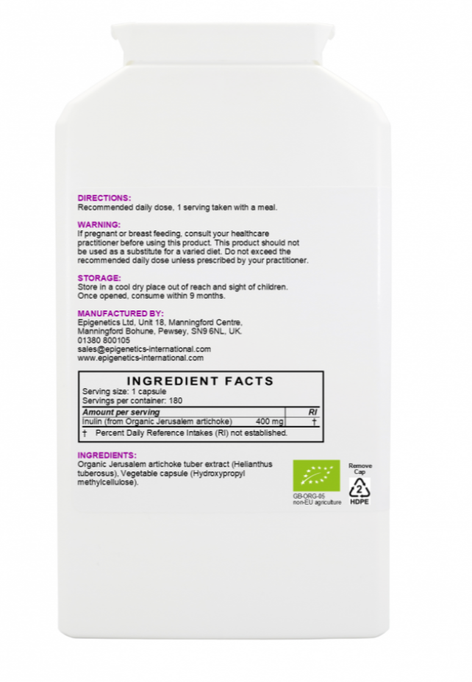
Organic Inulin (Jerusalem Artichoke) pack of 180 capsules
6-8 caps at breakfast
Rich in Glucuronic acid

Slide 47
Post Infection and Recuperation

Slide 48
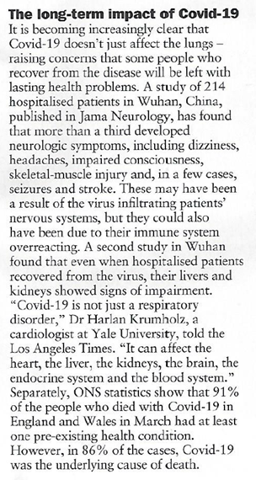
The Week 25th April 2020
Many people are left with post viral symptoms especially fatigue.
21ST May 2020

Slide 49
Most common post viral nutritional deficiencies are -
Zinc
Magnesium
CoQ10
DHA

Slide 50
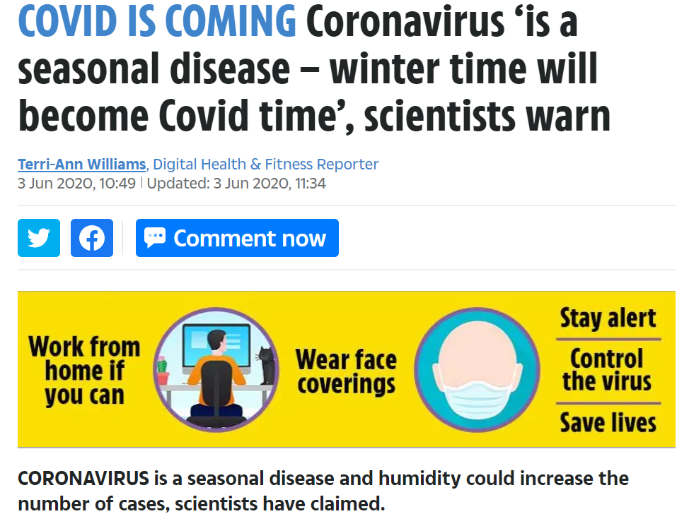
Experts had previously suggested a link between colder weather and the spread of the virus and highlighted that flu-like viruses often thrive in the winter months.
Professor Michale Ward from the University of Sydney said: "Covid-19 is likely to be a seasonal disease that recurs in periods of lower humidity.
"We need to be thinking if it's wintertime, it could be Covid-19 time.”

Slide 51
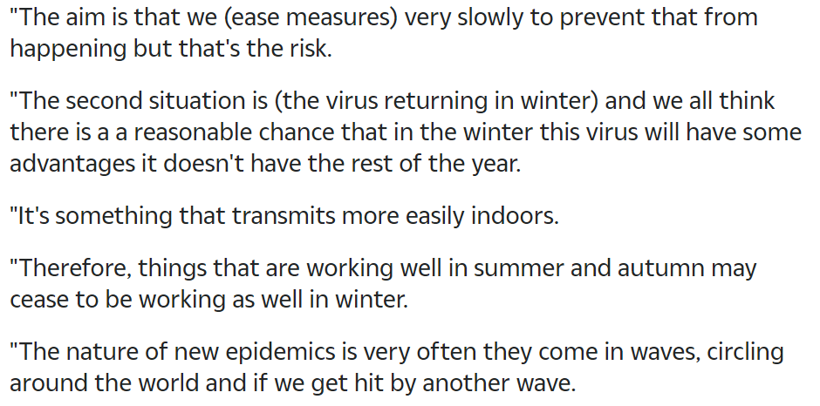
Dr Chris Whitty

Slide 52
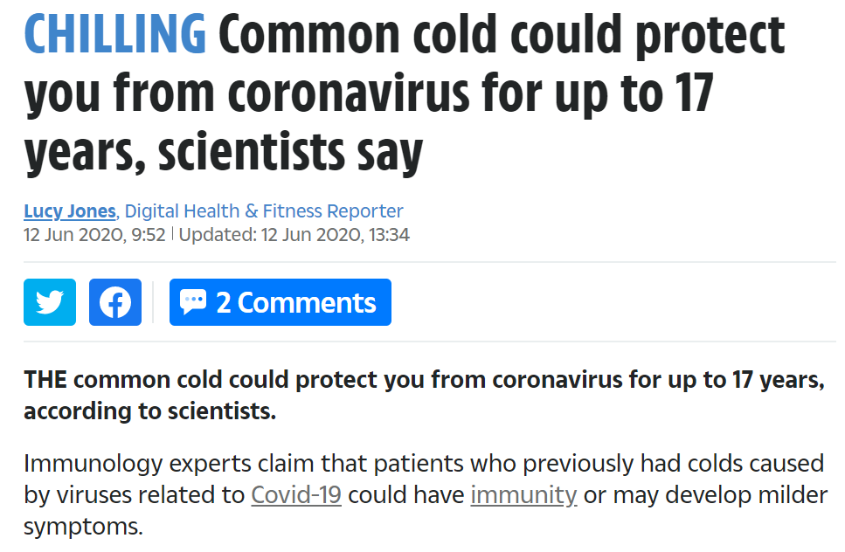
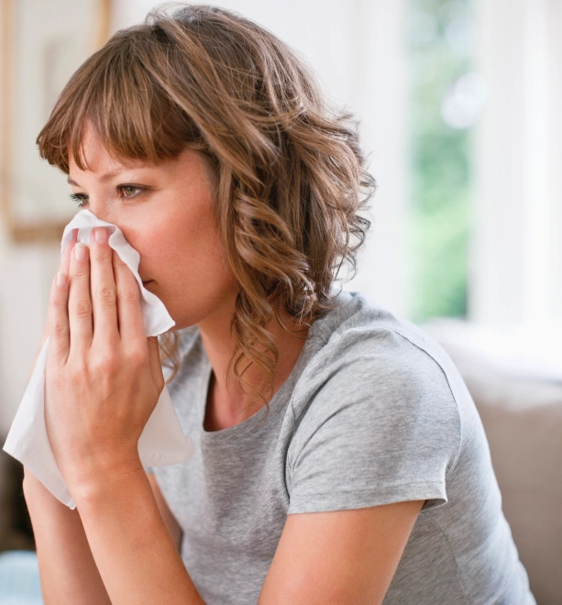
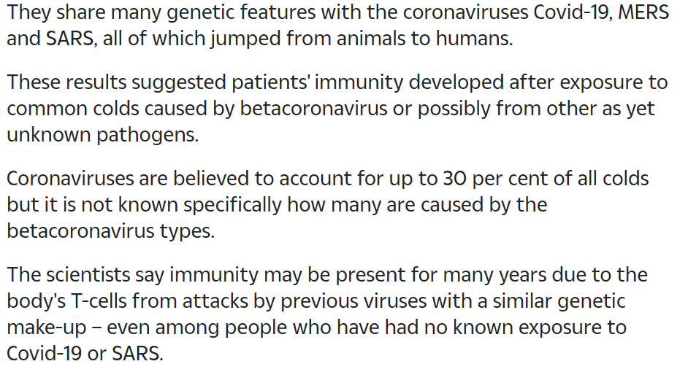

Slide 53
Post Infection and Recuperation
1. Must get people out into the sunshine to promote Vitamin D and exposed to broad spectrum health giving wavebands of light.
2. Use broad spectrum lighting inside homes.
3. Regular exercise.
4. Avoid high fat and sugar in the diet. (Changes gut microbiota.)
5. Avoid soy in all its forms.
6. Eat plenty of organic fruit and vegetables.
7. Eat organic whole grains.
8. Take 1-2 capsules of Zinc quercitin daily.
9. Take 1-2 multiple Vitamin / Mineral capsules daily.
10. Take a probiotic(s) with inulin.
11. DHA oil supplement daily.
12. Take 1gm Vitamin C capsule each day.
13. Co-enzyme Q10 minimum of 250gm daily

Slide 54
Suggested nutrients for practitioners to take to optimise their immune systems

Slide 55
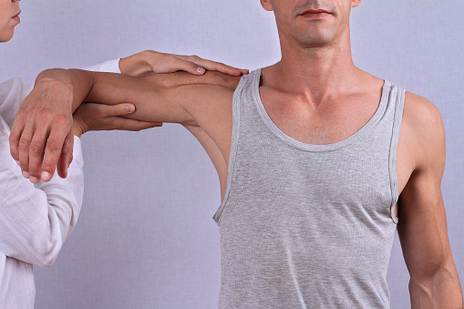
Suggested nutrients for practitioners to take to optimise their immune systems
Zinc quercitin 1x20mg cap
Vitamin C 1-2gm
Vitamin D3 essential after beginning of September 5000IU Liposomal D3
Inulin (for glucuronic acid)

Slide 56
A lot of parents are asking what can I give to our children when they go back to school in the autumn?
Back to School Nutrients for Children
Liquid Zinc 5 drops (=5mg)
Vitamin D3 Liposomal from September
Vitamin C as Sodium ascorbate for Children 200mg)
Inulin (prebiotic sweet tasting)
Children’s Multiple Vitamin / Mineral 1-2 capsules

Slide 57
Stay well and hope your clinic builds up rapidly to pre-lockdown levels very quickly.
We are hoping to re-start our seminar program in the autumn but in-between time there are plenty of free on-line seminars available on this site.

