Slide 1
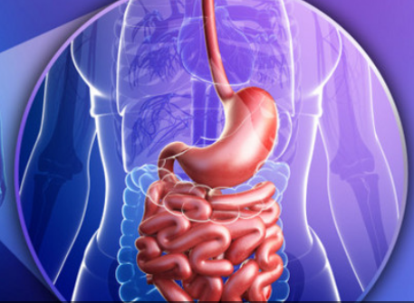
Epigenetics
and the Human Biome

Slide 2
Abdominal pains
On waking – Parasites
Immediately on eating – Allergy
Relieved by eating – Gastric ulcer
10-20 minutes after eating – Hypochlorhydria or low Pepsin
1-2 hours after eating – Pancreatic enzymes

Slide 3
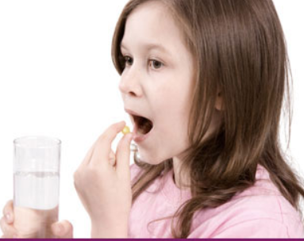
40% of children cannot swallow pills or capsules. Twice as many women have similar difficulties than men.

Slide 4
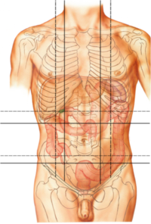
Epigastric
Right Hypochondrium
Left Hypochondrium
Right Lumbar
Left Lumbar
Right Inguinal
Left Inguinal
Umbilical
Hypogastric

Slide 5
Pyloric sphincter
Therapy Localisation points
Diaphragm
Sphincter of Oddi
Hepatic flexure
Splenic flexure
ICV
Duodenal – Jejunal junction
Therapy Localisation point with pressure for Probiotics. Root of Mesentery
Valve of Houston

Slide 6
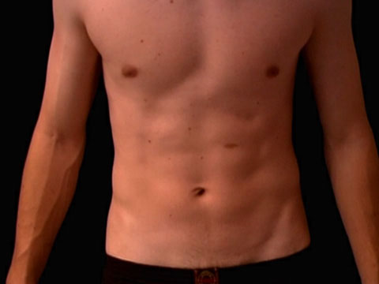
Therapy Localisation points for GUT problems
c
c
Hepatic flexure
Splenic flexure

Slide 7
Therapy Localisation point with pressure for Probiotics
Root of the Mesentery. Therapy Localisation point with pressure for Probiotics

Slide 8
Prana moves along channels called nadis and the points on these nadis are called marmas. So, nadis are the string, and marmas are the pearls of the necklace. A marma is a point of concentrated prana where anatomical structures (muscle, bone, tendon, vessels, ligament, and joints) are also present.

Slide 9
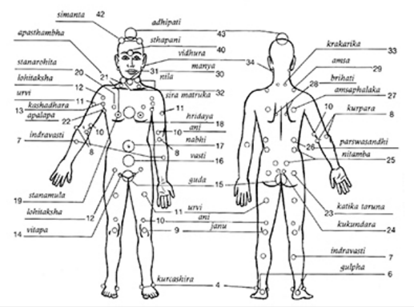

Slide 10
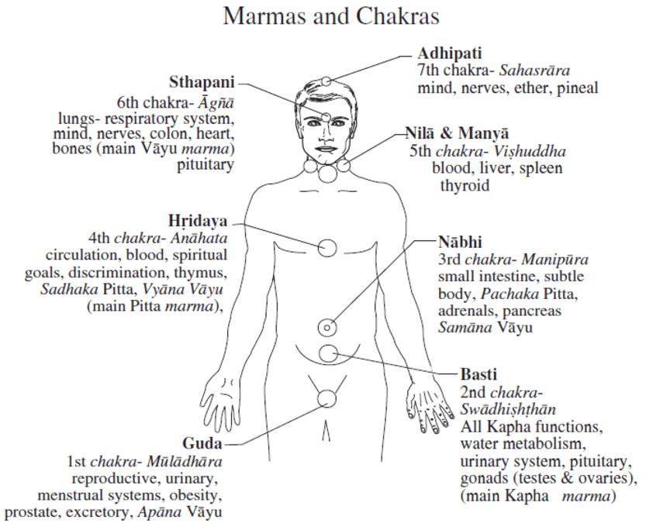

Slide 11
The Sanskrit word 'basti' (written as 'vasti' or 'wasti') is a general word that relates to anything pertaining to the lower abdomen, belly, pelvis and bladder. The practice of basti karma is a process of cleaning the lower abdomen, especially the colon.

Slide 12
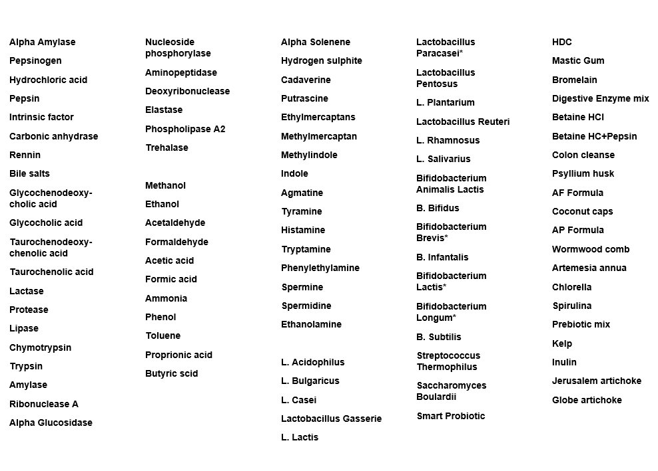
Epigenetics GUT Kit

Slide 13
Scale of Health
“If 100 is the very best you have ever been in your health, and health being all encompassing i.e. Emotional, Biochemical and Structural, right now your Scale of Health currently calibrates at …………”

Slide 14
2. Epigenetic Scale of Health
“If 100 is the very best your health could possibly be, and health being all encompassing i.e. Emotional, Biochemical and Structural, right now your Epigenetic Scale of Health currently calibrates at …………”

Slide 15
Scale of Vitality
“On a Scale of 1-100 your Vitality as defined as your capacity to generate energy, right now calibrates at ……..”

Slide 16
The Biome begins in the Mouth

Slide 17
Teeth
Cavities – Calcium fluoride
Wobbly teeth – Vitamin C, Manganese
Receding gums – Folates
Silica
Bleeding gums – Pyridoxal-5- phosphate, Bioflavonoids
(Rutin)

Slide 18
Plaque - Probiotics
Bad breath - Probiotics
Gingivitis - Vit C, Rutin, B Complex
Tartar - Magnesium, Oils
Mouth ulcers - P-5-P
Amalgam extraction -
Selenium, Chlorella, Spirulina

Slide 19
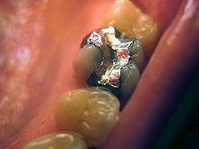
Dental amalgams are
Mercury 50%
Silver 22-32%
Tin -14%
Copper -8%
Zinc -2%
Indium – 4%
Palladium - 0.5%
The reason for lower mercury emission is that amalgam prepared with indium rapidly forms indium oxide and tin oxide films which reduce mercury release. Palladium reduces tarnish and corrosion.

Slide 20
Post amalgam extraction
Toxic metals – Black walnut Coriander herb Coriander spice
Lemon balm
α-Lipoic acid
Yarrow
N. Acetyl Cysteine Glutathione
Zinc, Silica, Sulphur

Slide 21
The Biome

Slide 22
Microbiome
The innumerable living organisms of the human GI tract play a direct and vital role in maintaining superior health and well-being: and may very well have an important impact on the life span of every individual

Slide 23
Microbiome
The human microbiome is the full complement of microbial species and their genes and genomes that inhabit the human body
In the healthy human body, microbial cells outnumber human cells 10 to 1
Present on almost all exposed surfaces of the body

Slide 24
Microbiome
The greatest diversity and density are found within the GI tract
The human microbiota contains greater than 100 times more genetic material than our own

Slide 25
Microbiome Disturbance
Microbiome disturbance is due to food we eat – food preservers and lack of fermented foods, emulsifiers in food
Antibiotics and over hygiene effects the biome, detergents
Chlorinated water
Environmental chemicals

Slide 26
Optimising the Microbiome – Gut Kit
Hydrochloric acid and pepsin
Pancreatic digestive enzymes
Bile salts
Fungus
Pathogenic bacteria
Amino acid derivatives
Prebiotics/Probiotics

Slide 27
Therapy Localisation points for GUT problems
c
c
Hepatic flexure
Splenic flexure

Slide 28
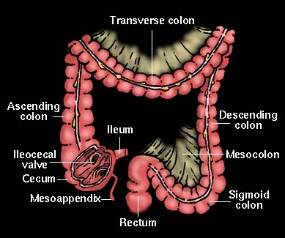

Slide 29
Stomach
Pepsinogen
Pepsin
Hydrochloric acid
Intrinsic Factor

Slide 30
Stomach
Test vials – HCl, pepsinogen, pepsin
HCl activates pepsinogen to generate pepsin
Pepsin degrades dietary proteins into their components, peptides and amino acids to be readily absorbed by intestinal lining

Slide 31
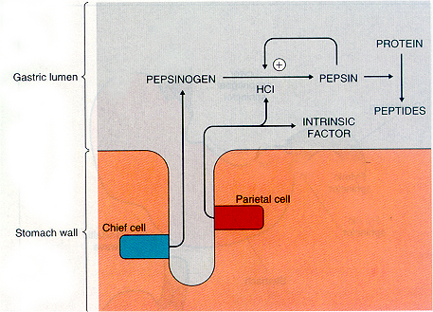

Slide 32
Stomach
HCl acidifies the stomach contents to pH 1
Destroys bacteria and parasites left in food

Slide 33
Gut kit biomarkers for the Stomach
From weakness:
Splenic/hepatic flexure
Biophoton acetates
Definitive meridian
Test Pepsinogen
Pepsin
HCl

Slide 34
Gut kit biomarkers for the Stomach
If strong to Pepsinogen
Test selenium, zinc
If strong to Pepsin & HCl
Betaine HCl and Pepsin
Zinc, P5P
If strong to HCl
Betaine HCl, P5P, Zinc

Slide 35
Pathogenic Bacteria
Inapproriate levels of pathogenic bacteria damage the microbiome
Test: E.Coli
Salmonella
Campylobacter
Helicobacter Pylori
Clostridum

Slide 36
Remedies for pathogenic bacteria
Zinc
Colloidal or Ionic Silver – gram +ve bacteria
Immune Why 600 – gram -ve
Goldenseal tincture

Slide 37

Treatment – The 4 R program
1. Remove- Pathogens
2. Replace – Digestive enzymes
3. Re inoculate- Probiotics
4. Repair- Glutamine, Folic, Zn, Vitamin A
Jeffrey Bland PhD

Slide 38
Gut Kit biomarkers for GB
From weakness test:
Bile Salts - composite
Glycocholic acid
Glycochenodeoxy-cholic acid
Taurochenolic acid
Taurochenodeoxy-cholic acid

Slide 39
Bile
During the digestion of fats the GB contracts and secretes bile into the duodenum via the common bile duct along with the pancreatic enzymes
Bile is crucial for breaking fats down into the essential fatty acids and absorption of fat soluble vits

Slide 40
Gall Bladder – Functions of Bile
When fat digestion is impaired, other foodstuffs are also poorly digested since the fat covers the food particles and prevents the enzymes from attacking them, leading to putrefaction and gas
NB. Supplements containing stearic acid or magnesium stearate

Slide 41
Key Nutrients for Bile synthesis
Taurine
Glycine
Vitamin C
Magnesium
Copper

Slide 42
Pancreatic and Small Intestine enzymes

Slide 43
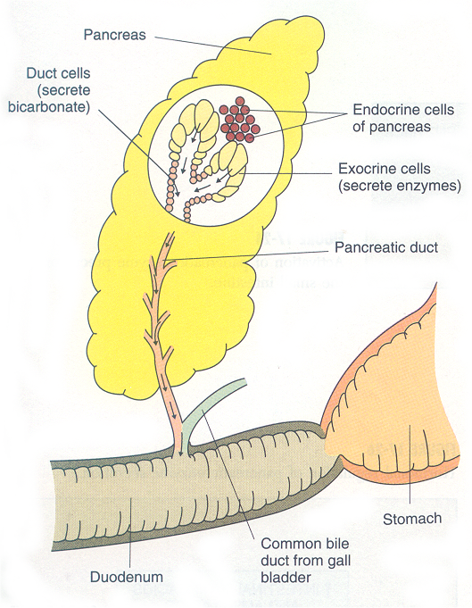

Slide 44
Pancreatic enzymes - main
Amylase hydrolyses starch and glycogen to maltose, oligosaccharides and glucose
Lipase hydrolyses triacylglycerols yielding fatty acids and glycerol
Protease attacks the peptide bonds of the basic amino acids

Slide 45
Pancreatic enzymes
From weakness test:
Amylase
Lipase
Protease
If strong:
individual enzymes: Amylase, Lipase, Protease
Probiotics

Slide 46
Zinc deficiency
Lipase deficiency
Undigested fatty acids in colon
Conversion of undigested fatty acids to odd numbered in colon by gram-ve bacteria

Slide 47
Undigested proteins may lead to parasitic infestation.
Undigested sugars may lead to fungal overgrowths.
Undigested fats may lead to essential fatty acid deficiencies.

Slide 48
Deficiency of the pancreatic enzymes leads to gas formation as a result of undigested and unabsorbed nutrients travelling to the colon where bacteria ferment these nutrients.
Most common gas is Methane, CO2, Hydrogen and Hydrogen sulphite.

Slide 49
Gut kit Biomarkers for dysfunction
Brewers yeast derivatives:
Ethanol
Acetaldehyde
Acetic acid
Pathogenic Fungii derivatives:
Methanol
Formaldehyde
Formic acid

Slide 50
Large Intestine biomarkers
Pain and Diagnostic Kit
Parasites Sporozoa Protozoa
Cestodes
Nematodes
Trematodes
Fungus

Slide 51
Large Intestine biomarkers
Gut Kit
Ammonia
  Phenol
  Toluene

Slide 52
Anti Fungal Remedies
if weak to FUNGUS or FUNGAL TOXIN:
Zinc Oregano
Sodium sulfate Probiotics
Coconut oil AF cream locally
Coriander/Ginger spice capsules
Pau d’arco Mannose

Slide 53
Anti Parasitic Remedies
Smart Iodides Garlic capsule
Artemisia Annua AP Formula
Cumin, Clove, Ginger, Turmeric cap
Black Walnut tincture & capsule
Wormwood & Wormwood comb.
Coriander spice (cestodes)
Cloves/nutmeg (nematodes)

Slide 54
Insoluble Fibre for the Large Intestine
Colon cleanse
Psyllium husk capsules
Kamut wheat
Sesame seeds
Flax seeds

Slide 55
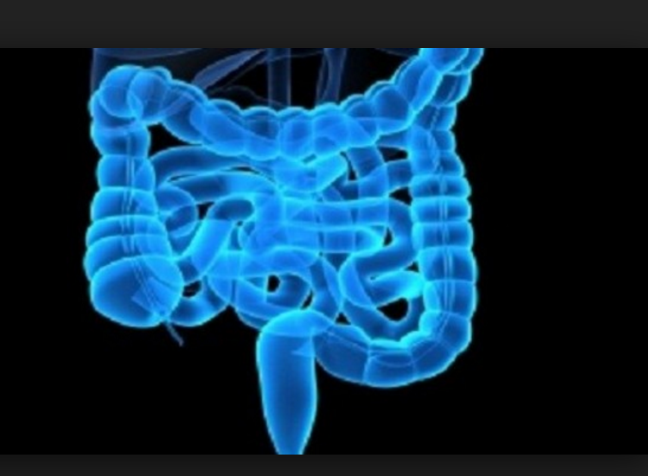
Prebiotics

Slide 56
Prebiotics
Substances that induce the growth of microorganisms that contribute to the wellbeing of their host
Most commonly in the GI tract where prebiotics can alter the composition of organisms in the gut microbiome

Slide 57
Prebiotics
Non digestible fibre compounds that pass undigested through the upper part of the GI tract
Stimulate the growth of advantageous bacteria in LI by acting as a substrate for them
First identified and named by Marcel Roberfroid in 1995

Slide 58
Prebiotics
Relate to the growth of bifidobacteria and lactobacilli as opposed to other groups of bacteria in the gut such as bacteriodes, clostridia, eubacteria, entrobacteria and enterococci
Can only enhance growth of bacteria that are already present

Slide 59
"A prebiotic is a selectively fermented ingredient that allows specific changes, both in the composition and/or activity in the gastrointestinal microflora that confers benefits upon host well-being and health.“

Slide 60
Prebiotics
Roberfroid in 2007 identified only two that fully met his definition: trans galactooligosaccharides and inulin
Also fit this definition – larch arabinogalactan, resistant starch, pectin, beta glucans, xylooligosaccharides (XOS)

Slide 61
Types of Prebiotics
Trans-galactooligosaccharides
Enzymatic conversion of lactose
Chain of galactose units
Commercially available and added to foods. Mostly in baby foods
Glycoside bonds resist intestinal digestion and reach end of intestine intact

Slide 62
Types of Prebiotics - Inulins
Group of naturally occurring polysaccharides produced by many types of plants
Industrially most often extracted from chicory
The inulins belong to a class of dietary fibres known as fructans

Slide 63
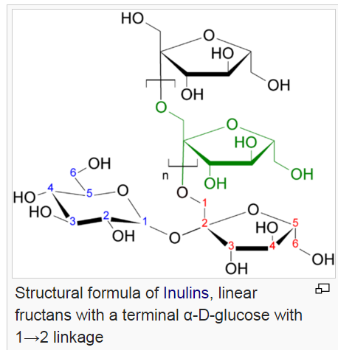

Slide 64
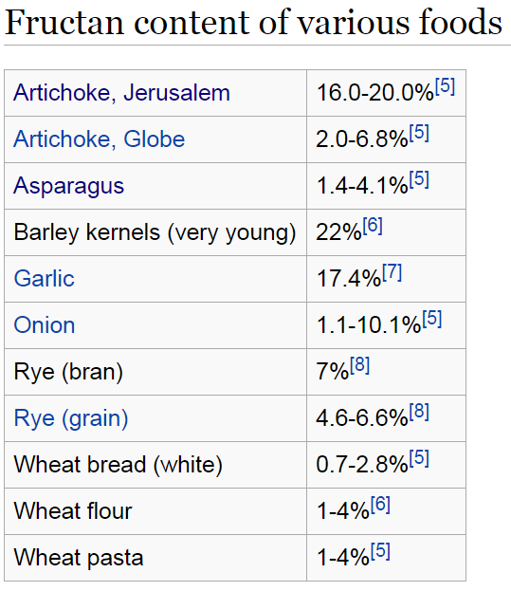

Slide 65
Inulin is used by some plants as a means of storing energy and is typically found in roots or rhizomes.
Most plants that synthesize and store inulin do not store other forms of carbohydrate such as starch.

Slide 66
Plants that contain high concentrations of inulin include:
Agave (Agave spp.)
Banana/Plantain (Musaceae)
Burdock (Arctium lappa)
Camas (Camassia spp.)
Chicory (Cichorium intybus)
Coneflower (Echinacea spp.)
Costus (Saussurea lappa)
Dandelion (Taraxacum officinale)
Elecampane (Inula helenium)
Garlic (Allium sativum)
Globe artichoke (Cynara scolymus)
Jerusalem artichoke (Helianthus tuberosus)
Jicama (Pachyrhizus erosus)
Leopard's-bane (Arnica montana)
Mugwort Root (Artemisia vulgaris
Onion (Allium cepa)
Sweet potato
Wild yam (Dioscorea spp.)
Yacón (Smallanthus sonchifolius spp.)

Slide 67
Types of Prebiotics
Arabinogalactin
Biopolymer consisting of arabinose and galactose monosaccharides
Found in nature as the major component of many gums – Arabic gum

Slide 68
Fructooligosaccharides (FOS)
Produced by degradation of inulin enzymatically or chemically to a mixture of oligosaccharides
General structure of Glu-Fru_{n} and Fru_{m} with n and m ranging from 1 to 7
This process also occurs to some extent in nature, and these oligosaccharides can be found in -

Slide 69
Jerusalem artichoke and chicory, bananas, onions, chicory root, garlic, asparagus and leeks. Some grains and cereals, such as wheat and barley, also contain FOS.
The Jerusalem artichoke has been found to have the highest concentration of FOS of cultured plants.

Slide 70
We can get Resistant Starch (RS) from food. The richest food sources are raw potatoes, green bananas, plantains, cooked-and-cooled potatoes, cooked-and-cooled-rice, parboiled rice, and cooked-and-cooled legumes.

Slide 71
There are 3 types of RS:
RS Type 1 – Starch bound by indigestible plant cell walls; found in beans, grains, and seeds.
RS Type 2 – Starch that is intrinsically indigestible in the raw state due to its high amylose content; found in potatoes, bananas, plantains, becoming accessible upon heating.

Slide 72
RS Type 3 – Retrograded starch; when some starches have been cooked, cooling them (fridge or freezer) changes the structure and makes it more resistant to digestion; found in cooked and cooled potatoes, grains, and beans.

Slide 73
Pectin
Heteropolysaccharide contained in primary cell walls of plants
Commercially extracted from citrus fruits as gelling agent
Natural part of human diet but does not contribute to nutrition
Average daily intake 5g

Slide 74
Pectin
In digestion pectin binds to cholesterol in GI tract and slows glucose absorption by trapping carbohydrates – soluble dietary fibre
In LI microorganisms degrade pectin and liberate short chain fatty acids – beneficial to health

Slide 75
Pectin
Large amounts of pectin in apples, pears, plums, gooseberries, oranges and citrus fruits
Small amounts in soft fruits – cherries, grapes, strawberries

Slide 76
Beta Glucans
Polysaccharides naturally occurring in cell walls of cereals, oat and barley
Cereal types used to lower cholesterol, modulate glucose and provide soluble fibre
Other sources – reishi & shitaki mushrooms - insoluble

Slide 77
Xylooligosaccharides
Polymer of the sugar xylose
XOS is the only nutraceutical that can be produced from logno cellulosic biomass
Production of XOS from agricultural residues offers great scope to the nutraceutical industry as it is cheap and readily available

Slide 78
Xylooligosaccharides
Used as an artificial sweetner due to its sweet taste
With increasing ban on use of antibiotics in livestock, XOS can be an alternative to guard GI tract in livestock from pathogenic microflora

Slide 79
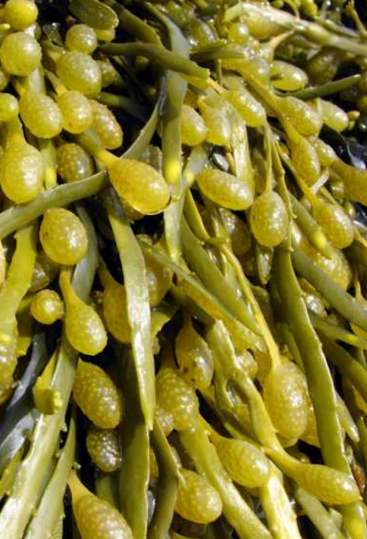
Researchers have also studied the effects of some fibres and other compounds in seaweeds on gut bacteria.

Slide 80
Alginates, fucoidans, laminarin and other polysaccharides (complex sugars) found in brown seaweeds like kelp, bladderwrack and rockweed, contain fibre that does not seem to be digested, but is fermented in the large intestine, becoming prebiotics that support the millions of bacteria that live in the gut.

Slide 81
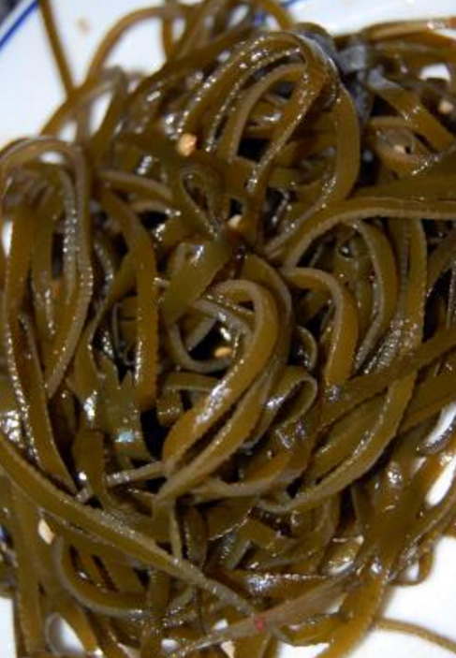
These seaweed fibres and sugars have also been shown to help with elimination and soothe the lining of the intestinal tract.

Slide 82
Short & Long Chain Prebiotics
Distinction between short, long chain and full spectrum prebiotics
Short chain eg oligofructose contain 2 to 8 links per saccharide molecule
Ferment more quickly in the ascending colon providing food for local bacteria

Slide 83
Short & Long Chain Prebiotics
Longer chain prebiotics, eg inulin, contain 9 to 64 links per saccharide molecule
Fermented more slowly and nourish the bacteria in descending colon

Slide 84
Short & Long Chain Prebiotics
Medium chain prebiotics – nourish the transverse colon
Full spectrum provide the full range of molecular links from 2 to 64 and nourish bacteria throughout the colon
Oligofructose-enriched Inulin (OEI)

Slide 85
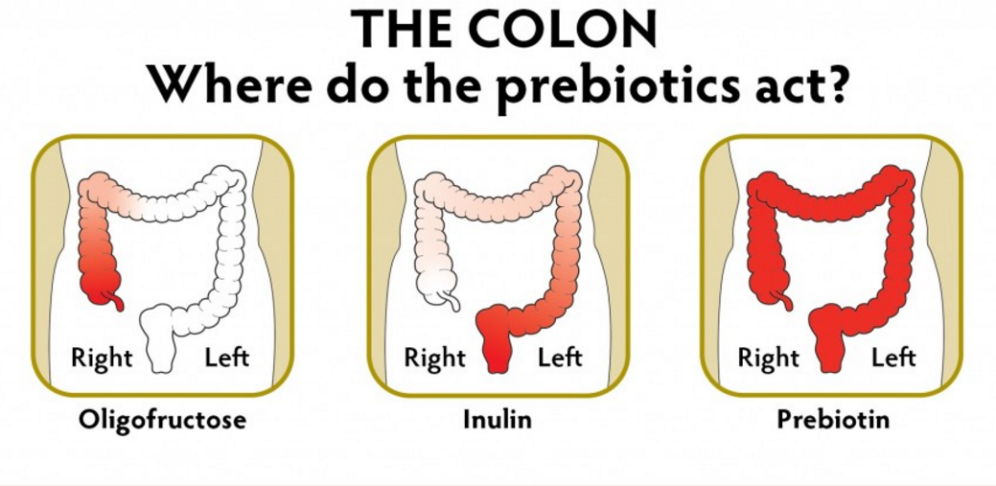
Oligofructose Inulin Prebiotic

Slide 86
Oligofructose Inulin Prebiotic
Jerusalem artichoke
Asparagus
and
Globe artichoke
Asparagus
Jerusalem artichoke
Globe artichoke

Slide 87
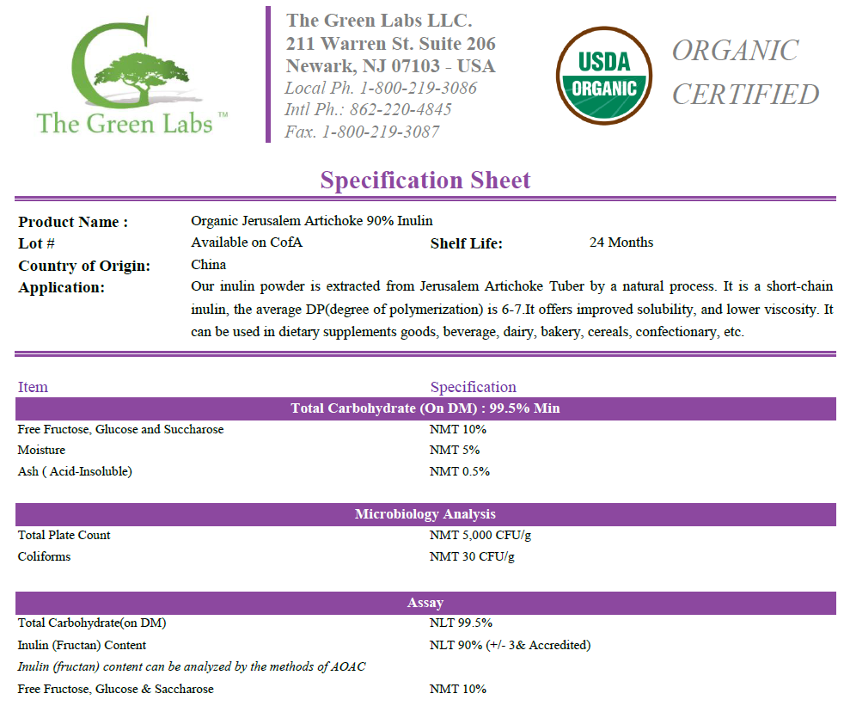

Slide 88
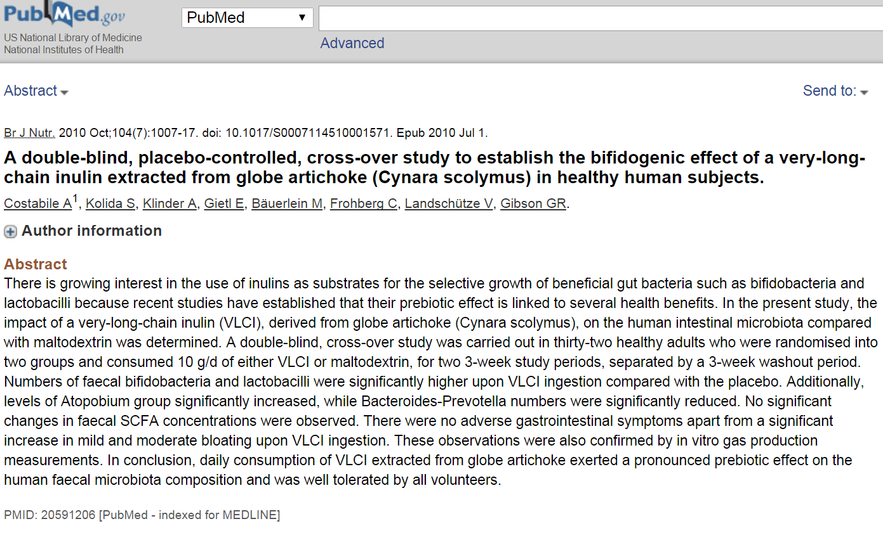

Slide 89
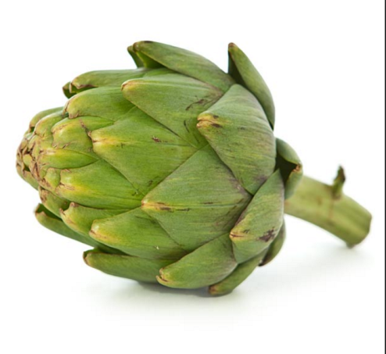
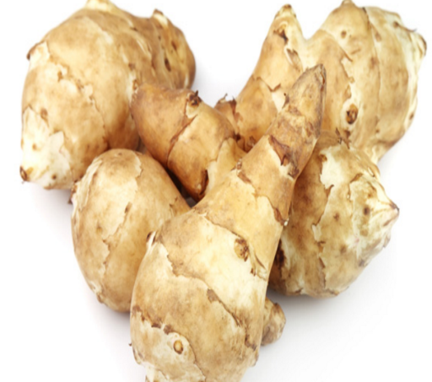
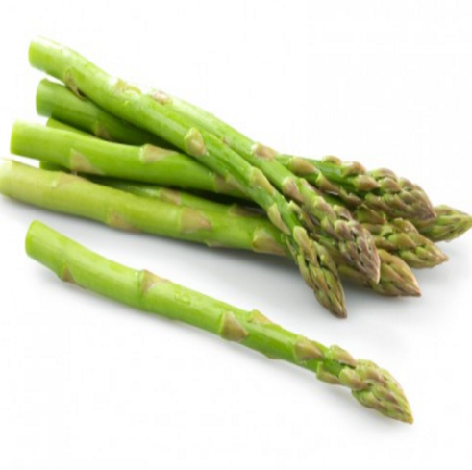
Prebiotic formula
All organic
Globe artichoke 3 parts
Jerusalem
artichoke 1 part
Asparagus 1 part

Slide 90
Prebiotics “Heads Up”
The addition of large amounts of prebotics to the diet may result in an increase in fermentation leading to increased gas production, bloating or bowel movements
Fermentation and SCFA production are reduced with low fibre diets

Slide 91
Prebiotics “Heads Up”
Until bacterial flora are gradually established to rehabilitate or restore intestinal bacteria, nutrient absorption can be temporarily impaired and colon transit time increased
Short term effect

Slide 92
Benefits of Prebiotics
Increase the number or activity of bifidobacteria and lactic acid bacteria
Improve digestion, especially mineral absorption (Ca, Mg) and strengthen the immune system
Product that stimulates bifidobacteria is a bifidogenic factor

Slide 93
Benefits of Prebiotics
Mineral absorption – improve calcium and magnesium uptake in SI
Potential anti-cancer properties
Lipid metabolism
Anti-inflammatory properties
Immune system responses

Slide 94
Benefits of Prebiotics
In mouth believed to be protective against dental caries
Attach to cellular binding sites for pathogenic bacteria
In LI prebiotic fermentation leads to increased production of bacterial cell mass with improved laxation

Slide 95
Benefits of Prebiotics
Mice and rats challenged with carcinogens and mutagens showed that prebiotics or mixed with probiotics can have strong anti-cancer effects
Minimise damage to DNA in colonic epithelial cells, reduce aberrant crypt foci on mucosal surface and prevent tumours

Slide 96
Benefits of Prebiotics
Research has shown that prebiotics have a potential effect on:
Bowel acidity
Reduction of colorectal cancer risk
Inflammatory bowel disease (Crohn’s or ulcerative colitis),
Hypertension
Defecation frequency

Slide 97
Benefits of Prebiotics
May be effective in decreasing the number of infectious episodes requiring antibiotics and the total number of infections in children aged 0-24 months
Beneficial through the production of SCFA via fermentation which nourish the gut and have beneficial effects on the body

Slide 98
Short Chain Fatty Acids (SCFA)
Physiological processes in the body that are affected by prebiotics result from their breakdown by colonic microorganisms and the consequent formation of short chain fatty acids (SCFA)

Slide 99
Short Chain Fatty Acids (SCFA)
Acetate C2, Proprionate C3 and Butyrate C4
Energy generation, colonic function, immune system reactivity, carcinogenesis, satiety, oxidative stress, barrier function, insulin sensitivity

Slide 100
Acetate C2
Forms Acetyl Co A – substrate to Krebs cycle. Provides energy for heart, kidney, muscle and brain
In colon induces thickening of the lining by stimulating crypt cells
Enhances ileal motility and increases colonic blood flow

Slide 101
Acetate C2
Immune system – decreases release of TNFa from neutrophils when stimulated by LPS
Inhibits NF Kappa B activity (NF Kappa b stimulates free radicals)
Reduces IL-6 release (pro-inflammatory cytokine)

Slide 102
Acetate C2
Carcinogenesis – increases antibody production and natural killer cell activity

Slide 103
Butyrate C4
Carcinogenesis
Induces apoptosis
Inhibits tumour cell progression
Reduces lymphocyte proliferation
Modulates genes associated with cellular differentiation
Protects against chromosome damage

Slide 104
Butyrate C4
Anti-inflammatory
Increased apoptosis of neutrophils
Oxidative stress by increasing mucosal glutathione and protects against H2O2 damage
Barrier function – upregulates mucin production and reduces

Slide 105
Butyrate C4
Reduces translocation of pathogens
Promotes Satiety – increases proglucagon which increases blood glucose, increases peptide YY which decreases appetite
Major energy source for the colonic epithelium, controls gut motility

Slide 106
Proprionic Acid C3 – An enigma!
Immune system activity
General anti inflammatory
Inhibits NF Kappa B
Inhibits TNF a production in neutrophils
Inhibits resisten – a pro inflammatory cytokine produced by adipose tissue

Slide 107
Proprionic Acid C3 – An enigma!
Carcinogenesis – induces Coli rectal cancer apoptosis
Stimulates cell differentiation
Increases satiety and reduces food intake, increase production of leptin
Aids in cholesterol metabolism

Slide 108
Proprionic Acid C3 – An enigma!
Dr David Perlmutter
Ratio – need more butyric & acetic and less proprionic
High levels indicate that gut is dominated by bad bacteria
Toxic for the brain
Increases gut permeability

Slide 109
Proprionic Acid C3 – An enigma!
Different types of bacteria produce different SCFA
Bad bacteria eg Clostridial species produce PPA in abundance
Without the right balance of gut microbes to keep barrier intact, PPA enters bloodstream and turns

Slide 110
Proprionic Acid C3 – An enigma!
On inflammation and activates the immune system
Affects cell to cell signalling
Leads to compromised mitochondrial function, alters the brains ability to use energy
Increases oxidative stress, harms proteins, cells, fats, DNA

Slide 111
Proprionic Acid C3 – An enigma!
Depletes the brain of molecules such as antioxidants, neurotransmitters and omega 3 fats
Body finds it difficult to burn odd chain fatty acids
Natural way to eliminate is Adenosylcobalamin

Slide 112
Test for Prebiotics
Test with the short chain fatty acids
Using the splenic or hepatic flexure to find the weakness
Check if Acetic acid and/or Butyric acid strengthen
If so test Smart Prebiotic

Slide 113
Test for Proprionic acid
In the clear test to see if proprionic acid weakens
If so test for Adenosylcobalamin, liquid or capsules

Slide 114
Test for Proprionic acid
B5
Magnesium
Biotin
Adenosylcobalamin
Proprionate
Proprionate CoA
D-Methyl malonyl CoA
Intermediates of the Krebs’ cycle
Adenosylcobalamin
(B12 coenzyme)
Succinyl CoA
L-Methyl malonyl CoA
Methylmalonic acid

Slide 115
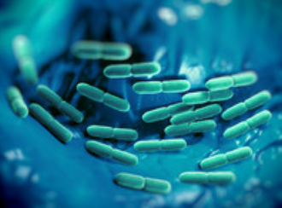
GUT Flora

Slide 116
Definition of Probiotics is:
“Live microoganisms that when administered in adequate amounts confer a health benefit on the host”
Source: FAO/WHO (2001)
The term Probiotics is derived from the Greek pro (for) and bios (life) meaning “for life”

Slide 117
The concept of probiotics evolved at the turn of the 20th century from a hypothesis fist proposed by Nobel Prize winning Russian scientist Eli Metchnikoff who suggested that the long, healthy live of Bulgarian peasants resulted from their consumption of fermented milk products.

Slide 118
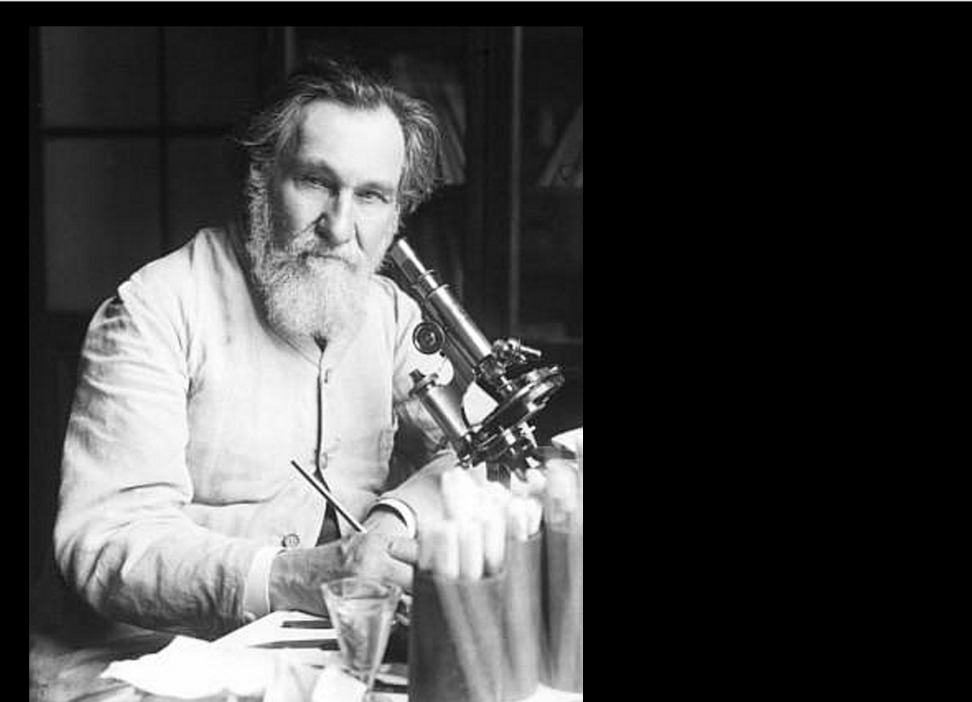
Élie Metchnikoff first suggested the possibility of colonizing the gut with beneficial flora in the early 20th century.

Slide 119
Metchnikoff, at that time a professor at the Pasteur Institute in Paris, proposed the hypothesis that the aging process results from the activity
of putrefactive (proteolytic) microbes producing toxic substances in the large bowel. Proteolytic bacteria such as clostridia, which are part of the normal gut flora, produce toxic substances including phenols, indols, and ammonia from the digestion of proteins. According to Metchnikoff, these compounds were responsible for what he called "intestinal autointoxication", which would cause the physical changes associated with old age.

Slide 120
Benefits include
Competition for binding sites to the intestinal wall
Competition for essential nutrients
Production of antimicrobial substances
Stimulation of mucin production
Stabilization of the intestinal barrier
Improvement of gut transit
Metabolism of nutrients to volatile fatty acids
Immune modulation
Source: CAST Issue Paper, Number 36, October 2007.

Slide 121
In detail
Aids Carbohydrate fermentation and absorption.
Production of short chain fatty acids.
Enhance the absorption and storage of lipids.
Synthesis of vitamins Biotin, Folic acid, Vitamin K2.
Absorption of ions including magnesium, calcium and iron.

Slide 122
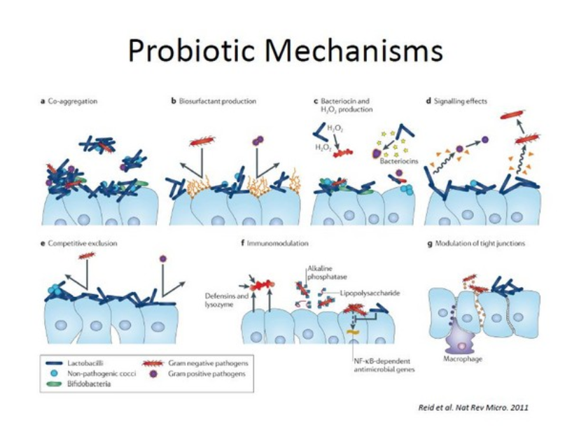

Slide 123
Increase the gut's absorption of water.
Reduce counts of damaging bacteria.
Increase growth of human gut cells.
Stimulate growth of indigenous bacteria.
Cause lymphoid tissue near the gut to grow.

Slide 124
Change the expression of cell surface proteins such as sodium/glucose transporters.
Prevent injury to the gut mucosa from occurring.
Suppression of pathogenic microbial growth.
Prevent allergies.
Prevent inflammatory bowel disease.

Slide 125
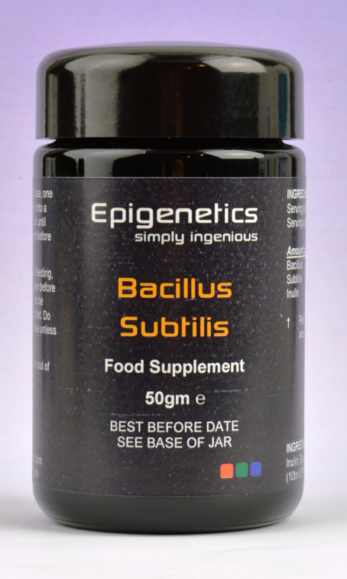
Maybe involve with weight loss / obesity.
Prevention of bowel cancer.

Slide 126
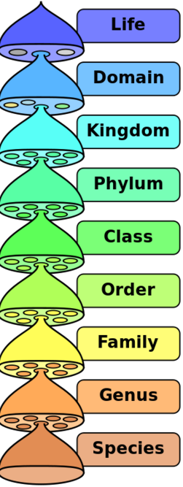
The hierarchy of biological classification's eight major taxonomic ranks. A kingdom contains one or more phyla.

Slide 127
Vast majority of microbial content of colon consists of Bacteria. They also make up to 60% of the dry mass of faeces. Somewhere between 300 and 1000 different species live in the gut, with most estimates at about 500. However, it is probable that 99% of the bacteria come from about 20-25 or less species.

Slide 128
Though people can survive without gut flora, the microorganisms perform a host of useful functions, such as fermenting unused energy substrates, training the immune system, preventing growth of harmful, pathogenic bacteria -

Slide 129
regulating the development of the gut, producing vitamins for the host, such
as Biotin and vitamin K2 and producing hormones to direct the host to store fats.
In return, these microorganisms procure within the host a protected, nutrient-rich environment in which they can thrive.

Slide 130
Over 99% of the bacteria in the gut are anaerobes, but in the cecum, aerobic bacteria reach high densities.
The compositions of microbiota rely on several factors like host diet, colonization history, and immune status. Some microbes are better suited to complement specific metabolic enzymes over others.

Slide 131
In 2009, scientists from INRA (French National Institute for Agricultural Research)
highlighted the existence of a small number of species (20-25) shared by all individuals constituting the human intestinal microbiota phylogenetic core.

Slide 132
Bacteria in the gut fulfill a host of useful functions for humans, including digestion of unutilized energy substrates, stimulating cell growth, repressing the growth of harmful microorganisms, training the immune system to respond only to pathogens, and defending against some diseases.

Slide 133
Beneficial flora increase the gut's absorption of water, reduce counts of damaging bacteria, increase growth of human gut cells, and stimulate growth of indigenous bacteria.

Slide 134
The four dominant phyla in the human gut are
Firmicutes (majority)
Bacteroidetes (30%)
Actinobacteria,
Proteobacteria
+ Fungi
+ Protozoa and Helminths
+ Archaea (which are involved in the removal of end products of bacterial fermentation such as hydrogen.)

Slide 135
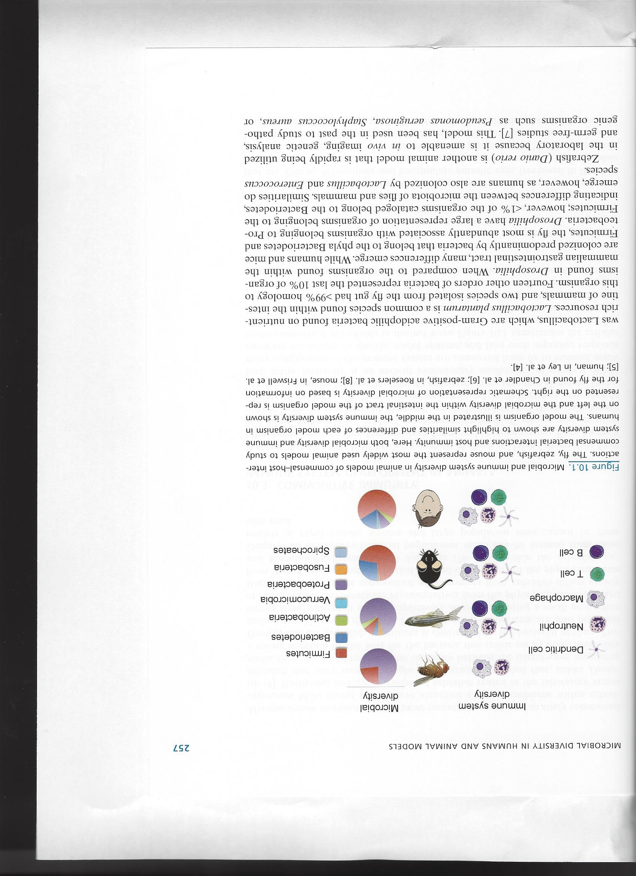

Slide 136
Bacteria are classified according to whether they function as
Aerobes (needing oxygen)
Anaerobes (not requiring oxygen)

Slide 137
This classification is further
subdivided by the type of cell
wall the bacteria contains.
Gram positive or
Gram negative

Slide 138
Gram positive cell walls contain 90% peptidoglycan composed of N. Acetyl Glucosamine and N. Acetyl Muraminic Acid.
They are stained blue-violet by a crystal violet stain.

Slide 139
Gram negative cell walls have two layers.
1. A thinner inner membrane which is composed of 20% peptidoglycan.
2. An outer lipopolysaccharide (LPS) membrane which contains toxic Lipid A which is responsible for their pathogenic effects.

Slide 140
1. Fermicutes G+
Bacteria
Firmicutes
Bacilli, Clostridia
e.g. Bacillales, Lactobacillale
e.g. B. Subtilis,
L. Acidophillus

Slide 141
The Firmicutes are a phylum of bacteria, most of which have Gram-positive cell wall structure. They make up the largest portion of the human gut microbiome.
The division Firmicutes as part of the gut flora has been shown to be involved in energy resorption and obesity.

Slide 142
Gut flora has been shown to differ between lean and obese humans. There is an indication that gut flora in obese and lean individuals can affect the metabolic potential. This apparent alteration of the metabolic potential is believed to confer a greater capacity to harvest energy contributing to obesity.

Slide 143
They are made up of
Bacilli such as
Bacillus e.g. B. Subtilis*
Listeria
Staphylococcus
Lactobacillales e.g. Lactobacillus*
Clostridia e.g. Clostridium
Heliobacterium

Slide 144
An enterotype is a classification of living organisms based on its bacteriological ecosystem in the human gut microbiome.
Gut microflora is mainly composed of three enterotypes:
Prevotella – with plant diet
Bacteroides- with protein / fat
Ruminococcus.

Slide 145
Research suggests that the relationship between gut flora and humans is not merely commensal (a non-harmful coexistence), but rather a mutualistic relationship.

Slide 146
2. Bacteroides G-
Bacteria
Bacteroidetes
Bacteroidetes
Bacteroidales
Bacteroidaceae
Bacteroides

Slide 147
Bacteroides is a genus of Gram-negative, obligate anaerobic bacteria making up a substantial portion of the mammalian gastrointestinal flora, where they play a fundamental role in processing of complex molecules to simpler ones in the host intestine.

Slide 148
They can use simple sugars when available; however, their main sources of energy in the gut are complex host-derived and plant glycans.

Slide 149
Studies indicate that long-term diet is strongly associated with the gut microbiome composition - those who eat plenty of protein and animal fats have predominantly Bacteroides bacteria, while for those who consume more carbohydrates the Prevotella species dominate.

Slide 150
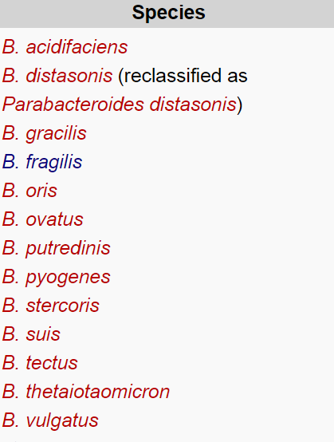
Bacteroides species may benefit their host by excluding potential pathogens from colonizing the gut. Some species (B. fragilis e.g.) are opportunistic human pathogens.

Slide 151
Prevotella G-
Bacteria
Bacteroidetes
Bacteroidetes
Bacteroidales
Prevotelaceae
Prevotella

Slide 152
Prevotella is a genus of
Gram-negative bacteria.
Bacteroides melaninogenicus has
been reclassified and split into Prevotella melaninogenica
and Prevotella intermedia.
Prevotella spp. are members of
the oral and vaginal flora, and are recovered from anaerobic
infections.

Slide 153
3. Actinobacteria G+
Bacteria
Actinobacteria
Actinobacteria
Bifidobacteriales
e.g. Bifidobacterium bifidus

Slide 154
4. Proteobacteria G-
Bacteria
Proteobacteria
Gammaproteobacteria
e.g.Escherichia, Salmonella

Slide 155
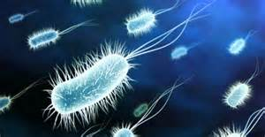
Probiotics

Slide 156
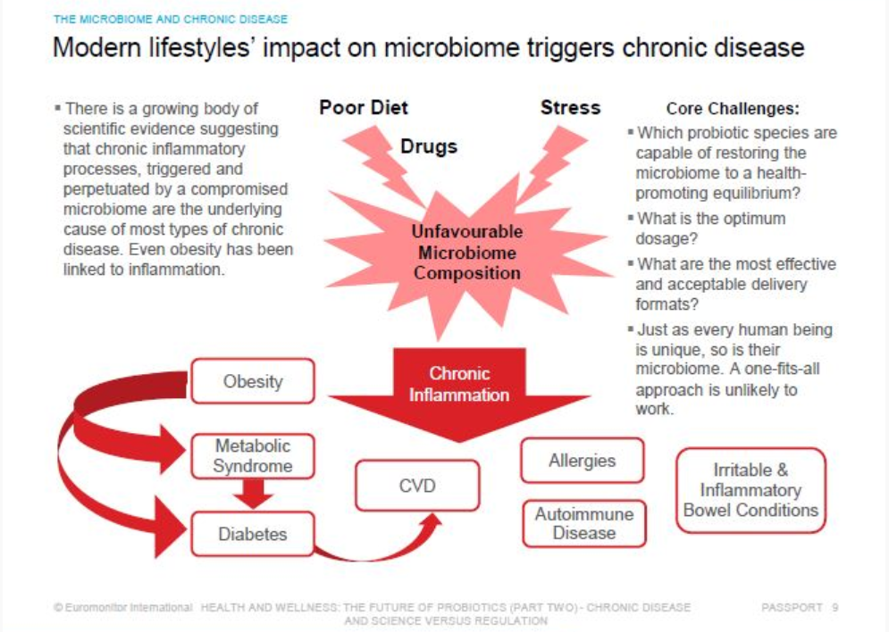

Slide 157
"Among the innumerable living inhabitants of the human gastro-intestinal tract, there are both resident microorganisms as well as transient or visiting microorganisms.
Both play a direct and vital role in maintaining superior health and well-being: and both may very well have an important impact on the life span of every individual".

Slide 158
Taking an antibiotic is not without risk. Killing pathogens in the colon can be a hazardous venture. Antibiotics that annihilate our colonic friendly bacteria can get us into big trouble fast.

Slide 159
Low levels of friendly bacteria will inhibit the conversion of lignans to enterodiol and enterolactone which has been shown to inhibit mammary carcinogenesis.

Slide 160
Improve the biome and increase resistance to neuro-degenerative diseases.
David Perlmutter, M.D

Slide 161
Microbiome disturbance is due to the food we eat.
Gut organisms contain 100x the genetic material in our bodies. It is a DNA store. It influences the brain.
Antibiotics and over hygiene effects the biome and increases the risk of Alzheimer’s.
David Perlmutter, M.D

Slide 162
People with the greatest diversity of the biome have the lowest incidence of Alzheimer’s.
Diversity increases gut integrity.
Gram negative bacteria (Clostridium – C.Difficile) increase Lipopolysaccharide (LPS) which creates inflammation and permeability especially in autism, Parkinson’s and Alzheimer’s.

Slide 163
Proprionic acid (C3) is a metabolic poison. It increases Omega 6 to Omega 3 ratios, alters neurotransmitters, influences glutamate influx into the mitochondria.

Slide 164
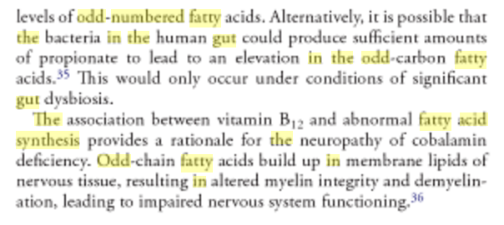
Textbook of Natural Medicine – Joseph Pizzorno

Slide 165
Zinc deficiency
Lipase deficiency
Undigested fatty acids in colon
Conversion of undigested fatty acids to odd numbered in colon by gram-ve bacteria

Slide 166
1. Lactobacillus Acidophilus*
2. Lactobacillus Brevis
3. Lactobacillus Buchneri
4. Lactobacillus Bulgaricus
5. Lactobacillus Casei*
6. Lactobacillus Crispatus
7. Lactobacillus Delbrueckii
(Bulgarigus)
8. Lactobacillus Fermentum
9. Lactobacillus Gasserie
10. Lactobacillus Helveticus
11. Lactococcus Lactis
12. Lactobacillus Paracasei*
13. Lactobacillus Pentosus*
14. Lactobacillus Plantarium*
15. Lactobacillus Reuteri
16. Lactobacillus Rhamnosus*
17. Lactobacillus Salivarius*
18. Streptococcus Thermophilus*
19. Enterococcus Feacium
20. Bifidobacterium Adolescentis
21. Bifidobacterium Animalis Lactis
22. Bifidobacterium Bifidum*
23. Bifidobacterium Brevis
24. Bifidobacterium Catenulatum
25. Bifidobacterium Infantis*
26. Bifidobacterium Lactis
27. Bifidobacterium Longum*
28. Bacillus Subtilis*
29. B. Coagulans (Sporogenes)
30. Saccharomyces Boulardii
Bacillus clausii
Bacillus indicus
Bacillus licheniformis
*SMART 12 which with added Vitamin C repair and regenerate the GUT

Slide 167
1. Lactobacillus Acidophilus*
2. Lactobacillus Brevis
3. Lactobacillus Bulgaricus
4. Lactobacillus Casei*
5. Lactobacillus Gasserie
6. Lactococcus Lactis
7. Lactobacillus Paracasei*
8. Lactobacillus Pentosus*
9. Lactobacillus Plantarium*
10. Lactobacillus Reuteri
11. Lactobacillus Rhamnosus*
12. Lactobacillus Salivarius*
13. Streptococcus Thermophilus*
Epigenetics
Probiotic Products
14. Bifidobacterium Animalis Lactis
15. Bifidobacterium Bifidum*
16. Bifidobacterium Brevis
17. Bifidobacterium Infantis*
18. Bifidobacterium Lactis
19. Bifidobacterium Longum*
20. Bacillus Subtilis*
21. Saccharomyces Boulardii

Slide 168
SUPER 12 which with added Vitamin C Repair and Regenerate the GUT
1. Lactobacillus Acidophilus*
2. Lactobacillus Casei*
3. Lactobacillus Paracasei*
4. Lactobacillus Pentosus*
5. Lactobacillus Plantarium*
6. Lactobacillus Rhamnosus*
7. Lactobacillus Salivarius*
8. Streptococcus Thermophilus*
9. Bifidobacterium Bifidum*
10. Bifidobacterium Infantis*
11. Bifidobacterium Longum*
12. Bacillus Subtilis*

Slide 169
1. Lactobacillus Acidophilus
Balances good and bad bacteria
Curbs growth of Candida Albicans
Produces amylase
Produces lactase to digest milk
Produces Vitamin K1 for blood coagulation

Slide 170
Lactobacillus Acidophilus
In Small Intestine it produces beneficial substances against pathogenic microbes – acidolphilin, acidolin, bacteriocin, lactocidin
Helps maintain cholesterol levels

Slide 171
2. Lactobacillus brevis
It can be found in many different environments: fermented foods such as sauerkraut and pickles.
Ingestion has been shown to improve human immune function.
Found in human intestines, vagina and faeces.

Slide 172
3. Lactobacillus Buchneri
Produces lactic acid and acetic acid during fermentation.
It is used as a bacterial inoculant to improve the aerobic stability of silage. These bacteria are inoculated and used for preventing heating and spoilage after exposure to air.

Slide 173
4. Lactobacillus Bulgaricus
Improves a leaky gut
Helps with diarrhea and nausea
Improves dairy digestion
Fights dyspepsia
Lowers triglycerides, LDL levels, total cholesterol

Slide 174
Lactobacillus Bulgaricus
Improves immunity and fights viruses
Helps manage HIV symptoms
Decreases tooth decay

Slide 175
5. Lactobacillus Casei
Digestive System
Helps intestinal permeability
Inhibits growth H. Pylori
Helps fight C.difficile
Helps with diarrhea caused by antibiotics

Slide 176
Lactobacillus Casei
Complements growth of L. Acidophilus
Wide coverage against pathogenic organisms that translocate from GI tract. Notably helps against pancreatic necrosis
Produces lactic acid which lowers the pH in digestive system and

Slide 177
Lactobacillus Casei
Impedes growth of harmful bacteria
Reduces lactose intolerance
Anti-inflammatory for the gut
Helps with digestion and absorption of food and nutrients

Slide 178
Lactobacillus Casei
Immune System
Modulates the immune system
Protects against microorganisms
Counteracts the pro-inflammatory effects of E. Coli

Slide 179
6. Lactobacillus crispatus
Is a hydrogen peroxide producing species located in both the vagina, through vaginal discharge, and the gastrointestinal tract.
Can be used by premenopausal and post-menopausal women with recurrent urinary tract infections.

Slide 180
7. Lactobacillus Delbrueckii is part of the microbiota of the lower reproductive tract of women.

Slide 181
8. Lactobacillus fermentum
Is associated with active dental caries lesions.
It is also commonly found in fermenting animal and plant material.
It has been found in sourdough.

Slide 182
At least one strain has been applied to treat urogenital infections in women.
Some strains of Lactobacilli Fermentum have since been reclassified as Lactobacillus reuteri.

Slide 183
9. Lactobacillus gasseri
Is part of the vaginal flora. Its genome has been sequenced.
L. gasseri produces gassericin A, a bacteriocin.

Slide 184
10. Lactobacillus Helveticus
Is most commonly used in the production of American Swiss cheese and Emmental cheese, but is also sometimes used in making other styles of cheese, such as Cheddar, Parmesan, Romano,Provolone, and Mozzarella.

Slide 185
Ingestion of powdered milk fermented with L. helveticus was shown to decrease blood pressure due to the presence of manufactured tripeptides that have ACE inhibitor activity.

Slide 186
11. Lactococcus lactis
Used extensively in the production of buttermilk and cheese, but has also become famous as the first genetically modified organism to be used alive for the treatment of human disease.

Slide 187
11. Lactococcus lactis
L. lactis is used in the early stages for the production of many cheeses, including Brie, Camembert, Cheddar, Colby, Gruyère, Parmesan, and Roquefort.
Makes Vitamin B12 in ruminants.

Slide 188
12. Lactobacillus paracasei
Used in dairy product fermentation and probiotic.
It is commonly found in many human habitats such as intestinal tracts and mouths as well as sewages, silages, and dairy products.

Slide 189
It was found to exhibit strong opposition against Salmonella enterica and Heliobacter pylori.
It was also found to break down oligofructose and inulin, while also growing rapidly on both and producing lactic acid as the end product.

Slide 190
14. Lactobacillus Plantarum
Controls inflammation in the gut
Fights pathogenic microbes
Fortifies the gut lining so helps reduce gut permeability
Quickly digests proteins so prevents food allergies

Slide 191
Lactobacillus Plantarum
Absorbs and maintains levels of important nutrients – omega 3 fatty acids, vitamins and anti-oxidants
In terms of immune system, it fights infection, controls inflammation and controls pathogens
In mice reduce symptoms of M.S

Slide 192
15. Lactobacillus reuteri
Naturally inhabits the gut of mammals and birds. First described in the early 1980s, some strains of L. reuteri are used as probiotics.
Known to produce reuterin, reutericin 6, and reutericyclin.

Slide 193
Reuterin was found to inhibit the growth of some harmful Gram-negative and Gram-positive bacteria, along with yeasts, fungi, and protozoa.
Greatly mitigates the symptoms of methotrexate-induced enterocolitis in rats, one of which is bacterial translocation.

Slide 194
16. Lactobacillus Rhamnosus
Fortifies intestinal wall since it has good intestinal wall adhesion
Role in diabetes management by increasing glucose control
Stimulates the immune system – fights bacterial infection in general
Ear infections, respiratory infections, vaginosis, colds & flu

Slide 195
Lactobacillus Rhamnosus
Inhibits ulcer causing H. Pylori
Enhances immunity in HIV and decreases HIV symptoms
Reduces allergies and inflammation
Helps with eczema symptoms and prevents atopic eczema

Slide 196
Lactobacillus Rhamnosus
Cancer fighting and preventing by stimulating tumour killing activity and decreasing the risk of colon cancer
Reduces LDL cholesterol
For infants, fights diarrhea from rotavirus, stimulates growth and reduces colic

Slide 197
17. Lactobacillus salivarius
Suppression of pathogenic bacteria. Has been found to have a wide spectrum of coverage against pathogenic organisms that translocate from the gastrointestinal tract thereby demonstrating therapeutic benefit in the management of pancreatic necrosis.

Slide 198
Research has shown that the addition of this species along with other probiotic species suppressed pro-inflammatory cytokines and further suppressed bacterial overgrowth in the small intestine leading to a reduction in bacterial translocation.

Slide 199
18. Streptococcus Thermophilus
Digestive System
Reduces symptoms of antibiotic induced diarrhea and ulcerative colitis
Improves a leaky gut
Improves lactase digestion

Slide 200
Streptococcus Thermophilus
Immunity
Prevents and fights upper respiratory tract infections
Prevents ulcers from H.Pylori
Fights C. difficile
Decreases AIDS symptoms
Increases anti-tumour activity

Slide 201
Streptococcus Thermophilus
Reduces symptoms of atopic dermatitis
Decreases chance of kidney stones
Increases HDL
Lowers baby colic
Induces a stable growth rate in children

Slide 202
21. Bifidobacterium Animalis Lactis
Found in the large intestines of humans.
B. Animalis and B. Lactis were previously described as two distinct species. Presently, both are considered B. animalis with the subspecies B. animalis subsp animalis and B. animalis subsp lactis.

Slide 203
22. Bifidobacterium Bifidum
Aids Digestive System
Eliminates bad bacteria
Inhibits the binding of E.Coli to intestinal cells
Helps diarrhea and IBS
Fights yeast infections
Produces lactic & acetic acid

Slide 204
Bifidobacterium Bifidum
Helps the body to better absorb calcium
Builds Immune System
Helps responses to inflammation
Decreases allergies
Helps immune cells to mature

Slide 205
Bifidobacterium Bifidum
Anti-inflammatory properties – protects cells lining mucous membranes from toxins
Helps with inflammatory diseases associated with over reaction of immune system – autoimmune diseases, asthma, allergy

Slide 206
Bifidobacterium Bifidum
Remedy for vaginitis
Helps to lower cholesterol

Slide 207
23. Bifidobacterium breve. Is unique in its ability to compete with other bacteria, due to the large variety of molecules it can digest.
Ailments such as antibiotic-associated diarrhea, allergies, gas, and irritable bowel syndrome have been linked to a shortage of the B breve bacteria.

Slide 208
The presence of B breve appears to inhibit E coli. B breve is also present in the vagina, where it helps to inhibit overproduction of candida albicans,
In young babies who are breast-fed, B breve has been found to make up a majority of the colon's bacteria.

Slide 209
24. Bifidobacterium Catenulatum
Are ubiquitous inhabitants of the gastrointestinal tract, vagina and mouth of mammals, including humans.

Slide 210
25. Bifidobacterium infantis
May help reduce the symptoms of irritable bowel syndrome in women (IBS). Bifidobacterium infantis is a probiotic bacterium that inhabits the intestines of both infants and adults. This type of bacteria is considered beneficial because of the acids it produces.

Slide 211
The acids produced by Bifidobacterium infantis may help impede the growth or colonization of harmful bacteria within the colon. Bifidobacterium infantis works within the digestive system to restore intestinal balance and maintain normal digestive health.

Slide 212
26. Bifidobacterium lactis
is one of the most versatile and hardest working for the human body. Similarly to other strains, this lactic acid bacteria can help fight lactose intolerance and boost the immune system.

Slide 213
In addition to these benefits, B. lactis may also support healthy cholesterol levels, ease ulcerative colitis, and even combat the effects of celiac disease.

Slide 214
It’s an integral aspect of supporting overall digestion of all sugars, fibres, and macronutrients.
It may also help reduce the occurrence of antibiotic-associated diarrhea.
Maybe beneficial against respiratory ailments and infections.

Slide 215
27. Bifidobacterium longum
Considered to be one of the earliest colonizers of the gastrointestinal tract of infants.

Slide 216
While B. longum is significantly present in the adult it is considered part of the gut flora and its production of lactic acid is believed to prevent growth of pathogenic organisms. B. longum is non-pathogenic and is often added to food products for its beneficial probiotic health effects.

Slide 217
28. Bacillus subtilis
Found in soil and the gastrointestinal tract of ruminants and humans. A member of the genus Bacillus, B. subtilis is rod-shaped, and can form a tough, protective endospore, allowing it to tolerate extreme environmental conditions.

Slide 218
Cultures of B. subtilis were popular worldwide before the introduction of antibiotics as an immunostimulatory agent to aid treatmentof gastrointestinal and urinary tract diseases. Digestion has been found to significantly stimulate broad-spectrum immune activity including activation of secretion of IgM, IgG and IgA.

Slide 219
It is used to produce various enzymes, such as amylase and proteases and
Natto from soy beans.
The fermented beans are recognized for their contribution to a healthy gut flora and vitamin K₂ intake.

Slide 220
Bacillus Subtilis
Production of Vitamin K2 in the gut
Allows the body to make Vitamin K2 by bacterial fermentation elongating Vitamin K1 in leafy green vegetables to Vitamin K2
Vitamin K2 is crucial for building bones and removing calcium from the arteries

Slide 221
Gamma - carboxylation
Ca++
COO+
COO¯
COO¯
Glutamate
γ-Carboxy-Glutamate
CO2
Vit K2 dependent protein (osteocalcin or MPG)
Vit K2 dependent carboxylase
Glutamate side chain on a Vit K2 dependent protein (osteocalcin or MPG)
Carboxylated protein now ready to bind calcium

Slide 222
Bacillus Subtilis
Digestive System
Suppresses the growth of harmful pathogens
Strengthens the mucosal biofilm
Enhances the growth of other good probiotic strains
Produces various enzymes such as amylase and proteases

Slide 223
Immune System
Helps with GI and urinary tract disease
Activates the secretion of antibodies – IgM, IgG, IgA
Activates leukocytes and cytokines for the development of cytotoxicity towards tumour cells
Used to produce hyaluronic acid for joints and skin

Slide 224
29. Bacillus
Coagulans (previously called L. Sporogenes) is a Gram-positive rod (0.9 by 3.0 to 5.0 μm in size), catalase positive, spore-forming, motile, and a facultative anaerobe.
Not a normal inhabitant of the human GUT.

Slide 225
30. Saccharomyces Boulardii
Tropical strain of yeast (not baking yeast which is Saccharomyces cerevisiae)
In digestive system helps with diarrhea, gastric ulcer, gastroenteritis, heartburn, inflammation of the mucosa
Protects against pathogens, Helicobacter, C. difficile

Slide 226
Saccharomyces Boulardii
E.coli and Salmonella adhere to mannose on the surface of S.B. via lectin receptors. When bound to S.B, these pathogens are prevented from attaching to brush border and are eliminated during bowel movements.

Slide 227
Saccharomyces Boulardii
Anti-inflammatory effects:
Works to combat LPS (lipopolysaccharide)
Decreases pro-inflammatory cytokines eg. TNF-a, IL-6
Increases anti-inflammatory IL-10

Slide 228
Saccharomyces Boulardii
Helps with the digestion & absorption of Carbohydrates
Breaks down dissacharides into monosaccharides that can be absorbed into the bloodstream via enterocytes
Increases immune response by the secretion of Immunoglobulin A

Slide 229

Childhood microbiome shows distinct and functional differences to the adult GUT

Slide 230
Predominant probiotics in infancy
Lactobacillus brevis
Bifidobacterium brevis
Bifidobacterium infantis
Bifidobacterium longus

Slide 231


Predominant probiotics in the vagina
L. Acidophillus
L. Brevis
L. Crispatus
L. Delbrueckii
L. Fermentum
L. Gasseri
L. Paracasei
L. Rhamnosus
B. Bifidus
Women misinformed about discharge may douche to clean the vagina, but this upsets he bacteria and fungi balance and can lead to thrush or bacterial vaginosis.

Slide 232
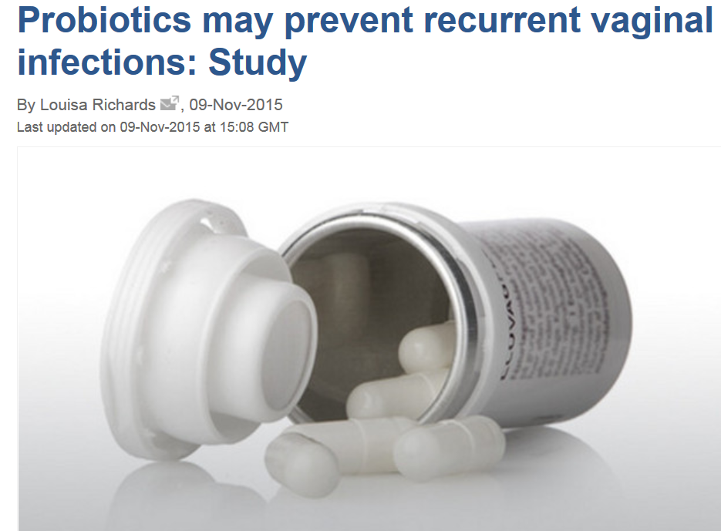

Slide 233
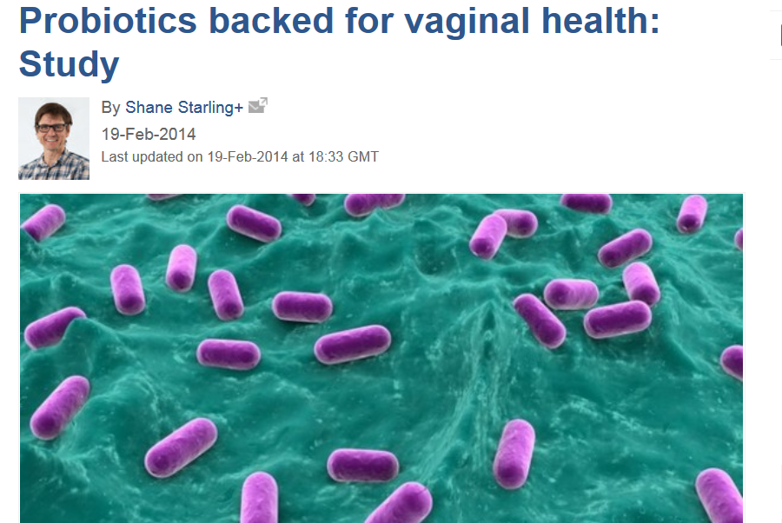
L. Rhamnosus, L. Paracasei 502, L. Paracasei 303, L. Plantarium. L. Fermentum

Slide 234
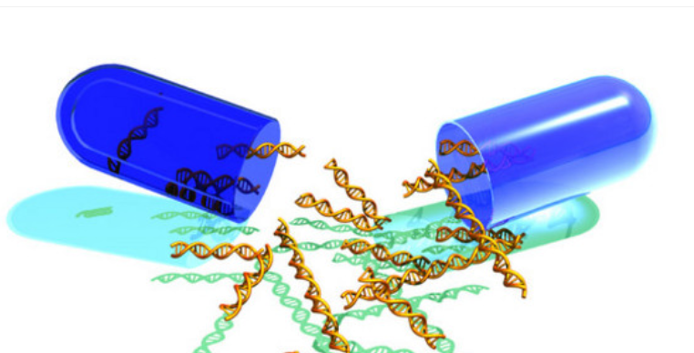
Nutrigenomics
The Probiotic Approach
The human microbiota contains greater than 100 times more genetic material than our own.

Slide 235
Therapy Localisation point with pressure for Probiotics
Therapy Localisation point with pressure for Probiotics

Slide 236
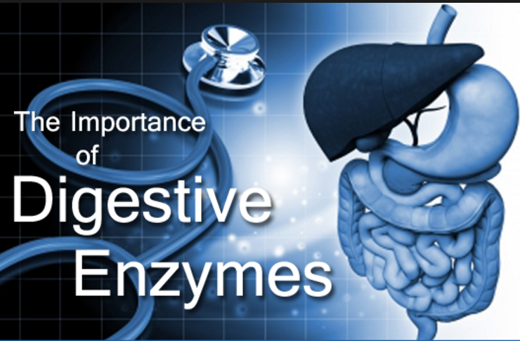

Slide 237
“You are not what you eat but what you absorb”.
You can eat the best of foods and take the best well balanced supplements but if you do not digest and absorb these substances you will suffer from malnutrition and enjoy less optimal health.

Slide 238
The function of the GUT is to breakdown big molecules in the diet to smaller absorbable components – amino acids, saccharides and free fatty acids. These can then be taken into the blood across the intestinal barrier where thay promote nutrition of the whole body.

Slide 239
The GUT is not a major avenue for eliminating waste from the body – only small amounts of excretory products are normally eliminated in the feces which should be made up of ¼ water, ¼ mucus, ¼ insoluble fibre and ¼ bacteria and no undigested food. The major route of elimination is through the urine, skin and lungs.

Slide 240
The digestive action is controlled by the secretion of enzymes which participate in the breaking down of food materials The Gut is home for billions of bacteria – commensurates, transients and parasites – all in balance.

Slide 241
Absorption depends upon the integrity of the GUT mucous membranes of the small intestine. The lining is deeply folded and covered with millions of tiny villi projections where absorption takes place. Different regions absorb specific nutrients so that loss of integrity in one area may cause malabsorption of only one nutrient.

Slide 242
Some people may experience selective malabsorption and show a specific nutrient deficiency rather than generalised malabsorption.
The colon contains symbiotic bacteria that produce certain Vitamin B’s and short chain fatty acids used as fuel and regeneration of the colon cells.

Slide 243
There are 10x more bacteria living in the GUT than there are human cells. When these bacteria are living in symbiosis (they contribute to us and we provide an environment for them) we have a healthy GUT, effective elimination of waste materials and good nutrient absorption.

Slide 244
Toxic colon disorders are associated with higher levels of various anaerobic bacteria such as C. Difficile and parasites that are know to produce various by products from undigested food (such as decarboxylated amino acids like tyramine) which maybe absorbed and lead to toxic like reactions.

Slide 245
The integrity of the colon bacteria is controlled by the acidity of the mucous as well as by fibre. Bacterial action is important in the maintenance of bowel regularity, for de-watering of the stools and for bile salt reabsorption.

Slide 246
Undigested food in the stools leads to rapid bacterial multiplication and the production of toxic metabolites some of which maybe carcinogenic.

Slide 247
Undigested proteins may lead to parasitic infestation.
Undigested sugars may lead to fungal overgrowths.
Undigested fats may lead to essential fatty acid deficiencies.

Slide 248
Leaky GUT Syndrome
Post Prandial Toxicity
Metabolic Endotoxicity

Slide 249
Digestive enzymes themselves are proteins – proteases, amylases and lipases.
Secretion begins in the mind. Vagus nerve. Good thoughts lead to optimal enzyme secretion. Anxious stressed thoughts lead to low enzyme secretion and thus malabsorption which is why some people lose weight when stressed.

Slide 250
Digestive begins in the mouth with the secretion of alpha amylase to help start the digestion of starches.
Then gastic digestion with the secretion of gastin – a hormone in the stomach – initiated by protein intake.
Gastrin stimulates the parietal cells to secrete HCl.

Slide 252
HCl makes the ingested food acidic, sterilises the stomach, aids mineral absorption and stimulates the conversion of pepsinogen to pepsin for the initial digest of proteins to polypeptides. Conversion of pro-enzymes to their active forms require co-factors such as zinc, selenium and manganese.

Slide 253
Pepsin is a digestive protease a member of the aspartate protease family.
Pepsin is one of three principal protein-degrading, or proteolytic, enzymes in the digestive system, the other two being chymotrypsin and trypsin.

Slide 254
The partially digested food after a period of stomach time pumps into the small intestine and is acidic in order to promote small intestinal enzyme secretion i.e.
Proteases – Chymotrypsin and Trypsin
Amylases and Saccharidases
Lipase
They are secreted by the pancreas.

Slide 255
They are released into the duodenum. It is stimulated by
Secretin and Cholecystokinin – two small intestinal hormones which are stimulated by the acidity.
The pancreatic enzymes are secreted in a sodium bicarbonate matrix.

Slide 256
Both the production of HCL and NaHCO3 require the enzyme carbonic anhydrase – a zinc dependant enzyme. Insufficient carbonic anhydrase leads to an under acid stomach (hypochlorhydria) leading to an over-acid small intestine which renders the enzymes less able to make the nutrients absorbable.

Slide 257
Deficiency of the the pancreatic enzymes leads to gas formation as a result of undigested and unabsorbed nutrients travelling to the colon where bacteria ferment these nutrients.
Most common gas is Methane, CO2, Hydrogen and Hydrogen sulphite.

Slide 258
The pancreatic secretions adapt to the diet. Thus high protein diets induce protease enzymes. High starch diets induce high amylase enzymes. This is why a person who changes his diet may experience digestive symptoms. Thus best to change a diet slowly especially if involves more fibre intake.

Slide 259
There are some natural enzyme inhibitors.
Soybeans inhibit proteases and must thus be well cooked.
Beans and peas inhibit amylases.

Slide 260
Pancreatic enzyme secretion is greatest 1-2 hours after eating. Fluids taken with a meal stimulate gastic secretion for optimal acidity in the stomach and promote enzyme and bicarbonate secretion in the small intestine.
Liquids preferably should be at room temperature and 1-2 glasses for optimal intestinal function.

Slide 261
Acidity of certain foods such as citrus slows down the emptying of the stomach and elongates the digestive phase. Thus taking Vitamin C as Ascorbic cid may slow the digestive process and prolong the release of nutrients into the bloodstream. Vitamin C as ascorbates does not produce this effect as they are less acidic.

Slide 262
A 90% loss of the enzyme secreting pancreatic acinar cells must occur before actual clinical signs of malabsorption appear but there is evidence that chronic pancreatic enzyme insufficiency may contribute the a variety of adverse health effects well before this indication of pancreatic disease is seen.

Slide 263
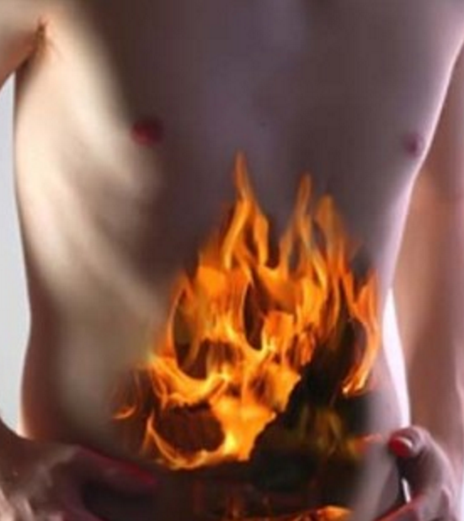
When food enters the stomach, the acidity of the gastic environment maybe quite high, sometimes so high that many enzymes present in the food are denatured and become ineffective.

Slide 264
This is one of the reasons that many vegetable enzymes such as papain and bromelain have been found not to be as useful in promoting digestion of food as animal derived enzymes.

Slide 265
Pancreatic enzyme replacement is usually by bovine or porcine extracts and administered orally have been shown to withstand even high stomach acidity.

Slide 266
Bile (lecithin, cholesteryl esters, cholesterol and bile salts) is important in the emulsification of of fats. Deficiency leads to essential fatty acid absorption along with deficiencies of the fat soluble vitamins A, D, E and K. Effective bile synthesis requires Taurine, Glycine, Vitamin C, Magnesium and Copper.

Slide 267
Fruits high in sucrose and low in fructose / glucose
Apricots
Bananas
Dates
Grapefruit
Mango
Melon
Nectarine
Oranges
Peaches
Pineapple
Plums
Watermelon
Fruits high in fructose / glucose and low in sucrose
Apples
Avocado
Blackberry
Blueberry
Cherry
Figs
Grapes
Kiwi
Lemon
Lime
Papaya -Pawpaw
Pear
Pomegranate
Passion fruit
Raisons
Raspberry
Strawberry
Tomato

Slide 268
Lipase is vital not only for the digestion of fats to the essentially fatty acids but also for the fat soluble vitamin absorption.
Vitamin A
Vitamin D3
Vitamin E
Vitamin K(2)

Slide 269
Some lipases are expressed and secreted by pathogenic organisms during the infection. In particular, Candida albicans has a large number of different lipases, possibly reflecting broad lipolytic activity, which may contribute to the persistence and virulence of C. albicans in human tissue.

Slide 270
Protease is essential for the absorption of the water soluble vitamins B’s and C.
The intestinal wall contains carrier proteins that transport the water soluble vitamins into the blood.

Slide 271
Proteases are involved in digesting long protein chains into shorter fragments by splitting the peptide bonds that link amino acid residues.

Slide 272
To synthesise these proteins enzymes abundant amino acid digestion is essential and no undigested proteins must be present that may irritate the gut lining.

Slide 273
It has been shown that maybe up to 5% of dietary proteins are absorbed not as single amino acids but as short chain peptides that have residual biological activity e.g. endorphin like peptides (now called exorphins) influencing the immune system, the nervous system and the endocrine system.

Slide 274
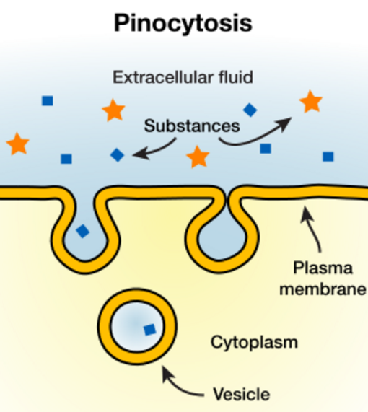
These small molecules get across the GI and Blood / Brain barrier by micropinocytosis to cross cell membranes.

Slide 275
Endogenous Toxicity

Slide 276
Decarboxylated A/A derivatives
Many amino acids may undergo bacterial and fungal decarboxylation to produce toxic amines
Deficiency of protease leads to proteins not being fully digested to single amino acids for absorption

Slide 277
Decarboxylated A/A derivatives
Tyrosine Tyramine
Lysine Cadaverine
Arginine Agmatine
Ornithine Putrascine
Histidine Histamine
Serine ethanolamine

Slide 278
Decarboxylated A/A derivatives
Tryptophan Indole
Methylindole
Tryptamine
Phenylalanine Phenylethylamine

Slide 279
Decarboxylated A/A derivatives
Cysteine Ethylmercaptans
Methylmercaptans
Hydrogen sulfide
Methionine Spermidine
Spermine
TEST FROM STRENGTH

Slide 280
Decarboxylated A/A derivatives
Cadaverine – foul smelling, putrefication of animal tissue. Odour of urine and bacterial vaginosis
Agmatine – affects Neurotransmitters, key ion channels and nitric oxide synthesis – gram –ve bacteria, viruses and fungi

Slide 281
Decarboxylated A/A derivatives
Putrascine – odour of putrefying flesh, role in bad breath, bacterial vaginosis
Putrascine attacks decarboxylated SAM and gets converted to spermidine
Spermidine attacks another dSAM and converts to spermine

Slide 282
Decarboxylated A/A derivatives
Low levels of Polyamine (Spermidine and Spermine) stimulate p53 suppressor gene so high levels lead to low tumour suppressor gene
Increased polyamines may lead to cell proliferation, decreased apotosis and increased expression of onco genes

Slide 283
Decarboxylated A/A derivatives
Indole and methylindole responsible for odour of faeces. In low concentrations flowery smell found in essential oils, like orange blossom and jasmine
Phenylethylamine – psychoactive and stimulant effect. Monoaminergic neuromodulator

Slide 284
Decarboxylated A/A derivatives
Ethyl merceptan smells of cooked cabbage
Methylmercaptan responsible for bad breath, smell of flatus
Methylmercaptan is a byproduct of the metabolism of asparagus

Slide 285
Hydrogen Sulfide
Binds to enzymes in place of cofactors inhibiting activity
Binds to cytochrome a3 oxidase blocking the terminal step in electron transfer system
Affects carbonic anhydrase preventing conversion of CO2 to water and bicarbonate

Slide 286
Hydrogen Sulfide
Reduces bonds of cellular proteins leading to loss of protein structure and activity
Inhibits monoamine oxidase and acetylcholinesterase
Blocks ability of white blood cells to phagocytize and kill
Neurotoxic affects

Slide 287
Solution to Decarboxylated A/A derivatives
Upregulate production of HCl, Pepsin, Protease
Temporarily reduce intake of associated amino acid
Improve the biome with prebiotics and probiotics.

Slide 288
Therapy Localisation points for GUT problems
c
c
Hepatic flexure
Splenic flexure

Slide 289
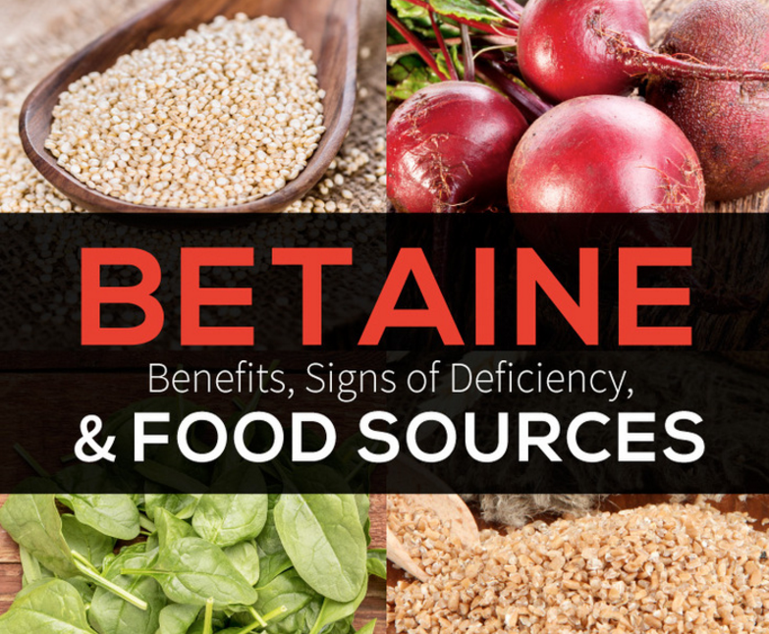

Slide 290
Betaine is a chemical that occurs naturally in the body, and can also be found in foods such as beets, spinach, cereals, seafood, and wine.
Betaine anhydrous is approved for the treatment of high urine levels of homocysteine in people with certain inherited disorders.

Slide 291
High homocysteine levels are associated with heart disease, weak bones (osteoporosis), skeletal problems, and eye lens problems.

Slide 292
Betaine is also used for treating liver disease, fatty liver, depression, osteoarthritis, congestive heart failure (CHF), and obesity; for boosting the immune system; and for improving athletic performance. It is also used for preventing noncancerous tumours in the colon (colorectal adenomas).

Slide 293
Betaine stimulates bile flow
Topically, betaine anhydrous is used as an ingredient in toothpastes to reduce the symptoms of dry mouth.

Slide 294
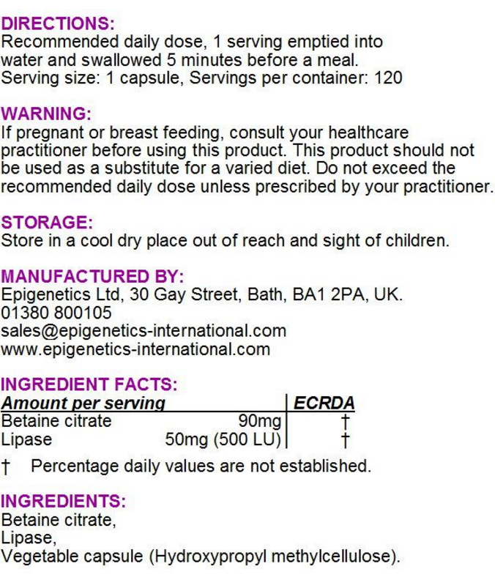
Betaine is a major methyl donor and readily donates methyl groups to the digestive enzymes to aid in their activation.

Slide 295
Dietary Sources
Food sources of betaine include:
Beets
Broccoli
Grains
Shellfish
Spinach

Slide 296
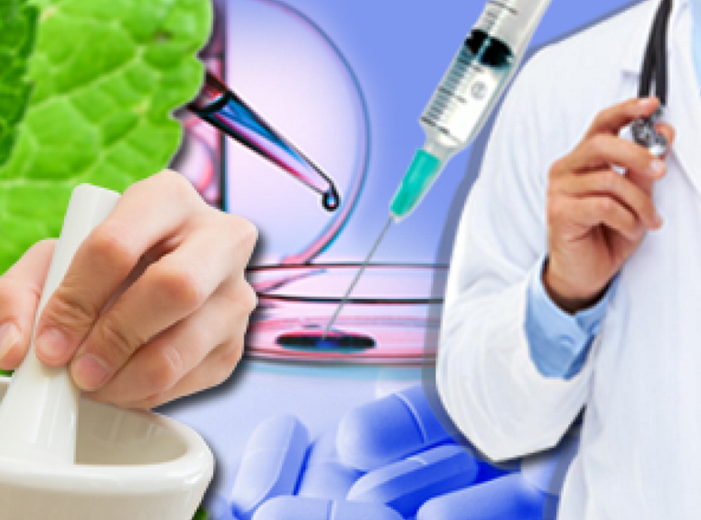
GUT Repair and Regeneration

Slide 297
Gut Repair and Regeneration
requires
Zinc
Pantothenic acid
Vitamin A
Glutamine
Biotin inhibits spores converting to mycelium in fungal overgrowths
Turmeric

Slide 298

and Probiomics

Slide 299

“Until proven otherwise, all chronic illness—all chronic illness—is autoimmune.”
Dr.Yehuda Shoenfeld, Infection and Autoimmunity. (Shoenfeld is arguably the most influential immunologist in the world)

Slide 300
John Croese in 2001 with a variety of other investigators from around the world, particularly developing countries—looking at the relationship of asthma to hygiene in children, and particularly looking at helminth infections and showing that there was an inverse prevalence: decreasing asthma with increasing intestinal worms.

Slide 301
There are about 1633 Pub Med-cited publications presently that talk about the use of fecal transplant and has 20,434 publications cited on helminth therapy for various forms of both localized to systemic problems related to allergy, arthritis, atopy, eczema, and asthma in children.

Slide 302
Original research was done with TSO (trichuris suis—“suis” for pig—ova) to restore immune tolerance in people including allergies. On the surface of these specific helminths are certain kinds of mucopolysaccharides and other molecules that they elaborate from their own metabolism that have immune active effects-

Slide 303
-and whether they work directly by membrane-binding ligand, direct-receptor activity or other effects that modulate signaling that is associated with the gene expression of inflammatory cassettes of genes.

Slide 304
History and Background on the Presence of Worms in the Human Food Supply. Grain beetles eat rat faeces. which is having in its flesh the eggs of the rat tapeworm. So the rats are in the grain to eat the grain, they poop and they have the tapeworm eggs in there.

Slide 305
The rat tapeworm has a deal with the rats, which is first come first served, so a rat has only one tapeworm. And then these tapeworm eggs get into the grain and then the beetles eat the poop to get the moisture out of it and they get infected with—or they get a gift, you might say—these eggs.

Slide 306
Primobiotics or Probiomics
The organisms selected for biome restoration, which are not bacterial probiotics, are called primobiotics or probiomics. Like a probiotic, they are beneficial organisms that inhabit the human digestive system. However, they are animal, as opposed to bacterial, life.

Slide 307
The now popular probiomic produced is HDC (Hymenolepis diminuta cystercercoid). The organisms are found in grain beetles, which are common contaminants in the human food supply.

Slide 308
Ancient humans would have consumed these organisms when they ingested fragments of grain beetles that were unprocessed and uncooked. (Recall that soap and running hot water were not in common use during pre-industrial times.)

Slide 309
HDCs normally live in rodents, and don’t typically develop into adult organisms in humans. Repeated exposure to higher organisms, like HDCs, complete the natural ecosystem of the human body (which also consists of trillions of bacteria and other species), supporting good health.

Slide 310
It is now widely appreciated that humans did not evolve as a single species, but rather that humans and the micro- and macrobiomes associated with us have co-evolved as a “super
organism.” Human evolution as a species and the evolution of the other organisms that live in and on us have always been intertwined.

Slide 311
Modernization, including our use of toilets, water purification, processed food and so on, may have led to the loss of components of our natural biome. Biome supplementation encompasses the idea of adding a wider variety of natural organisms to the ecosystem of the human body.

Slide 312
Selection of the Best Species
Probiotics help support the microbiome, but they don’t help support the rest of the biome. Helminths, or worms that inhabit the intestines of all mammals, have emerged as a leading candidate for supporting the ecosystem of the human body.

Slide 313
Several species have risen to the top of the list as potential candidates for supporting the body’s ecosystem.
Several nematode (roundworm) species have been considered, including whipworms and hookworms.

Slide 314
But the safe isolation of these organisms from faeces (either human or porcine) can be expensive, and some of the organisms can be transmitted from human to human, thus decreasing the utility of these organisms for use in the general population.

Slide 315
On the other hand, at least one cestode (tapeworm) species does not pose any of these limitations: the cestode Hymenolepis diminuta is easily cultivated in grain beetles nor it cannot be transmitted from human to human.

Slide 316
(a) The organism provides biodiversity. It supplements the biome.
(b) The organism has little or no adverse effects on humans.
(c) The organism is easily controlled in terms of colonization: No uncontrolled colonization is possible given ordinary circumstances in post-industrial society.
(d) The organism should be amenable to reproducible cultivation at an affordable cost.

Slide 317
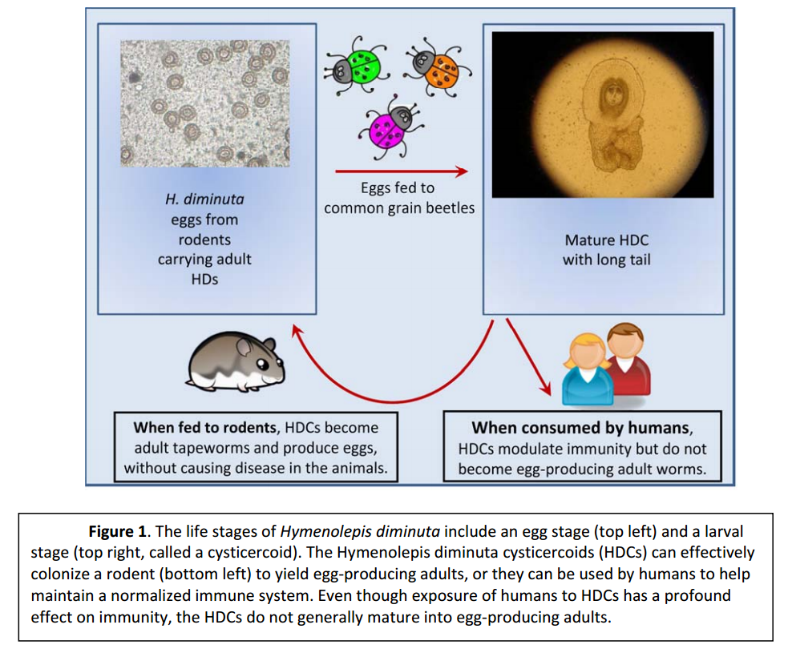

Slide 318
Lactobacillus genus doesn’t go well with the HDCs so you need to give patients Lactobacillus-free probiotics while they’re doing the HDCs to get them the most benefit.

Slide 319
HDCs may not be good for people who are severely immunosuppressed (for example, by HIV/AIDS or a genetic condition, or who are on major immune-suppressive drugs). The use of body biomics by those individuals is not recommended at the present time.

Slide 320
Be aware that there are certain pharmaceutical products that may harm HDCs. If you take any of these, you may wish to consider taking HDCs more frequently. These include:
Alcopar, Anecoline, Metronidazole and anti-helminthic medications (albendazole, diethylcarbamazine, mebendazole, niclosamide, ivermectin, thiabendazole, pyrantel pamoate, paraherquamide, levamisole, piperazine, praziquantel, promethazine, tridabendazole, octadepsipeptides, amino acetonitrile derivatives). Also, Alinia (Nitazoxanide) does have anti-helminthic properties.

Slide 321
HDC’s come ina vial. Samples can be stored in a refrigerator at 4ºC for up to 2 weeks. Should be taken in a little cow’s, goat, soy, rice, almond, oat or hemp milk i.e. a liquid containing fat.

Slide 322
Do not exceed 150 HDC in a single day and do not takemore than once a week.
Muscle testing indicates best to take at TW time (9-11pm).

Slide 323
www. biomerestoration.com

Slide 324

Faecal Transplants

Slide 325
Faecal Transplantation (Bacteriotherapy) is the transfer of stool from a healthy donor into the gastrointestinal tract for the purpose of treating recurrent C. difficile colitis and a range of other chronic bowel disorders such as auto-immune diseases, including Irritable Bowel Syndrome, Crohn’s Disease, and Ulcerative Colitis.

Slide 326
It is a procedure in which faecal matter, or stool, is collected from a tested donor, mixed with a saline or other solution, strained, and placed in a patient, by colonoscopy, endoscopy, sigmoidoscopy, or enema.

Slide 327
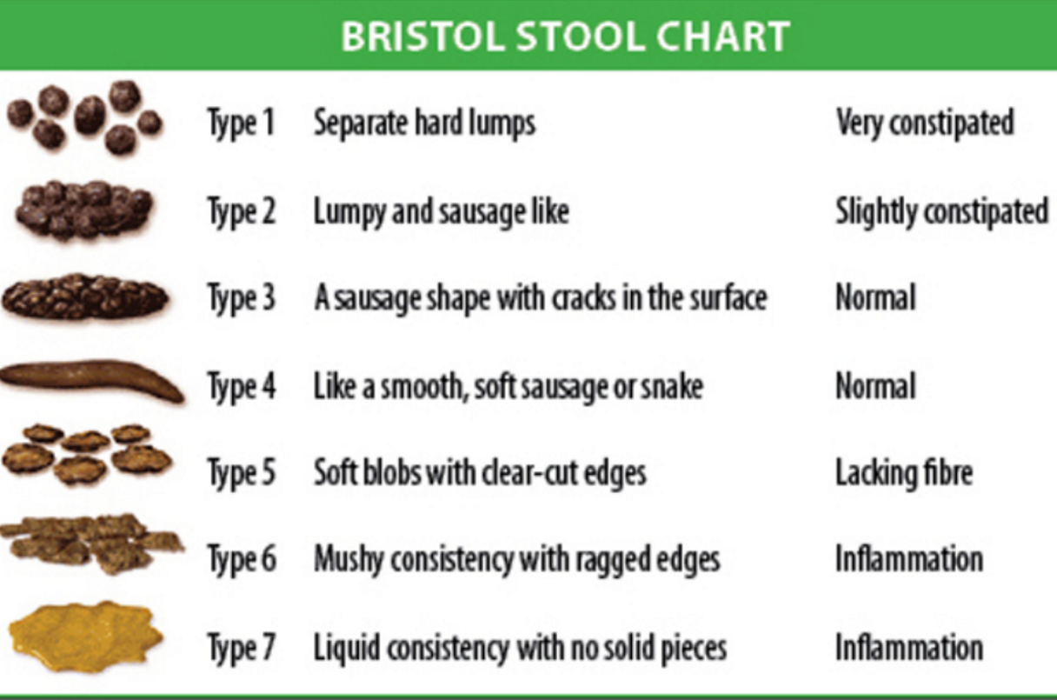

Slide 328
The seven types of stool are:
Type 1: Separate hard lumps, like nuts (hard to pass)
Type 2: Sausage-shaped, but lumpy
Type 3: Like a sausage but with cracks on its surface
Type 4: Like a sausage or snake, smooth and soft
Type 5: Soft blobs with clear cut edges (passed easily)
Type 6: Fluffy pieces with ragged edges, a mushy stool
Type 7: Watery, no solid pieces, entirely liquid

Slide 329
Faecal transplant was first documented in 4th century China, known as “yellow soup”.
It has been used for over 100 years in veterinary medicine, and has been used regularly for decades in many countries as the first line of defence, or treatment of choice, for C. diff.

Slide 330
It is customary in many areas of the world for a newborn infant to receive a tiny amount of the mother’s stool by mouth, thought to provide immediate population of good bacteria in the baby’s colon, thereby jump-starting the baby’s immune system.

Slide 331
http://thepowerofpoop.com/epatients/fecal-transplant-instructions/

