Slide 1

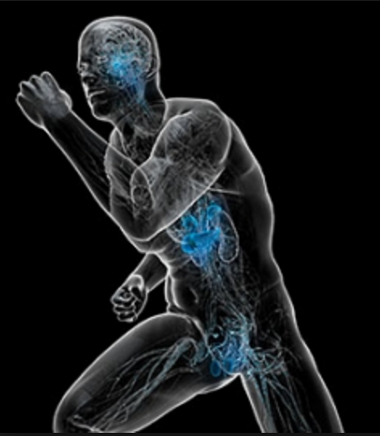
Film 6
The ENDOCRINE SYSTEM

Slide 2
Relative nutritional deficiencies (RND)
Occur when an optimal diet does not meet the needs of the system.
The RND is the most common and least understood nutritional deficiency.
Over 80% of patients suffer from one or more relative nutritional deficiencies.

Slide 3
A colloid is a particle substance that retains its identity and remains in liquid suspension. Colloids are very small in size and therefore easily absorbed by the cells of the body.
Plants convert metallic minerals into this form.

Slide 4
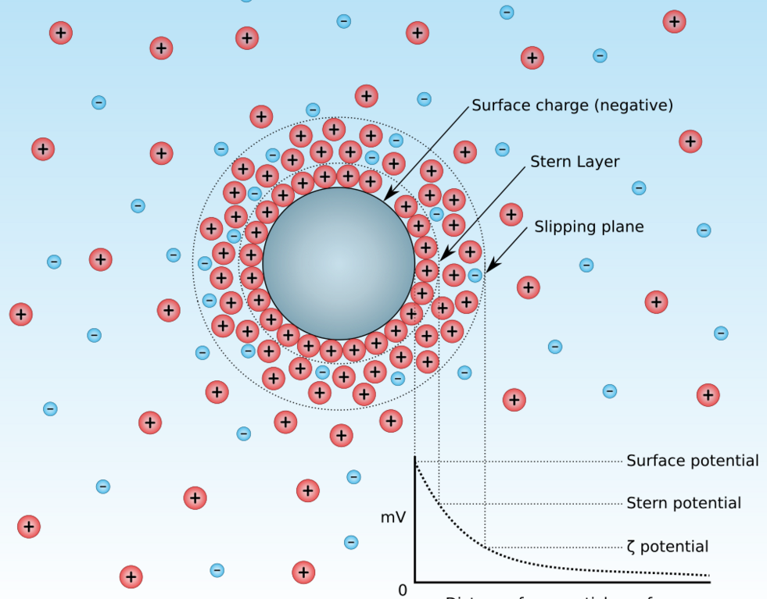

Slide 5
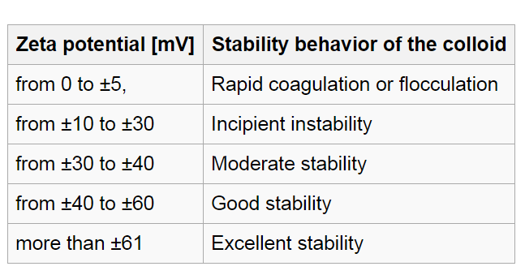
The zeta potential is a key indicator of the stability of colloidal dispersions. The magnitude of the zeta potential indicates the degree of electrostatic repulsion between adjacent, similarly charged particles in a dispersion. For molecules and particles that are small enough, a high zeta potential will confer stability, i.e., the solution or dispersion will resist aggregation.

Slide 6
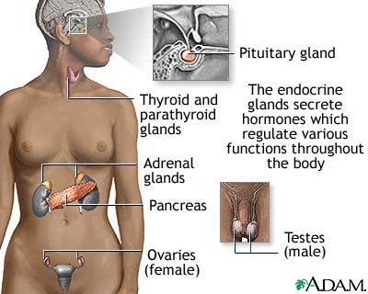

Slide 7
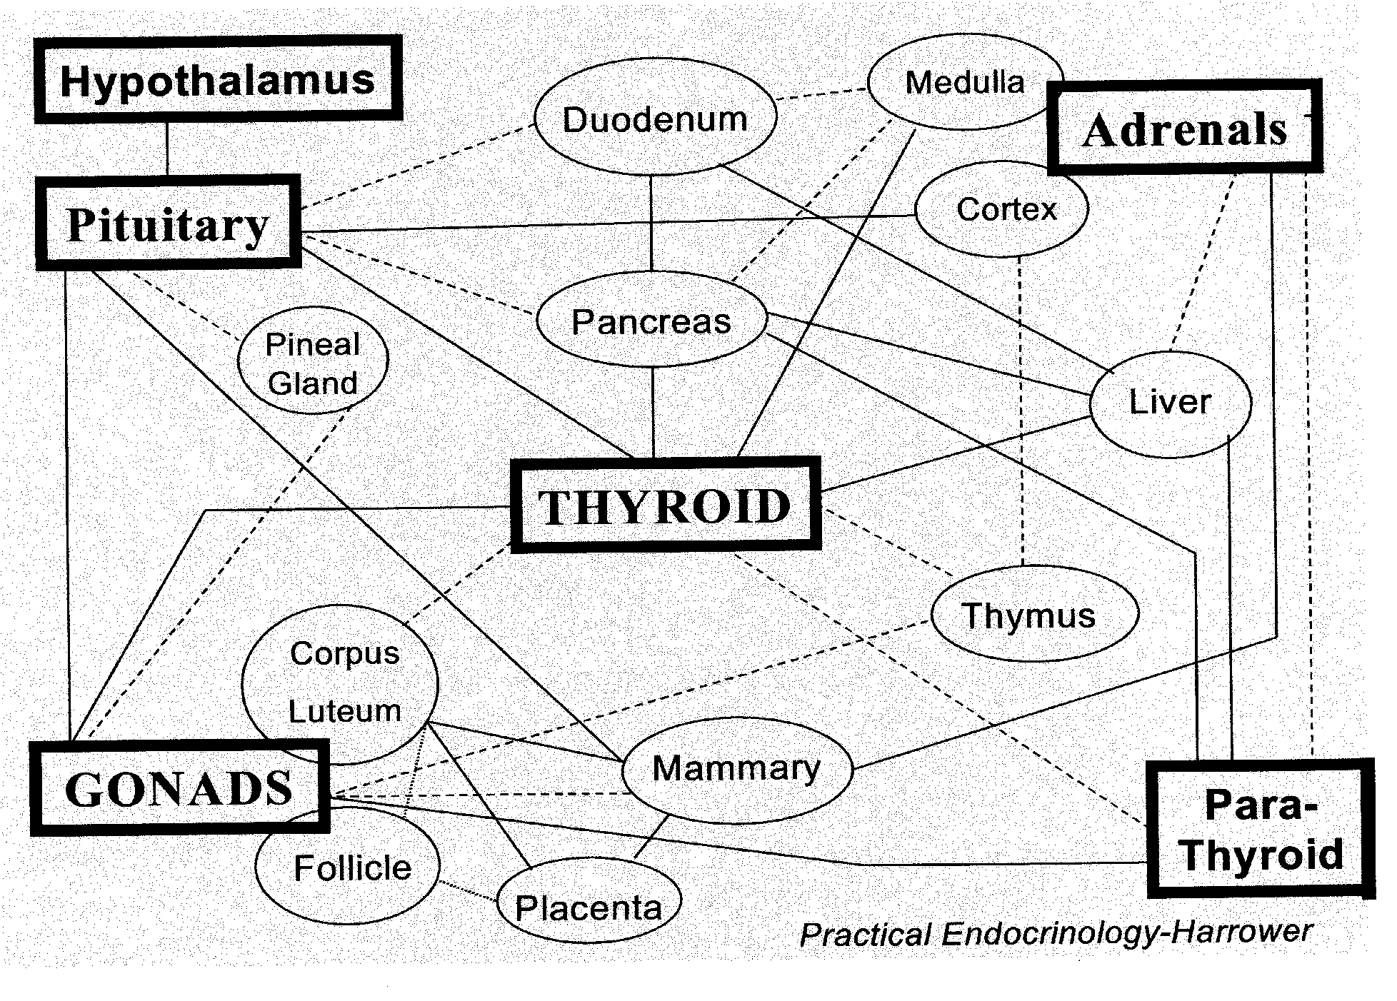

Slide 8
The endocrine system carries out a wide variety of physiological processes through chemical messengers called "hormones."
This system is a collection of glands that produces these hormones, which are necessary for normal bodily functions.

Slide 9
The hormones regulate metabolism, growth and sexual development.
These glands release the hormones directly into the bloodstream, where they are transported to organs and tissues throughout the entire body.

Slide 10
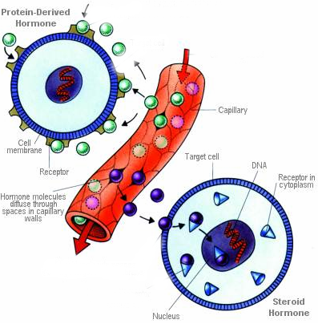
Some hormones bind to cell surface receptors
and use secondary messengers like cAMP, cGMP
Other hormones pass through the cell membranes

Slide 11
Hormones that bind to cell surface receptors
Adrenalin ACTH ADH Calcitonin CRH FSH LH MSH PTH Somatostatin TSH GnRH TRH GRH PRL Glucagon Insulin PRIH
hypothalamic releasing hormones pituitary trophic hormones

Slide 12
Main hormones that bind to intracellular receptors.
Thyroxin and T3
Mineralocorticoids (Aldosterone)
Glucocorticoids (Cortisol)
Androgens (DHEA, Testosterone)
Progesterone
Estrogens

Slide 13
ENDOCRINE THERAPY LOCALISATION POINTS
Pituitary (Glabella)
Thyroid (Thyroid cartilage)
Thymus (Angle of Louis)
Adrenals (Suprarenal) (also CV6 and 7)
Ovaries (Mid inguinal)
Testes (Scrotum)
Prostate (Perineal body)

Slide 14
The PINEAL

Slide 15
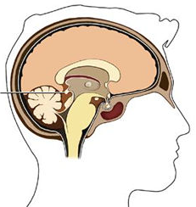
The Pineal Gland (epiphysis)

Slide 16
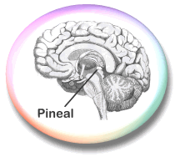
Located in the exact centre of the brain suspended between the two tentorium cerebri.
It’s often prematurely calcified.

Slide 17
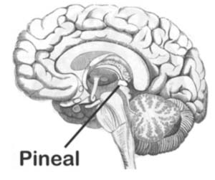
It secretes a number of hormones directly into the neuronal extra-cellular fluid.

Slide 18
The Pineal Gland secretes
Serotonin Melatonin
Epithalamin TRH
Vasopressin (ADH) Prolactin
Somatostatin Noradrenalin
Dopamine GnRH
DMT Pinoline

Slide 19
Melatonin is the pineal hormone of most biological significance.
It is synthesized from serotonin.

Slide 20
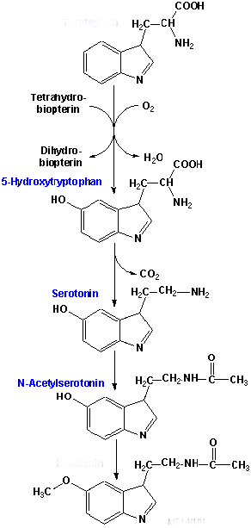
Tryptophan
hydroxylase
decarboxylase
acetyltransferase
methyltransferase
Melatonin

Slide 21
Tryptophan
O2
(Fe, Vit B12)
H4 Biopterin (P5P, Folinic acid, NADPH, Fe)
tryptophan hydroxylase
Dihydrobiopterin
5-Hydroxytryptophan
P5P (Thiamine pyro)
Zn
Mg
decarboxylase
CO2
SEROTONIN

Slide 22
Serotonin
Acetyl CoA
CoA
Key nutrients
P-5-P Folinic acid Zinc Magnesium Pantothenic acid Methylcobalamin Methyl H4 folate
n.acetyltransferase
N-Acetylserotonin
SAM
(Mg, Zn, P5P, Methylcobalamin Methyl H4 folate,)
O-methyltransferase
MELATONIN

Slide 23
MELATONIN
Fe+++
Fe++
NADPH + H+
hydroxylase
NADP+
Key Nutrients Iron NADPH Sulfur or Glucuronic acid
5-Hydroxymelatonin
PAPs (Sulfur) or
Glucuronate
sulfatase or
glucuronidase
Sulfate or Glucuronate conjugates

Slide 24
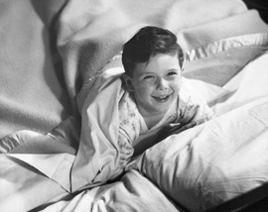
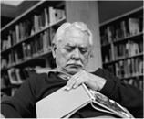
Melatonin production is small in young children, peaks around puberty and declines after 50 years of age.

Slide 25

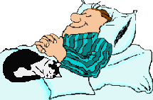
It is most abundant and active in total darkness peaking at 2am and declining to half levels by 5am.

Slide 26
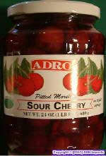
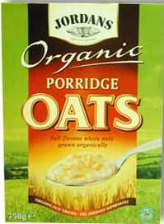
Melatonin is found naturally in Bananas, Morello cherries, Porridge oats

Slide 27
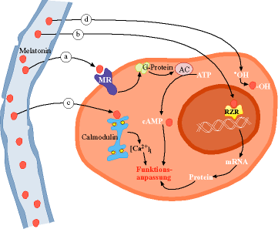

Slide 28
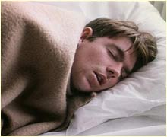
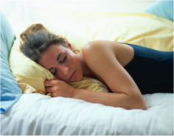
Clinically, it is best to double the night-time dose of melatonin to that required during the daytime.

Slide 29
Melatonin is also secreted by the retina, the gastrointestinal tract, the liver, lungs, skin and certain lymphocytes.

Slide 30
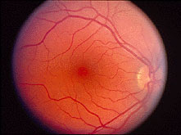
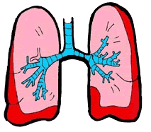
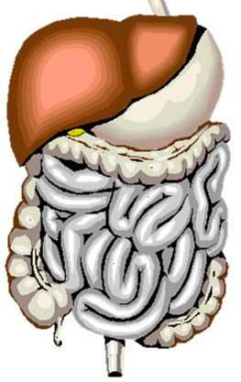


Retina
Liver
Lungs
GUT
Skin
Lymphocytes

Slide 31
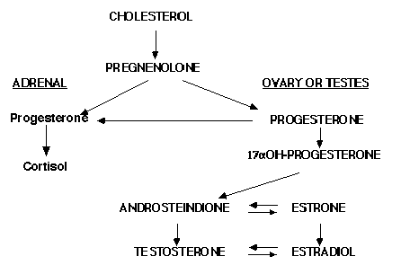
Melatonin has a modulating effect on all the steroid hormones.

Slide 32
It stimulates monoamine oxidase thus reducing high levels of dopamine, noradrenalin, serotonin and histamine.
This is why a good night’s sleep solves most problems.

Slide 33

Melatonin induces a state of relaxation leading to a sleep state. It is not a sleeping medicine.

Slide 34

High levels during the night inhibit sexual function.

Slide 35
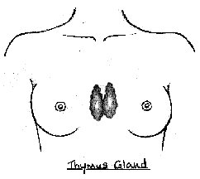
Melatonin has an immuno- modulatory effect on the thymus gland by differentiating undifferentiated white cells into mature T, B and NK cells.

Slide 36
It is a powerful antioxidant against the hydroxyl radical.

Slide 37
"Chemically, the reconnection to the Superconscious occurs by inhibiting the enzymatic actions of MAO (monoamine-oxidase) and enzyme indole-methyltransferase, so that serotonin can convert into melatonin and melatonin with the assistance of the O-methylating enzyme hydroxyindole-O-methyltransferase into the molecules 5-methoxy-dimethyltryptamine and DMT (dimethyltryptamine). The enzymes are inhibited by substances secreted in the pineal gland, such as harmaline and pinoline.

Slide 38
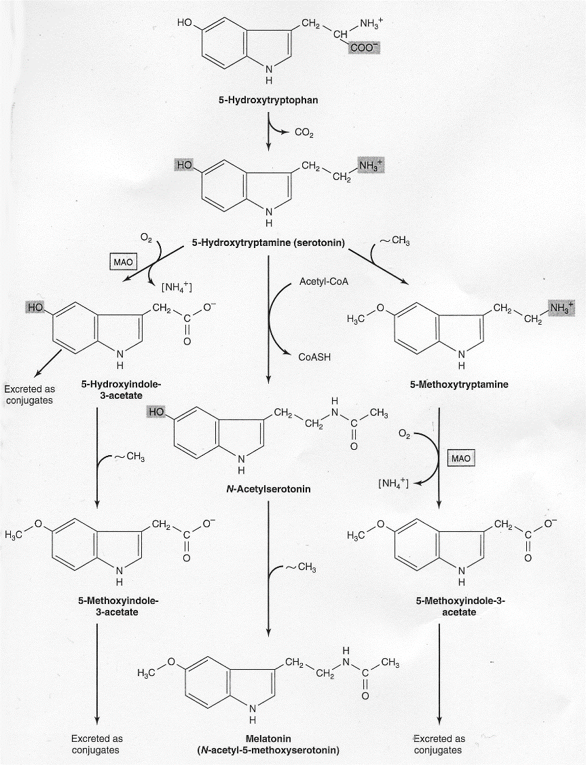
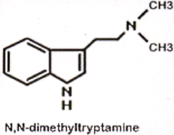
X
(SAM)
X
CH3 (SAM)
P5P
hydroxyindole-O-methyltransferase

Slide 39
The HYPOTHALAMUS

Slide 40
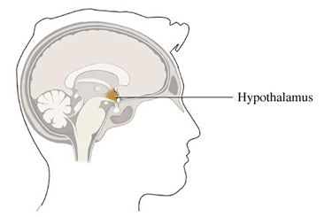

Slide 41
Hormones
Nerves
The hypothalamus is the main interface in the brain between the neurological system and the hormonal system.

Slide 42
The Hypothalamus regulates
1. Autonomic nervous system 2. Biological rhythms (Clock) 3. Hormones 4. Heart rate 5. Blood pressure 6. Appetite and thirst 7. Body weight

Slide 43
8. Water balance 9. Body temperature 10. Sleep pattern 11. Pain 12. Pupillary dilation 13. Ovulation

Slide 44
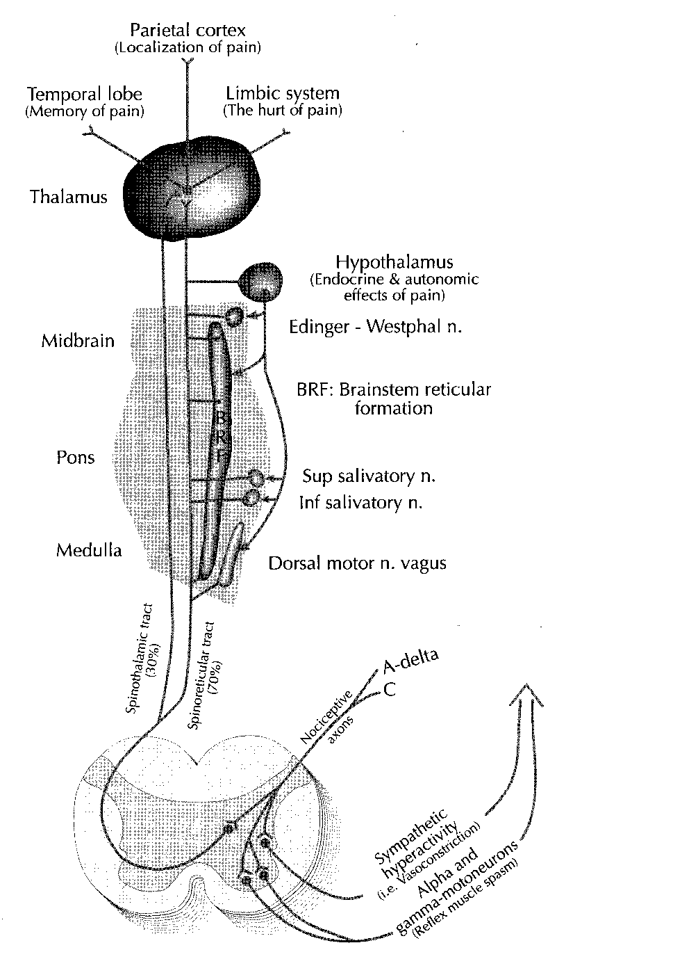
3rd order neurones
Thalamus
Hypothalamus
2nd order neurones
1st order neurones

Slide 45
All sensory information travels either directly or indirectly to the thalamus and from there third order neurons relay information to the sensory cortex for a motor response if required and to the hypothalamus for any autonomic and / or any hormonal response.

Slide 46
The Hypothalamus secretes 6 releasing hormones
CRH = Corticotrophin Releasing Hormone
TRH = Thyrotrophin Releasing Hormone
GnRH = Gonadotrophin Releasing Hormone
GRH = Growth Releasing Hormone
Somatostatin = Growth Hormone Release – Inhibiting Hormone
PRIH = Prolactin Release – Inhibiting Hormone

Slide 47
They are released in a pulastile manner from the hypothalamic nerve fibre endings and travel through a special portal system to the anterior lobe of the pituitary gland.
Each pituitary hormone is under tonic control of at least one hypothalamic hormone.

Slide 48
Corticotrophin releasing hormone
(CRH)
ACTH Adrenocorticotrophic hormone
+ ve

Slide 49
Thyrotrophin releasing hormone
(TRH)
TSH Thyroid stimulating hormone
+ ve

Slide 50
Gonadotrophin releasing hormone
(GnRH)
LH FSH Leutinising hormone Follicle stimulating hormone
+ ve

Slide 51
Growth hormone releasing hormone
(GRH)
GH Growth hormone
+ ve

Slide 52
Growth hormone release – inhibiting hormone
(Somatostatin)
GH (TSH, FSH, ACTH) Growth hormone
- ve

Slide 53
Prolactin releasing – inhibiting hormone (Dopamine)
PRL Prolactin hormone (and TSH)
- ve

Slide 54
Hypothalamus Pituitary Target Gland
Water CRH | ACTH, (MSH) | Mineralocorticoids Glucocorticoids
Fire A TRH | TSH, (PRL) | T3 and T4
GnRH | LH, FSH | Androgens, Estrogens, Progestins
GHRH | GH | IGF(1)
Somatostatin | GH, (TSH, FSH, ACTH) | IGF(1), T3 and T4
PRIH | PRL | Neurohormones

Slide 55
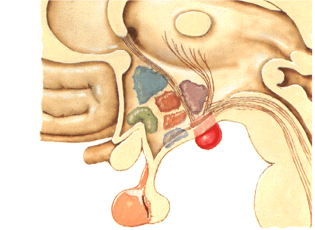
The HYPOTHALAMUS

Slide 56
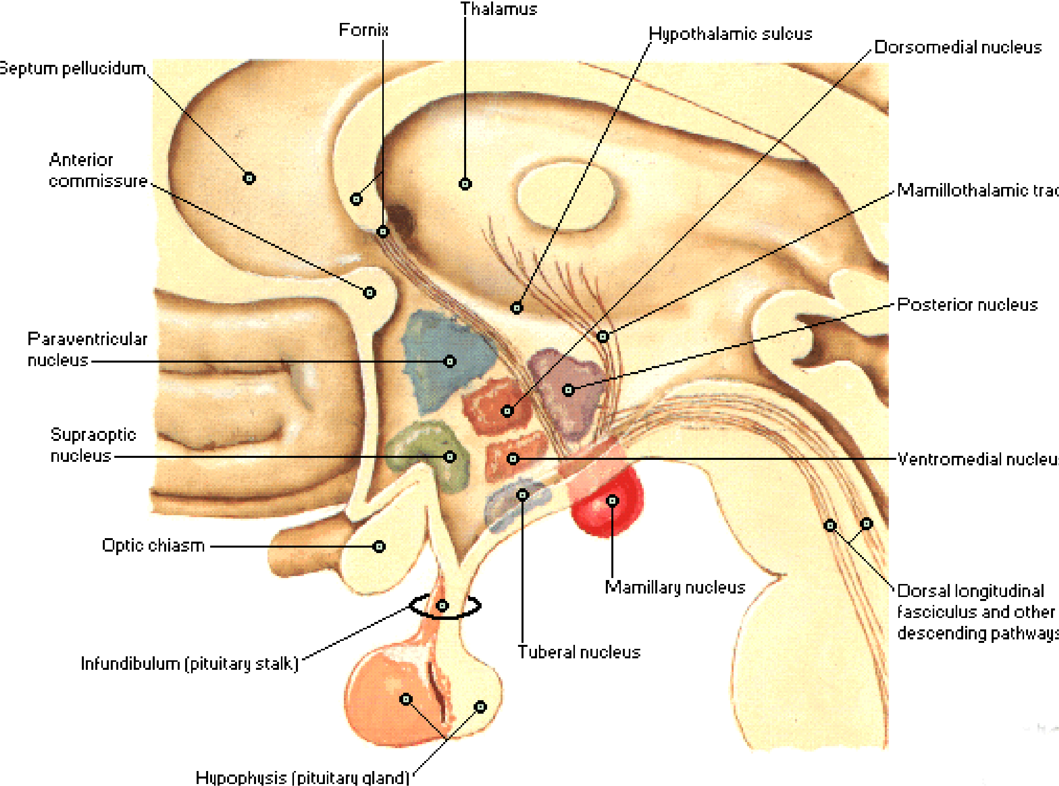

Slide 57
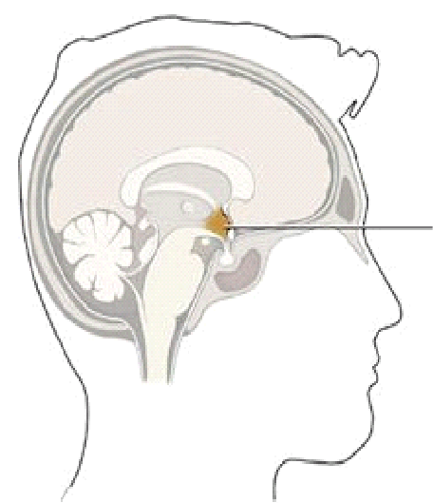
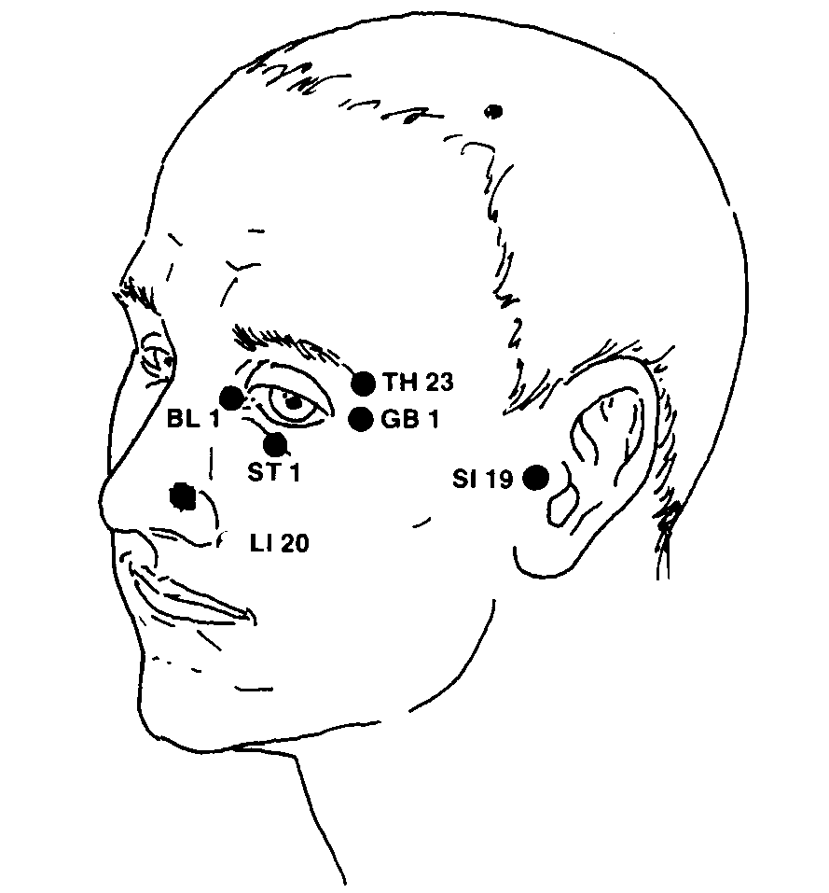
GV20
GV20
●
●
hypothalamus
Located on the sagittal suture mid way between the ears.

Slide 58
The ANTERIOR PITUITARY

Slide 59
Anterior Pituitary (hypophysis)

Slide 60
GROUP 1
Growth Hormone (GH) - mediates IGF I and II.
2. Prolactin (PRL) - mediates lactation.

Slide 61
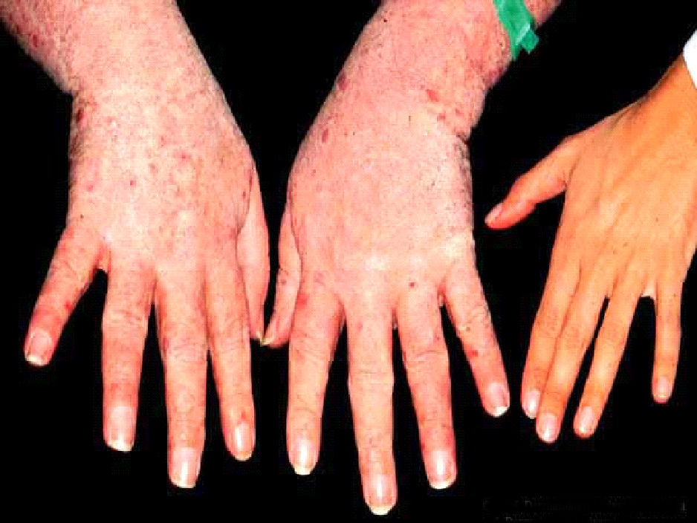
Acromegaly

Slide 62
GROUP 2
1. Thyroid stimulating hormone (TSH)– mediates Thyroxin and T3.
2. Luteinising hormone (LH) - mediates progesterone, testosterone.

Slide 63
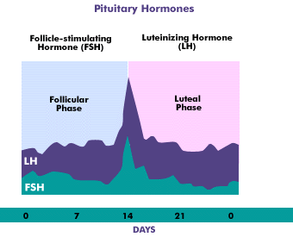

Slide 64
3. Follicle stimulating hormone (FSH) - mediates the follicular cells.
4. Chorionic gonadotrophin (HCG) - mediates the placenta.

Slide 65
GROUP 3
Adrenocorticotrophic hormone (ACTH) - mediates the adrenal cortical steroids.
2. Melanocyte stimulating hormone (MSH) – mediates melanin production.

Slide 66
The POSTERIOR PITUITARY

Slide 67
The Posterior Pituitary Hormones
Vasopressin (Antidiuretic hormone) – mediates the reabsorption of water from the distal renal tubules.
Oxytocin – mediates uterine smooth muscle contraction. The hormone of love!

Slide 68
The THYROID

Slide 69
The Thyroid Gland

Slide 70
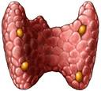

Slide 71
Thyroid
extremely common
Medication not always resolve
Weight gain, tiredness, bloated, depressed
Thyroid cancer rates are rising. Everyday chemicals linked to nodules and cancer

Slide 72
Thyroid Hormones have two functions
Regulation of metabolic rate
2. Stimulation of growth in children

Slide 73
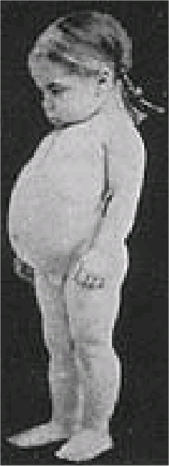
Because a fully functioning thyroid gland is required for normal development of the brain, any reduction in function (for example as a result of iodine deficiency) can cause mental retardation.

Slide 74

The major symptoms of low thyroid are so common today as to be considered normal –
Low energy, marginal health and overweight.

Slide 75
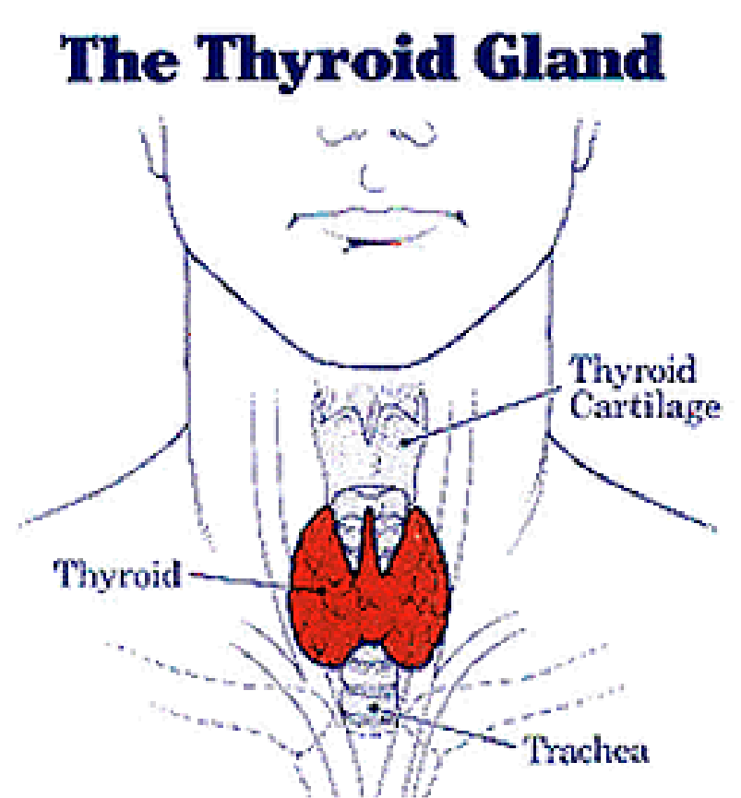

Slide 76
Thyroid Gland
Gland is located at the front of the neck attached to the lower part of the larynx(voice box) and the upper part of the trachea(windpipe)
It is shaped like a butterfly and composed of 2 lobes

Slide 77
Thyroid
Lobes are connected in the middle by a narrow band of tissue called the isthmus
The thyroid cartilage surrounding the gland sticks out in the neck and forms the Adam’s apple

Slide 78
Thyroid Gland
One of the largest endocrine glands in body – approx. 18 g in women and 25 g in men
Contains many follicles or small spheres
These contain a protein mixture called colloid where the protein thryroglobulin is found

Slide 79
Thyroid Gland
T4 and T3 are made out of thyroglobulin
Parafollicular cells are found between the follicles, these secrete hormone calcitonin which reduces calcium in the body fluids & drives it into bone

Slide 80
Parathyroid Gland
4 small glands – parathyroid glands are located behind the thyroid
Parathyroid hormone which increases calcium in the blood by drawing it out of the bones

Slide 81
Thyroid Hormones
Produces 2 main hormones
Triiodothyronine T3 – 3 iodine
Tetraiodothyronine T4 – 4 iodine
Thyroglobulin (thyroid binding protein) contains numerous tyrosine molecules

Slide 82
Thyroid Hormones
Produces more T4 than T3 – ratio of 80% to 20%
T3 is approx. 10 times stronger in its action, more biologically active
Most T3 is made out of T4 in other parts of the body besides the thyroid. Only small amounts from the thyroid

Slide 83
Thyroid Hormones
In thyroid, tyrosine plus 1 iodine make T1. 2 molecules of iodine make T2
In thyroid DIT x 2 = T4
In thyroid MIT + DIT = T3

Slide 84
Thyroid Hormones
In mitochondria, liver and kidney T4 looses an iodine molecule to become T3
Deiodinase enzyme – selenium dependant, zinc and copper co-factors

Slide 85
Thyroid Hormones
If deficient in T3 then the thyroid may not be producing from T1 & T2. Or in tissues not converting T4 to T3
If too high in T4 then too much in mitochondria and not converting
If deficient in T1 and/or T2 then problem is in the thyroid gland

Slide 86
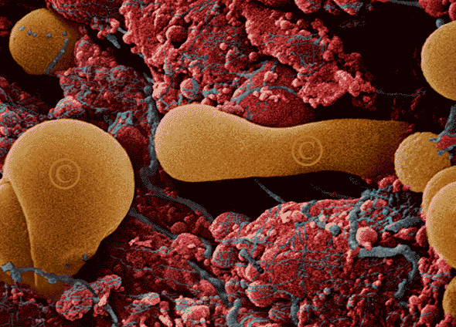
Thyroglobulin actively being excreted from tissue nourished by an extensive capillary network. After maturing in tiny chambers within the thyroid gland, these hormones affect the function of every cell in the body. x12,000

Slide 87
THYROXINE and T3 SYNTHESIS

Slide 88
Tyrosine
Diodotyrosine (DIT)
Monoiodotyrosine (MIT)
Tetraiodothyronine
THYROXIN (T4)
Triiodothyronine
(T3)
or Reverse T3

Slide 89
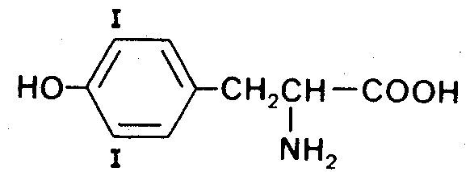
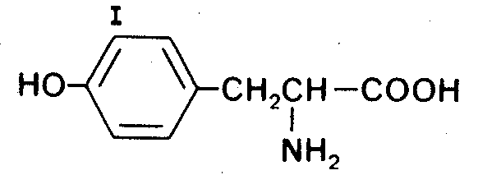
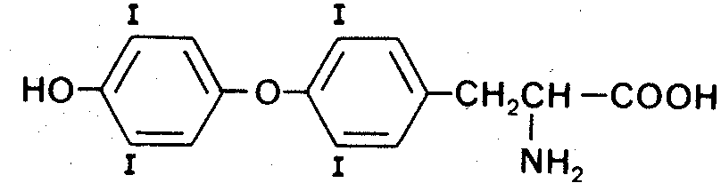
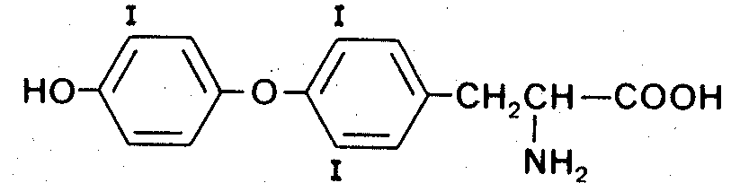
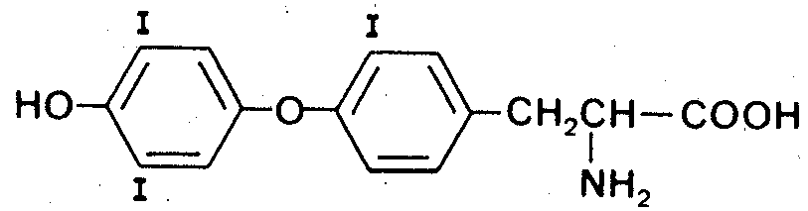
Tyrosine
Diodotyrosine (DIT)
Monoiodotyrosine (MIT)
Triiodothyronine (T3)
Tetraiodothyronine THYROXIN (T4)
or Reverse T3

Slide 90
Thyroxin (T4)
Type 1&2 deiodinase
Type 1&3 deiodinase
35% deiodination to T3
45% deiodination to reverse T3 and T4 to DIT
20% conjugation mainly with glucuronate in the liver

Slide 91
Function of the Thyroid Gland
Thyroid hormones control the basic activity of each cell in the body, including metabolism, growth and development
If levels drop, metabolism slows and energy levels drop
If too high – speeds up

Slide 92
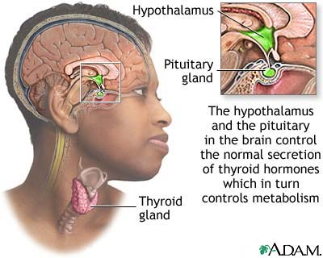

Slide 93
Hypothalamus
TRH
stimulation
Inhibition
Pituitary
T3
T4
TSH
stimulation
Thyroid

Slide 94
thyroid deiodinase
Requires selenium
T4
T3
Inhibited by Toxic Metals

Slide 95
Thyroid hormones in circulation
T3 and T4 stored in the follicles attached to protein called thyroglobulin
Proteinase enzymes split T3/T4 from the thyroglobulin and these enter the bloodstream
Can store 2-3 months of T4

Slide 96
Conversion of T4 to T3
T4 converted into T3 by 5’deiodinase
Occurs mainly in liver & kidneys
Enzyme is selenium dependant and also zinc
T4 can be converted into Reverse T3

Slide 97
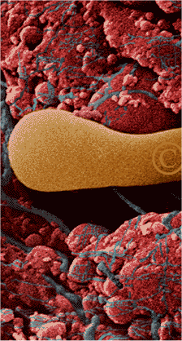
Most T4 and T3 in the body is extra-thyroidal and most circulates bound to Thyroid Binding Globulin (TBG) or to Thyroxine Binding Pre-albumin (TBPa).

Slide 98
Thyroid Diseases and Disorders
Underactive
Overactive
Goiter, enlarged gland
Thyroid nodules, lumpy growths
Thyroid cancer

Slide 99
Hypothyroidism
Iodine deficiency
Hashimoto’s thyroiditis causes hypothyroidism
Body’s immune system attacks and destroys thyroid cells, causing inflammation and inability to produce thyroid hormones

Slide 100
Hypothyroidism
Iatrogenic, doctor induced
Patient treated for hyperactive thyroid and because of the treatment the gland becomes underactive
Metabolism and all body processes slow down
Rate of aging accelerates

Slide 101
Hypothyroidism Symptoms
Lethargy and fatigue
Weight gain for no apparent reason
Decreased appetite
Increased sensitivity to cold
Slow heart rate (bradycardia)

Slide 102
Hypothyroidism Symptoms
Slow, weak pulse
Goiter (enlarged gland)
Depression
Poor concentration
Poor memory
Mental confusion

Slide 103
Hypothyroidism Symptoms
Loss of interest in sex
Dry skin and hair
Aging skin
Scalp hair loss and eyebrows
Constipation
Deeper, hoarse voice

Slide 104
Hypothyroidism Symptoms
Muscle weakness, arms & legs
Slow reflexes
Carpal tunnel syndrome
Aches & pains in muscles, bones
Infertility
Fluid retention, myxoedema
Puffiness around the eyes

Slide 105
Iodine Deficiency
Main cause of hypothyroidism in developing world
Found in oceans and soils
Goiter belt, Derbyshire neck
Babies can have intellectual impairment and physical development issues, cretinism

Slide 106
Iodine Deficiency
Increased risk of attention deficit disorder, learning difficulties
In pregnancy can lead to miscarriage and stillbirths
Thyroid enlarges to try to become more efficient when iodine is scarce

Slide 107
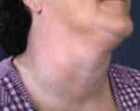
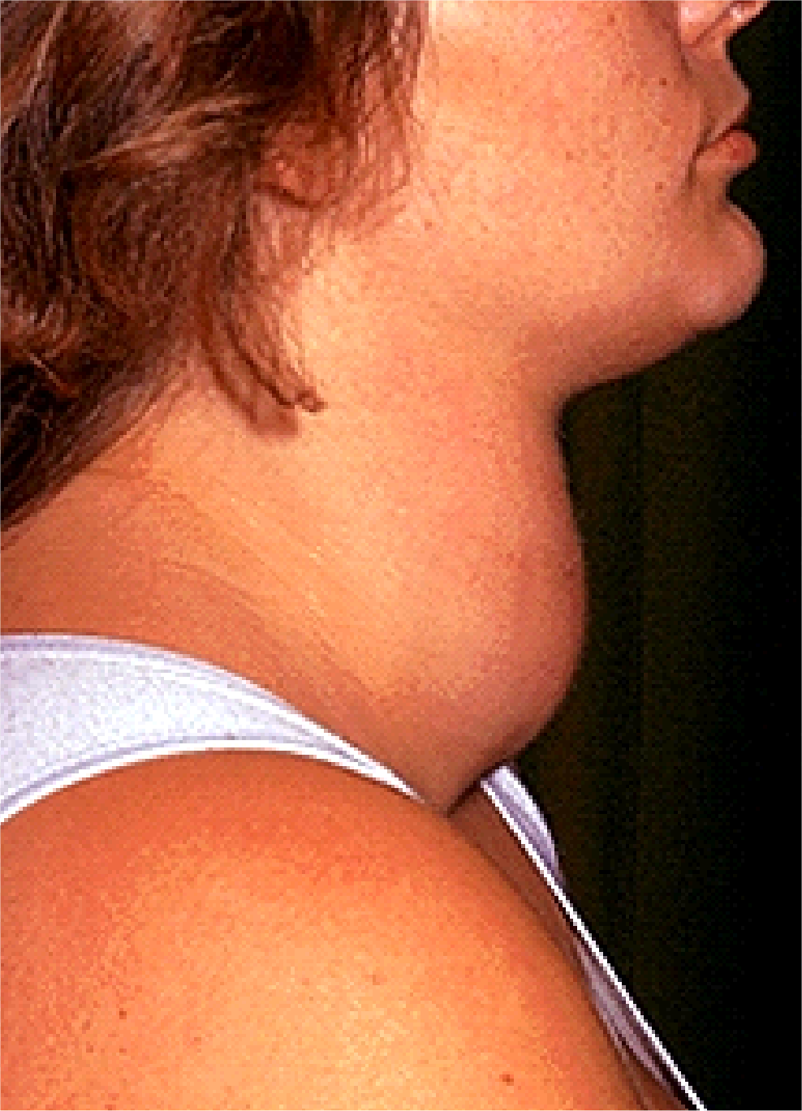
Goiters are benign (not cancerous) enlargements of the gland. They may occur as a result of iodine deficiency, autoimmune disease or quite normally during pregnancy.

Slide 108

Other swellings of the gland may be caused by benign cysts or cancer in the gland. The majority of thyroid enlargements are not malignant.

Slide 109
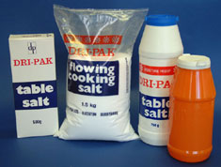
Adults may develop hypothyroidism from dietary iodine deficiency, although iodine is added to salt, breads and cereals to prevent deficiency it is usually sodium or potassium iodide.

Slide 110
Iodine Deficiency
More prone to developing radiation induced thyroid cancer if exposed to radioactive iodine
More susceptible to damage by environmental pollutants, pesticides, toiletry toxins

Slide 111
Iodine
Goitrogens, like cabbage and broccoli, can inhibit the absorption of iodine in stomach and upper SI
Cooking mostly inactivates goitrogens

Slide 112
Iodine Products
Smart Iodides liquid
Iodine liquid 5ml
Magnesium iodide liquid
Potassium iodide liquid
Potassium iodide capsules
Iodine & tyrosine capsules

Slide 113
Iodine Products
Sea vegetable flavouring (Kelp)
Sea vegetable capsules
Bladderwrack capsules
Black walnut tincture
Black walnut capsules

Slide 114
Selenium
Essential for thyroid hormone production, activation and metabolism
Thyroid contains more selenium per gram than any other tissue
Required by enzyme converting T4 to T3

Slide 115
Selenium
Deficiency associated with a greater risk of cancer, including thyroid cancer
Can improve the outcome of autoimmune diseases
Many parts of the world have selenium deficient soils

Slide 116
Selenium products
Ionic selenium
Selenium methionine
Selenium phosphate
Colloidal selenium

Slide 117
Other nutrients for thyroid
Zinc – to convert T4 to T3
Copper
Tyrosine – good digestion is important for the absorption
Thyroid hormones convert beta carotene to vitamin A. Riboflavin to FMN and FAD

Slide 118
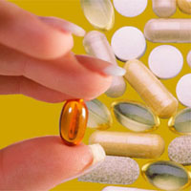
Prolonged intake of Vitamin A supplements can lead to hypothyroidism

Slide 119
Other nutrients for thyroid
Manganese
Smart Vitamin D3
Unsaturated fatty acids

Slide 120
Hyperthyroidism

Slide 121
Hyperthyrodism Symptoms
Rapid pulse & heart palpitations
Fast heart rate (tachycardia)
Overly sensitive to heat
Increased sweating
Increased appetite
Weight loss

Slide 122
Hyperthyrodism Symptoms
Inability to sleep
Irritability, anxiety, nervousness
Panic attacks
Diarrhea or frequent bowel movements
Hand tremors

Slide 123
Hyperthyrodism Symptoms
Mood swings
Goiter
Raised, thickened skin over top of feet or shins
Fatigue
Shortness of breath
Muscle weakness

Slide 124
Hyperthyrodism Symptoms
Thin, moist skin
Periods become light or stop
Joint pains
Difficulty in concentrating
Brittle nails
Eye complaints, bulging, gritty

Slide 125


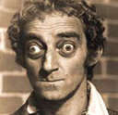
Exophthalmus

Slide 126
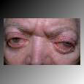

Grave’s Disease

Slide 127
Thyroid hormone tests
Low TSH – overactive thyroid gland or pituitary gland not able to make TSH
High TSH – under active thyroid not producing enough T4 & T3 in response to TSH stimulation

Slide 128
Thyroid hormone tests
Low T4 – under active thyroid. Thyroid not able to make hormones or pituitary not stimulating the thyroid
High T4 – overactive thyroid.
Low T3 – under active thyroid. Not converting T4 into active T3

Slide 129
Reverse T3
Inactive form of T3
5-deiodinase converts T4 into rT3
High rT3 suppress the formation and action of regular T3
Binds to T3 receptors
Inhibits 5’deiodinase

Slide 130
Reverse T3
Normally T4 is converted into T3 and rT3 and the body eliminates rT3 quickly
Main stimulants of rT3 are stress, low calorie intake, starvation, lack of vital nutrients, liver disease

Slide 131
Thyroid Resistance
Inability of cells and tissues to respond to thyroid hormone
Causes symptoms of hypo
Unhealthy cell membranes
Deficiency of selenium, iodine, zinc
Heavy metal toxicity

Slide 132
Thyroid Resistance
Toxic chemicals
Poor liver function
High rT3 blocking receptors

Slide 133
Factors in thyroid dysfunction
Aging
Stress causing high adrenalin and cortisol
Severe injury
Calorie restriction and fasting
Cold exposure
Chemical exposure

Slide 134
Factors in thyroid dysfunction
Increased free radical exposure and lack of antioxidants
Toxic metals, cadmium, mercury, lead
Selenium / iodine deficiency
Chronic high alcohol intake
Insulin dependant diabetes

Slide 135
Factors in thyroid dysfunction
Liver or kidney disease
Hemorrhagic shock
Severe illness
Surgery
High inflammatory chemicals, cytokines, IL-6, TNFa

Slide 136
Hypothyroidism & Infertility
Heavy painful periods or more frequent periods
Can trigger early menarche
Reduced ability to excrete oestrogen and androstenedione
Increased risk of polycystic ovarian syndrome

Slide 137
Hypothyroidism & Infertility
Can increase pituitary gland hormone prolactin
May cause milk production
High prolactin can prevent ovulation
Menstrual periods irregular or stop altogether

Slide 138
Hypothyroidism & Infertility
Failure to ovulate creates a progesterone deficiency, leading to oestrogen dominance
PMS, painful heavy periods, reduced fertility, increased risk of breast and uterine cancer
Suppresses the thyroid

Slide 139
Hypothyroidism & Infertility
Women who fall pregnant with underactive thyroid have increased risk of miscarriage and stillbirth
Child can be at increased risk of mental retardation , physical abnormalities and impaired IQ

Slide 140
Hyperthyroidism & Infertility
Very light periods, irregular periods or amenorrhea
May fail to ovulate so will not produce progesterone, fertility problems
Teenage girls can have delayed puberty and menarche

Slide 141
Hyperthyroidism & Infertility
If pregnant, greater risk of miscarriage, fetal growth retardation, premature labour, congenital malformations,pre-eclampsia
Can have 2 to 3 times the normal level of oestrogen

Slide 142
Thyroid & Cardiovascular Disease
Heart muscle is very sensitive to changes in thyroid hormone levels
Heart contains receptors for thyroid hormones, needed for growth & function of the heart
Too little or too much detrimental

Slide 143
Hypothyroidism & CV Disease
Heart rate slows
High LDL cholesterol, low HDL
High triglycerides
High Lipoprotein (a) thickens artery walls
High blood pressure

Slide 144
Hypothyroidism & CV Disease
High homocysteine which erodes walls of arteries and promotes blood clots
High C-reactive protein. Marker of inflammation in body. The more inflammation the greater the risk of heart disease

Slide 145
Hypothyroidism & CV Disease
Can develop thicker carotid arteries, leading to arteriosclerosis and stroke
Weakens heart muscle and can encourage the accumulation of fluid in the pericardium
70% more likely – hardened aorta
More that twice risk of heart attack

Slide 146
Hyperthyroidism & CV Disease
Rapid heart rate, fast pulses and palpitations
Heart rate may go up faster when exercise and takes longer to get back to normal
Systolic Bp can be elevated
Irregular heart rhythm, atrial fibrillation

Slide 147
Compounds that adversely affect the thyroid

Slide 148
Foods that affect the Thyroid
Goitrogens interfere with thyroid hormone production
Can cause enlargement of the thyroid if consumed in large quantities
Cooking mostly inactivates goitrogens in food

Slide 149
Foods containing Goitrogens
Cruciferous vegetables (cabbage, broccoli,cauliflower, Brussel sprouts)
Corn
Sweet potatoes
Lima beans
Tapioca

Slide 150
Foods containing Goitrogens
Swede
Millet
Peanuts
Soy

Slide 151
A common cause of thyroid malfunction
Per ton of phosphate, 1 to 1.2 percent will be fluoride. A couple of tons per field is not an unusual fix. Fluoride is a halogen and is thyrotoxic. It dominates iodine. This is the Law of Halogen Displacement.

Slide 152
Chemicals & Pesticides - Fluoride
Halogen family
Chemically very similar to iodine
Displaces iodine in thyroid gland
Added to drinking water 1ppm
Foods, medications, chemicals
Accumulates in body

Slide 153
Chemicals & Pesticides - Fluoride
Slows down the production of T3 and T4 by interfering with the enzymes
Inhibits the secretion of TSH
Competes with TSH for receptor sites on the thyroid gland

Slide 154
Sources of Fluoride
Drinking water
Toothpaste
Tea – accumulates more fluoride that any other edible plant
Fluoride pesticides
Soft/carbonated drinks
Medication eg SSRI

Slide 155
Sources of Chlorine
Water purification, disinfectants and bleach
Paper production, paints, plastics and solvents

Slide 156
Sources of Bromine
Evaporates easily
Flameproofing agents
Water purification compounds
Dyes
Photographic products
Brominated vegetable oil – emulsifier in soft drinks

Slide 157
Sources of Bromine
Brominated Flame Retardants (BFR)
Computer monitors and casings
Interior of new cars
Televisions
White goods
Mobile phones

Slide 158
Sources of Bromine
Carpet
Polyurethane foam in furniture and bedding
Easily outgases into the environment
Found in blood, liver, fat, breast milk

Slide 159
Adverse effects of Pesticides
1998 in journal “Thyroid” 90 compounds identified with thyroid disrupting properties
Chlorpyrifos – organophosphate insecticide. California State University found caused antibodies against thyroid

Slide 160
Adverse effects of Pesticides
Amitrole – systemic herbicide
Known to be an anti-thyroid agent
Increases release of TSH by pituitary and so has goitrogenic effects – enlargement of thyroid
In animals causes thyroid tumours

Slide 161
Pyrethrins & Pyrethroids
Pyrethrins insectides derived from chrysanthemum
Pyrethroids – synthetic version
Fly sprays, bug bombs, head lice treatment, pet flea sprays
Raises TSH & suppresses T4 T3
Aerial pesticide spraying

Slide 162
Chemicals that disrupt thyroid
Dioxins and PCBs – by-products of PVC production
Remain in environment for many years and accumulate in human and animal tissue
Reduce levels of T4 hormone

Slide 163
Chemicals that disrupt thyroid
EBDCs – fungicides
Roots, leafy veg, fruits, cereal
Inhibit iodine uptake by thyroid & can cause goiters
Body breaks down into ethylenethiourea – thyroid carcinogen

Slide 164
Chemicals that disrupt thyroid
In rats – EBDCs lower thyroid hormone levels
Inhibit thyroid peroxidase – enzyme required for synthesis of T4 and T3

Slide 165

Because of the resultant change in endocrine feedback taking birth control pills, adrenalin, amphetamines, cortisone, can lead to thyroid dysfunction.

Slide 166

Taking synthetic thyroid hormone for an inactive thyroid gland will tend to make your thyroid rely more on exogenous thyroxin and will thus lead to further inactivity.

Slide 167

Decreased production occurs following androgen or glucocorticoid therapy

Slide 168

Toxic metals Most common toxic metals are aluminium, nickel and mercury. Thyroid is high in the amino acid cysteine.

Slide 169
Toxic metals disrupt the thyroid
Mercury – reduces production of T4 and inhibits conversion of T4 to T3
Selenium antagonist and selenium is required by enzyme that converts T4 to T3

Slide 170
Toxic metals disrupt the thyroid
Cadmium blocks the action of selenium and zinc and depletes levels in the body
These are required for conversion of T4 to T3
Lead suppresses conversion of T4 to T3

Slide 171
Radiation disrupts the thyroid
Sensitive to all types of radiation
Cannot distinguish between regular iodine and radioactive iodine
People who are iodine deficient are more prone to radiation induced disease

Slide 172

X-rays striking the thyroid (including dental x-rays) can damage the thyroid.

Slide 173


Since 1945 every human has been repeatedly dusted with radioactive Iodine 131.

Slide 174

An imbalance in the amount of estrogen in the body (be it due to pituitary, liver, ovary, or adrenal malfunction) can alter thyroid function.

Slide 175

Thyroid Binding Globulin is produced in the liver and its synthesis is increased by estrogens (pregnancy and the birth control pills).

Slide 176
Oestrogen Dominance
High oestrogen blocks the effect of thyroid hormones
Stimulates greater production of thyroid binding globulin, a protein that binds with T4 in blood and makes it inactive
Lowers amounts of free T4

Slide 177
Oestrogen Dominance
Oestrogen excess stimulates body to retain copper
Copper and zinc are antagonists so high oestrogen can result in zinc deficiency
Zinc is needed for conversion of T4 to T3

Slide 178

In hypoadrenia, the thyroid may become inhibited to decrease the metabolic rate and give the adrenals a chance to rest.

Slide 179
Various strong emotional states can affect TSH and thus cause thyroid hormone output to change. Failure to treat an emotional state properly may result in thyroid dysfunction. Other causes of pituitary dysfunction can cause thyroid disturbances secondary to pituitary malfunction.

Slide 180
Overeating, especially fats and sugars over prolonged periods will make the body produce more thyroid hormones (to increase fat burning and glucose uptake) than it can comfortably produce.
This can lead to hypothyroidism.

Slide 181

Because of the thyroid’s effect on insulin secretion, prolonged intake of sugar can cause the over stimulation of the thyroid gland and lead to dysfunction.

Slide 182
Nerve pressure at the mid cervical spine can cause thyroid dysfunction. Many times patients involved in car accidents with resultant whiplash and cervical nerve dysfunction, go into a state of hypothyroidism and put on 5-12Kg (10-30 pounds) over the following 3-4 months.

Slide 183
BASAL AXILLARY TEMPERATURE

Slide 184

Normal

Slide 185

Hypothyroid

Slide 186

Hyperthyroid

Slide 187
THYROID PATCH TEST
Purchase a small bottle of Tincture of Iodine and paint a 2" x 2" patch at the crease of your elbow or behind your knee. The iodine patch should be seen for 24 hours. If the iodine patch leaves, it is a sign that your body is utilizing and/or absorbing the iodine. Keep track of the hours that the iodine is visible.
_______________ hours

Slide 188
Iodine skin test
½ hour 5 drops
½ - 1 hour 4 drops
1 – 2 hours 3 drops
2- 4 hours 2 drops
4 + hours 1 drop

Slide 189
Test for Thyroid dysfunction
From weakness:
Positive T4 – test tyrosine and all types of iodine
Positive T3 - manganese, zinc, copper, selenium
Test unsaturated fatty acids

Slide 190
Test for Thyroid dysfunction
Test from strength for high Reverse T3. if weak test: manganese, zinc, copper, selenium
Check for toxicity: toxic metals, chemicals, radiation
Emotional remedy – VEP spray

Slide 191
Test for Thyroid dysfunction
If T3 strengthens and T4 weakens then problem is with deiodinase in mitochondria.
If T3 strengthens and T4 does npt weaken then problem is in the synthesis of T3 in the Thyroid.

Slide 192
The STEROIDS

Slide 193
The Steroid Hormones and Body Tissues
Elastin - Progesterone Ligament – Aldosterone Bone – DHEA Cartilage - Androstenedione Muscle – Testosterone Fat – Estrogen

Slide 194

Master Steroid Ring

Slide 195


Slide 196


Slide 197


Slide 198
The synthesis of PREGNENALONE

Slide 199
Cholesterol
C
C
C
C
C
C
C
CH3
C
12
17
11
13
C
D
16
CH3
14
15
cytochrome p450
NADPH Fe - S O2
1
9
2
10
8
A
B
3
5
7
4
6
CH3
C = O
CH3
C
D
16
CH3
2
A
B
Pregnenalone
3
HO
4

Slide 200


Slide 201
The synthesis of PROGESTERONE

Slide 202
CH3
Pregnenalone
C = O
CH3
C
D
16
3β-hydroxysteroid dehydrogenase
NAD(P) Fe
CH3
2
A
B
3
HO
4
CH3
C = O
CH3
C
D
16
CH3
2
A
B
Progesterone
3
O
4

Slide 203
Progesterone reduces the proliferative activity of the estrogens on the vaginal epithelium and convert the uterine epithelium to secretetory, thus preparing the uterine epithelium for implantation of the fertilised ovum.

Slide 204
Progesterone 1. Enhances the acinar portions of the breasts. 2. Decrease peripheral blood flow thereby decreasing heat loss during the luteal phase and in pregnancy. 3. Requires estrogens to stimulate their receptor sites.

Slide 205

Low Progesterone
(37.2C)
(37.1C)
(37 C)
(36.9C)
(36.8C)
(36.7C)
(36.5C)
(36.4C)
(36.3C)
(36.2C)
(36.1C)
(36 C)

Slide 206
Synthesis of the Androgens

Slide 207


Slide 208


Slide 209
Testosterone
OH
CH3
C
D
16
CH3
2
5α-reductase NADPH Fe
A
B
=
3
O
4
Inhibited by
Saw palmetto Stinging nettle root
OH
CH3
C
D
16
CH3
2
Dihydro-testosterone
A
B
3
=
O
4
H

Slide 210

DHEA
Dehydro-epiandosterone is the most abundant androgen in the body.
Females have 90% of the levels of males.

Slide 211

It peaks by age 20 years and declines with age and chronic stress.

Slide 212
DHEA stimulates sexual function. Increases gonadal growth. Maintains wakefulness. Lifts depression. Stimulates the thymus to mature and differentiate T, B and NK cells. It is a powerful antioxidant. Lowers cholesterol.

Slide 213
TESTOSTERONE
Is produced in response to LH in the Leydig cells.
(Both LH and FSH are necessary for spermatogenesis which occurs first in the seminiferous tubules and later in the Sertoli cells.)

Slide 214

Testosterone targets the Wolffian structures (vas deferens), spematogonia, muscles, bones, kidney and brain.

Slide 215


DIHYDRO-TESTOSTERONE (DHT) is the active form that targets the seminal vesicles, prostate, external genitalia, skin and hair.

Slide 216
Testosterone and DHT function to
1. Sexual differentiation. 2. Spermatogenesis. 3. Secondary sexual characteristics. 4. Anabolic metabolism. 5. Gene regulation. 6. Male behaviour patterns.

Slide 217


Slide 218

The Times 5/1/04

Slide 219
Metabolism of Testosterone

Slide 220
Testosterone
OH
CH3
C
D
16
CH3
P450 NADPH Fe
2
A
B
=
3
O
4
OH
CH3
HO
11
2, 5, 11, 15, 19 Hydroxy-testosterone
C
D
16
OH
19
15
HO
2
A
B
OH
=
5
O
4
OH

Slide 221
Harper’s Biochemistry indicates that the metabolites of testosterone are then either conjugated by
Sulfation or
Glucuronidation.

Slide 222
Prostate-specific antigen test (PSA test.) The PSA test analyzes a blood sample drawn. It checks the sample for PSA, a substance the prostate gland naturally produces to help liquefy semen. A small amount of PSA naturally enters the bloodstream. If higher-than-normal levels of PSA occur (above a reading of 4), it may indicate prostate infection, inflammation (prostatitis), enlargement of the prostate gland — or cancer. Most important is the change of PSA levels.

Slide 223
What Is Benign Prostatic Hyperplasia ? (B.P.H.)
Benign Prostatic Hyperplasia, abbreviated to BPH, is when the walnut-sized prostate gland becomes enlarged, a common condition that affects more than 1 in 3 men over 40.
Once over 50 you are more likely than not to
have a prostate problem, usually BPH.
Within the prostate testosterone is converted to the more potent hormone Dihydrotestosterone (DHT). It is this compound DHT along with estrogens that stimulates prostate cells to multiply, eventually causing the gland to enlarge.
The enlarged prostate presses on the bladder and also restricts the urethra, the tube carrying urine from the bladder. This leads to:
frequent urge to urinate (especially during the night),
difficulty starting urination,
weak urination,
difficulty emptying the bladder completely,
dribbling after the end of urination.

Slide 224
Nutrients to stimulate testosterone: Zinc
Iron
Magnesium
Selenium
Ornithine
Phosphatidyl serine
B-Complex
α-Lipoic acid
Vitamin C
Vitamin D
Vitamin E

Slide 225
Phytoceuticals factors to stimulate testosterone: Black walnut (Juglans nigra), Cardamon pod and seed (Elettaria cardamomum), Ginger (Zingiber officiale), Ginseng (Elutherococcus), Nettle leaf, Oat seed (avens sativa), Sarsaparilla (Smilax officialis), Saw Palmetto (Serenoa repens), Yarrow (Achillea millefoliu).

Slide 226
Estrogen Synthesis

Slide 227
All naturally occurring estrogens
contain
1. an unsaturated A ring
2.a phenolic hydroxyl group at C3
3. a methyl group at C13
OH
CH3
12
17
11
13
C
D
16
14
15
1
9
2
10
8
A
B
3
5
7
HO
4
6

Slide 228
Testosterone
OH
CH3
C
D
16
CH3
2
cytochrome p450 (aromatase)
FADH2, NADPH, Fe, O2, Mg, B, Vit E
A
B
=
3
O
4
OH
CH3
11
C
D
16
15
17-β Estradiol (E2)
2
A
B
-
5
HO
4

Slide 229
17-β Estradiol (E2)
OH
CH3
C
D
16
2
17β-hydroxysteroid dehydrogenase
NAD(P), Fe, I
A
B
=
3
HO
4
O
CH3
=
NAD(P)H Fe
11
C
D
16
15
2
A
B
Estrone (E1)
-
5
HO
4

Slide 230
Androstenedione
An alternative route to synthesing estrone postmenopausally is from Androstenedione
O
CH3
=
C
D
16
CH3
2
aromatase
NADPH, Fe, O2, B
A
B
=
3
O
4
O
CH3
=
11
C
D
16
15
2
A
B
Estrone (E2)
_
5
HO
4

Slide 231
17-β Estradiol (E2)
OH
CH3
C
D
16
2
A
B
cytochrome p450 CYP 1A2
NADPH (Mg), Fe, O2
=
3
HO
4
16^{α}-hydroxy-estradiol (Estriol E3)
OH
CH3
_
11
_
C
D
16
OH
15
2
A
B
-
5
HO
4

Slide 232
Estrogens influence the growth, differentiation and function of tissues of the female reproductive system
i.e. Uterus
Ovaries
Breast

Slide 233

Estradiol (E2)
premenopausal
Estrone (E1) postmenopausal
Estriol (E3) pregnancy

Slide 234
Estradiol mainly targets the ovaries, fallopian tubes, the upper third of the uterus and the breast tissue.
Estrone mainly targets the mid portion of the uterus.
Estriol mainly targets the lower one third of the uterus and the vagina.

Slide 235

Estrogens stimulate the development of tissues involved with reproduction. They stimulate the size and number of cells by increasing the rate of protein synthesis.

Slide 236
There is proliferation of the vaginal epithelium, the uterine endometrium and glandular hypertrophy.
The myometrium develops an intrinsic rhythmical motility and the breast ducts proliferate.

Slide 237
Estrogens have some anabolic effects on bone and cartilage but largely function by inhibiting the breakdown of bone cells.

Slide 238
There are two estrogen receptors α and β which are expressed to varying extents in most organs including the uterus, ovaries, breast, brain, lung, liver, gastrointestinal tract, bone kidney, genitourinary tract, prostate and testes. They are expressed to a much greater level in carcinomas.

Slide 239
Mechanisms of action
Bind to cell membrane ER and stimulate secondary messengers.
Bind to nuclear ER and regulate gene expression.
E1 and E2 are metabolized to catechol estrogens which maybe carcinogenic.

Slide 240
The Metabolism of
17β-ESTRADIOL

Slide 241

17-β Estradiol (E2) hydroxylation
OH
CH3
C
D
16
OH
CYP 1A2
CYP 1A1, 3A4
HO
2
2
A
B
3
_
4
HO
4
OH
C Y P
1 B 1
15
2
Occurs mainly in the liver

Slide 242


Slide 243


Slide 244


Slide 245


Slide 246
OH
CH3
C
D
16
OH
15
2
HO
2
OH
A
B
3
_
4
HO
4
6
Unique in pregnancy
OH
OH
15
Sites of hydroxylation of Estrone (E1) and 17-β Estradiol (E2)
2

Slide 247
Estrone (E1) hydroxylation
CH3
O
=
C
D
16
OH
CYP 1A2
CYP 1A1
HO
2
2
A
B
4
_
HO
4
OH
C Y P
1 B 1
15
2
Occurs mainly in the liver

Slide 248

OH

Slide 249


Slide 250


Slide 251


Slide 252


Slide 253


Slide 254


Slide 255


Slide 256
Enzyme co-enzymes and co-factors
P450 Aromatase – NADPH, FADH2, O2, B, Vit E
17β-HSD – NAD, Fe, I
P450 (CYP1A1 etc) - NADPH, (Mg), Fe, O2
COMT – SAM, Mg, ATP, Zn,
Sulfotransferase – S
G-S-T – P-5-P, Zn, Se

Slide 257

High Estrogen
(37.2C)
(37.1C)
(37 C)
(36.9C)
(36.8C)
(36.7C)
(36.5C)
(36.4C)
(36.3C)
(36.2C)
(36.1C)
(36 C)

Slide 258



Glucosinolates are secondary metabolites that are mainly found in members of the Brassicaceae (Cruciferae) family. Glucosinolates consist of a common glycone group and a variable aglycone side-chain.

Slide 259
Upon tissue disruption, glucosinolates rearrange to isothiocyanates, thiocyanates, or nitriles. Natural isothiocyanates are effective chemoprotective agents that block chemical carcinogenesis and prevent several types of cancer in rodent models.

Slide 260
Isothiocyanates target mammalian Phase 1 and Phase 2 drug-metabolizing enzymes and their coding genes, resulting in decreased carcinogen-DNA interactions and in increased carcinogen detoxification.

Slide 261

e.g. methionine-derived isothiocyanate, sulforaphane, inhibits Phase 1 enzyme-mediated activation of procarcinogens, induces Phase 2 detoxification enzymes in hepatoma cells, and blocks mammary tumour formation in rats.

Slide 262

Sulforaphane is the most powerful natural inducer of chemo-protective enzymes thus far reported.

Slide 263

Oral Contraceptives

Slide 264
Large quantities of Estrone and Estriol are produced by the placenta during pregnancy.
These are also the primary estrogens produced by adipose tissue in men and post menopausal women.

Slide 265

Extragonadal conversion of Androstenedione to Estrone pre and post menopausally occurs mainly in fibroblasts surrounding adipose tissue.

Slide 266


Adipose tissue expression of aromatase is highest in the Buttocks, followed by the Thighs and lowest in the Abdomen.

Slide 267

Methoxyestrones are clinically the most active at adipose deposition to the buttocks and thighs.

Slide 268

Estriols are clinically most active at adipose deposition to the abdomen.

Slide 269

Estrogen risk factors

Slide 270
Enzymatic regulators of Estradiol levels in breast tissue.
INCREASE | DECREASE
Cytochrome P450 aromatase | Cytochrome P450 1A1 P450 1A2
17β-hydroxysteroid dehydrogenase | Cytochrome P450 1B1
Estradiol sulfatase | Estrone & Estradiol sulfotransferase

Slide 271

1. Age of menache. Higher risk the earlier the menarche, thus longer overall estrogen exposure.
Metabolics Ltd
The Pure Solution

Slide 272
Early menarche is a well established but weak positive risk factor for breast cancer. The risk factor is 1.2 for women in whom menarche occurred before the age of 12 years compared with women in whom it occurred at the age of 14 years. Studies show higher levels of E2 in these girls.

Slide 273

2. Parity. Higher risk in nulliparity. Nuns have 20% higher estrogen levels.

Slide 274

3. Age of first birth. Higher risk with first birth after 30 years. Lowest risk with first birth before 20 years (higher prolactin levels).

Slide 275

4. Breastfeeding

Slide 276

5. Women born prematurely before 33 weeks of gestation have increased risk.
Metabolics Ltd
The Pure Solution

Slide 277

6. Women with a twin brother have higher estrogens. (Greater exposure to estrogens in the placenta)
Epigenetics Ltd
simply ingenious

Slide 278

7. Later the menopause the longer the overall estrogen exposure.

Slide 279

For every one year increase in age at menopause, the risk of breast cancer increases by 3%. This is compounded by an early menarche leading to much longer exposure to estrogen.

Slide 280

8. Width and Height. Increased risk postmenopausally. Increased protection premenopausally due to lower ovulations and increase sequestration of E2 in adipose tissue.

Slide 281

As Body Mass Index (BMI) increases so do circulating estrogens. Breast cancer risk is 18% higher in obese women. Dr Lesley Walker of Cancer Research, Oxford University 20/8/03

Slide 282

Women are 25% more at risk to breast cancer for every 2½ inch increase in height above 5ft 2in. Maybe due to high calorie diet during puberty.
(British Journal of Cancer July 2003)

Slide 283

A similar link occurs in males and the risk of testicular cancer. Men taller than 6ft 1in have almost double the risk of contacting testicular cancer than those under 5ft 9in.
(British Journal of Cancer July 2003)

Slide 284

9. Diet. Higher risk with high saturated fat intake.
Lowest risk with high oleic fatty acid and Omega 3 oil intake.

Slide 285

The ratio of Omega 3 to Omega 6 fatty acids in adipose tissue
shows an inverse association with breast cancer risk.

Slide 286

No correlation between serum cholesterol and triglyceride concentrations and breast cancer rates.

Slide 287

Women who eat more than 90gm of fat a day have 2x the risk of developing breast cancer. Women eating less than 40gm fat per day have least incidence. (Lancet July 2003)

Slide 288

Asian women who consume 15% or less of their energy as fat have significantly lower plasma E2 levels than their Western counterparts on a 40% higher fat diet.

Slide 289


Reduction of fat intake to 20% of total calorie and/or increased dietary fibre consumption for at least 2 months resulted in a 20% reduction in serum E2 and a 5% reduction in E1.

Slide 290

High alcohol intake induces liver aromatase.
Postmenopausal women receiving estrogen replacement therapy experienced a sustained increase in circulating E2 following ingestion of alcohol

Slide 291

10. Bone density depends in part on estrogen levels.

Slide 292

E2 affects bone mass most likely via the ER in osteoblasts.
Women with hip fractures have a 16% lower risk of breast cancer and women with forearm fractures an even greater reduction of 58% compared to women without fractures.

Slide 293

11. Family history. Increased likelihood of inheriting various polymorphisms.
Evidence of CYP polymorphisms and some evidence with COMT polymorphisms.

Slide 294

Women whose mother and sister both have a history of breast cancer have a relative risk of 2.5 compared with those without a family history

Slide 295
12. Enzyme polymorphisms
Evidence that polymorphisms in CYP 1A1 or CYP 1B1 are of significance.
However studies of COMT gene polymorphisms G>A increased the risk by 2 fold due to significantly decreased enzyme activity.

Slide 296
13. Endogenous estrogen concentration. It appears that differences in serum E2 concentration could be etiologically important especially in post-menopausal women.

Slide 297

14. Exogenous estrogen concentration from oral contraceptives and hormone replacement therapy increase risk.
Metabolics Ltd
The Pure Solution

Slide 298

15. Phytoestrogens Formed from lignans (enterolactone) and from isoflavones (equols) by colonic bacterial fermentation.

Slide 299

Work by inhibiting aromatase and 17β-hydroxysteroid dehydrogenase enzymes and by increasing serum binding globulin thus lowering free estrogens.

Slide 300


16. Xenoestrogens. Organochlorides (DDT, DDE), carbamates, PCB’s, plasticizers, styrenes, nonylphenols all can have weak estrogen like effects.

Slide 301
Zearalenone and its reduced derivative, Zearalanol, are fungal or mycoestrogens from fusarium moulds.
They have been associated with estrogenizing syndromes in animals fed mould infected grain.

Slide 302
They have been shown to interact with the ER and to promote weight gain in rats.
100-1000 fold higher doses than E2 are required to achieve equivalent responses.

Slide 303

Phytoceuticals to stimulate Progesterone:
Dang quai (Angelica sinensis), Sarsaparilla (Smilaz officinalis), White deadnettle (lamium alba), Yarrow (Achillea millefolium).
Dang quai (Angelica sinensis)

Slide 304

Phytoceuticals to stimulate Estrogens: Angelica (Angelica archangelica), Aniseed (Pimpinella anisum), Black cohosh (Cimicifuga racemosa), Fenugreek (Trigonella foenum-graecum),
Ginseng (elutherococcus), Hops (Humulus lupulus),
Nettle (Urtica dioica), Oats (Avena sativa), Sarsaparilla (Smilax officinalis), Wild yam (Dioscorea villosa), Yarrow (Achillea millefolium)
Hops

Slide 305
  Indole-3-carbinol
    Indole-3-Carbinol is a type of Indole.
    Chemically, it is a metabolite of Glucobrassicin, which in turn is a hydrolytic product of Glucosinolates

Slide 306
    Indole-3-Carbinol is metabolized to Diindolylmethane (DIM) in the stomach, which recent research indicates is the compound that is actually responsible for the benefits formerly attributed to Indole-3-Carbinol.
    Chemically, Diindolylmethane (DIM) consists of two molecules of Indole-3-Carbinol bound together.

Slide 307
    Indole-3-Carbinol stimulates the endogenous production of Glutathione by hepatocytes.
    Indole-3-Carbinol facilitates the binding of various substances (including carcinogens) to Glucuronic Acid to form Glucuronides for excretion.

Slide 308
    Indole-3-Carbinol inhibits the conversion of Estrone to 16-Hydroxyestrone (a carcinogenic metabolite of Estrone).
    And redirects Estrone to be converted to 2-Hydroxyestrone (a safe metabolite of Estrone).

Slide 309
  Chaste Berry
    Is a shrubby herb with botanical name Vitex agnus-castus

Slide 310
    Chaste Berry may mimic the ability of Luteinizing Hormone (LH) to stimulate the production of Progesterone in the Corpus Luteum during the Luteal Phase of the Menstrual Cycle.
    Some studies have shown that Chaste Berry also stimulates the actual secretion of LH.

