Slide 1
Optimising the Immune System

Slide 2
My finding is that COVID 19 spectroscopic emission is at 633nm in the orange spectrum.
633nm
You can print this off either on paper or best on an acetate sheet. If on paper place it coloured side down on the patient or patient looks at it.. This acetate is now available from Epigenetics Ltd www.epigenetics-international.com

Slide 3
Thus if a patient weakens in the clear to this specific coloured acetate you can say that they might currently have COVID19.
But of course never base a diagnosis on this finding alone.
You must follow government guidelines in such a case.

Slide 4
I have tested this remotely using hair samples of known cases of COVID 19 and they weaken in the clear if the virus is (still) active.

Slide 5
Most people do not weaken in the clear to this acetate as they are currently not infectious.
However most people who do not weaken in the clear weaken when the acetate is challenged whilst therapy localising the current WON time point.

Slide 6
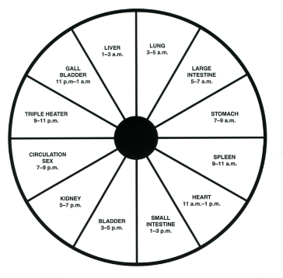
The WON time point is the coupled meridian’s ALARM point to the NOW time.
NOW time WON time
Lung 4-6am LI
LI 6-8am Lung
St 8-10am Sp
Sp 10-12midday St
Ht 12-2pm SI
SI 2-4pm Ht
Bl 4-6pm Kid
Kid 6-8pm Bl
Cx 8-10pm TW
TW 10-12midnight Cx
GB 12-2am Liv
Liv 2-4am GB
BST Summer times

Slide 7
This does not mean they have COVID19 but if they were exposed to it you can find what will optimise their immune system against it.

Slide 8
From this weakness you can now discover exactly what the individual requirements are to improve immunity against the virus. e.g.
Liposomal Vitamin D3
Zinc SA
Vitamin C (Sodium ascorbate tends to test best and Potassium ascorbate during infection)
Probiotics, Coconut oil (Monolaurate)
All products and test vials available from www.epigenetics-international.com

Slide 9
Update to Diagnosing COVID 19
Using the preceding protocol you have been able to assess a range of nutrients to support you, your family and your patients immune systems.
Most of the people I have put on the Vitamin D3, Zinc SA and the Sodium ascorbate have so far not contracted the virus.

Slide 10
I have had several people who have tested positive, had mild symptoms and recovered within a few days.
There appears to be another aspect to the reason some infected people are affected worse by the virus than others.

Slide 11
My observation is that patients who do not weaken in the clear but only with TL to the WON time do weaken when challenged firstly with GM soy followed the 633nm acetate.
The GM soy itself does not weaken in the clear but when left on and then the acetate added do weaken.

Slide 12
This may mean that GM soy is in some way facilitating the virus entry.
Organic soy does not create this weakening.
93% of the world’s soy is GM but be aware that much organic is affected also by cross contamination.

Slide 13
Generic GMO soybeans
Following expiration of Monsanto's patent on the first variety of glyphosphate-resistant Roundup Ready soybeans in 2015, development began on glyphosate-resistant generic soybeans.

Slide 14
Monsanto developed a glyphosate-resistant soybean that expresses Cry1Ac protein from Bacillus thuringiensis and the glyphosate-resistance gene.
Cry1Ac protoxin is a crystal protein produced by the gram-positive bacterium, Bacillus thuringiensis (Bt) during
sporulation.

Slide 15
Cry1Ac is one of the delta endotoxins produced by this bacterium which act as insecticides. Because of this, the genes for these have been introduced into commercially important crops by genetic engineering (such as soy, cotton and corn) in order to confer pest resistance on those plants.*
*McLean M (2011). "A review of the environmental safety of the Cry1Ab protein". Environ Biosafety Res. 10 (3): 51–71.

Slide 16
Cry1Ac is also a mucosal adjuvant (an over immune-response enhancer) for humans.*.
*Rodriguez-Monroy MA, Moreno-Fierros L (2010). "Striking activation of NALT and nasal passages lymphocytes induced by intranasal immunization with Cry1Ac protoxin". Scand. J. Immunol. 71 (3): 159–68.

Slide 17
Cry1Ac is a toxin that would have to be detoxified if ingested in humans probably by conjugation with glutathione.
All my patients positive to Covid19 show low in reduced glutathione and under expression of Glutathione-s-transferase (MGST3) enzyme.

Slide 18
Microsomal glutathione S-transferase 3 (MGST3) is an enzyme that in humans is encoded by the MGST3 gene.*
*Jakobsson PJ, Mancini JA, Riendeau D, Ford-Hutchinson AW (Oct 1997). "Identification and characterization of a novel microsomal enzyme with glutathione-dependent transferase and peroxidase activities". J Biol Chem. 272(36): 22934–9.

Slide 19
The MAPEG (Membrane-Associated Proteins in Eicosanoid and Glutathione metabolism) family consists of six human proteins, several of which are involved in the production of leukotrienes and prostaglandin E, important mediators of inflammation.

Slide 20
This gene encodes an enzyme that catalyzes the conjugation of leukotriene A4 and reduced glutathione to produce leukotriene C4.
This enzyme also demonstrates glutathione-dependent peroxidase activity towards lipid hydroperoxides.*
*"Entrez Gene: MGST3 microsomal glutathione S-transferase 3"

Slide 21
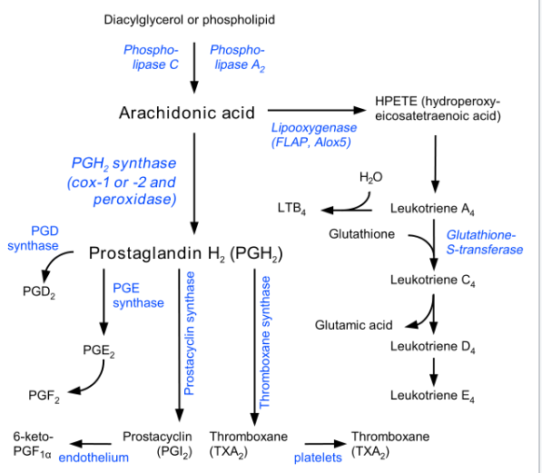
Leukotriene synthesis
Cry1Ac toxin?
By Jfdwolff, whitespace removed by Fvasconcellos - w:Image:Eicosanoid_synthesis.png, CC BY-SA 3.0, https://commons.wikimedia.org/w/index.php?curid=1619077

Slide 22
Note that if CryA1 toxin is detoxified by conjugation to Glutathione via Glutathione-s-transferase there will be less Glutathione-s-tranferase available and so leukotriene A4 will be shunted to the formation of leukotriene B4 the most inflammatory of all chemical mediators.

Slide 23
Leukotriene B4 is synthesized in vivo from Leukotriene A4.
Its primary function is to recruit neutrophils to areas of tissue damage, though it also helps promote the production of inflammatory cytokines by various immune cells.

Slide 24
Drugs that block the actions of Leukotriene B4 have shown some efficacy in slowing the progression of neutrophil-mediated diseases.*
*Crooks, S.W; Stockley, R.A (1998). "Leukotriene B4". The International Journal of Biochemistry & Cell Biology. 30 (2): 173–8.

Slide 25
Cytokine Storm Syndrome is a form of systemic inflammatory response syndrome and is an adverse effect of some infections, chemicals and drugs.*
A number of deaths due to COVID-19 have been attributable to cytokine release storms.**
*Lee DW, Gardner R, Porter DL, Louis CU, Ahmed N, Jensen M, Grupp SA, Mackall CL (July 2014). "Current concepts in the diagnosis and management of cytokine release syndrome". Blood. 124 (2): 188–95.
**Mehta P, McAuley DF, Brown M, et al. (16 March 2020). "COVID-19: consider cytokine storm syndromes and immunosuppression“. The Lancet. 395: 1033–34.

Slide 26
I thus strongly advise all people to strictly avoid all soy products in their diet.
Using the preceding challenge you may find a need for supplementing extra glutathione into their immune optimising regime. along with Sodium ascorbate, Zinc SA and Vitamin D3.

Slide 27
Interestingly
Vitamin C aids in the recycling of Glutathione.
Zinc co-factors the conversion of cysteine into glutathione.
Vitamin D stimulates the synthesis of glutathione and reduces expression of GGT.

Slide 29
Monolaurin (from Coconut oil) is known to inactivate lipid-coated viruses by binding to the lipid-protein envelope of the virus, thereby preventing it from attaching and entering host cells, making infection and replication impossible.*
*Monolaurin is known to inactivate lipid-coated viruses by binding to the lipid-protein envelope of the virus, thereby preventing it from attaching and entering host cells, making infection and replication impossible.^{[12]} Other studies show that Monolaurin disintegrates the protective viral envelope, killing the virus.^{[13}

Slide 30
Other studies show that Monolaurin disintegrates the protective viral envelope, killing the virus.*
*Thormar, H; Isaacs, C E; Brown, H R; Barshatzky, M R; Pessolano, T (1 January 1987). "Inactivation of enveloped viruses and killing of cells by fatty acids and monoglycerides". Antimicrobial Agents and Chemotherapy. 31 (1): 27–31.

Slide 31
Soy products
Soy protein isolate
Soy milk
Soy cheese
Soy ice cream
Soy yogurt
Soy flour
Tofu
Miso
Natto
Shoyu
Soy sauce
Tamari
Edamame
Soy vegetable oil
Tempeh
Vegetable gum
Vegetable broth
Vegetable starch
Hydrolysed vegetable protein
Textured vegetable protein
Hydrolysed plant protein
Monosodium glutamate
Artificial flavouring
Natural flavouring
Plum sauce
Hoisin sauce
Fish sauce
Teriyaki sauce
Instant gravy granules
Bouillon cubes
Okara
Soybean butter
Vegetable gum
Gum Arabic
Guar gum
Vegetable starch
Soy lecithin
Some cosmetics and lip balm
Bean sprouts
Mono and diglycerides
Thickeners
Mixed tocopherols (Vitamin E)

Slide 32
May contain Soy products
Candy
Cereals
Chicken broth
Asian foods
Baked goods and baking mixes
Chicken processed with chicken broth
Chocolate
Deli meats made with hydrolysesd vegetable protein
Energy bars or nutrition bars
Hamburger meat with soy protein fillers
Hamburger buns made with added soy flour
Imitation dairy foods
Infant formulas
Margarine
Mayonnaise
Nutritional \supplements
Peanut butter and peanut butter substitutes
Commercial sauces, gravies and soups
Sweet bean sauce
Soy molasses
Sausages and hot dogs made with soy protein fillers
Smoothies
Vegetable broth
Vegetarian meat substitutes

