Slide 1

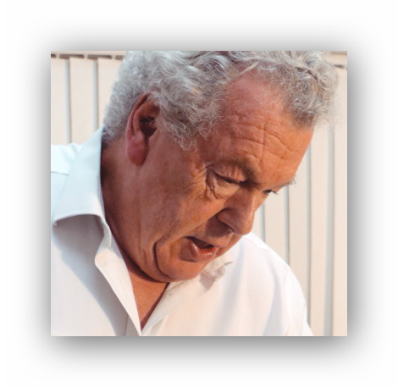
Anxiety or Depression
A new look at mental health issues from an Applied Kinesiology perspective
Chris Astill-Smith D.O., N.D. Diplomate ICAK
Marlow UK
chris@epigenetics@international.com

Slide 2
Prior to the COVID-19 global pandemic, the World Health Organization (WHO) reported that 44 million people in the European region suffer from depression and 37 million suffer from anxiety. High unemployment, social distancing requirements, isolation from family and friends, as well as other changes in response to the coronavirus crisis, have led to extra varying levels of uncertainty, fear and anxiety.*
*https://www.who.int/news-room/fact-sheets/detail/depression

Slide 3
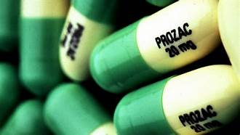
If you look actually at the statistics on the larger-selling categories of drugs, both anti-psychotics and antidepressants rank in the top five in terms of sales and profit.
It is fairly obvious there is a huge incentive there.
Vitamin P

Slide 4
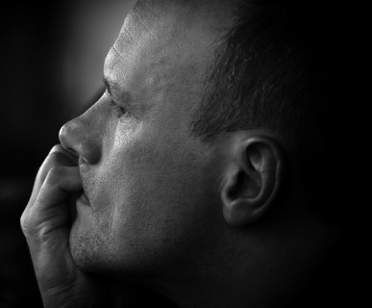

We all get anxious and depressed everyday for periods of time. But for most of us they lift when the event is over and we move on to other emotions hopefully more positive ones.
This is natural and normal.

Slide 5
5 Senses
Vision
Hearing
Touch
Taste
Smell
Eventt
Subconscious conditioning
Your perceptiont
Emotional changes due to Neurotransmitter imbalancet
Mediated by the Hypothalamus
Change of Feeling due to
Hormonal imbalancet
Mediated by the HPA axis
Loss of Muscle tone
Physical symptoms due to Meridian / Muscle imbalance

Slide 6
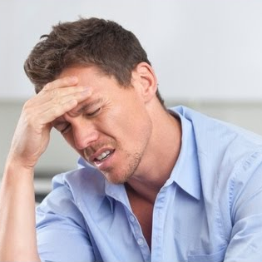
What is abnormal is if the anxiety or depression remain if the causal incident has passed or worse if we feel anxious or depressed and there has been no cause.

Slide 7
This is probably indicative of a biochemical imbalance in our neurotransmitter and / or hormonal systems.

Slide 8
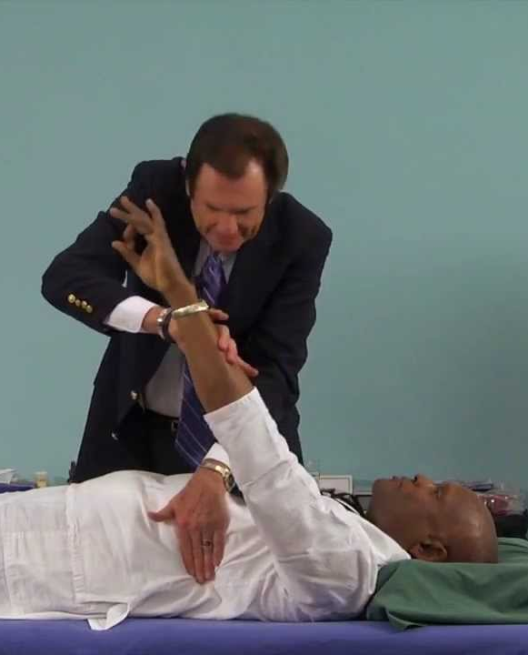
This imbalance perpetuates the emotional changes and the feelings within our bodies and is mediated through our meridian system creating weakening of specific muscles associated with the imbalanced meridian.
Dr Sheldon Deal

Slide 9
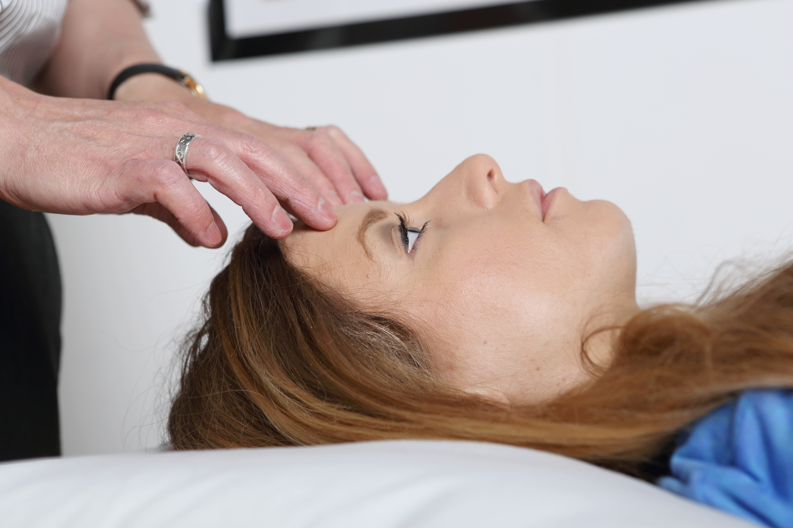
However in Applied Kinesiology (AK) if these muscle weaknesses strengthen to therapy localisation (TL) to the Emotional Stress Reflexes (ESR) then we tend to think that the person’s problem may well be emotionally instigated.

Slide 10
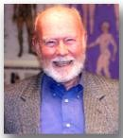
And may require more traditional AK emotional techniques and other therapies
Dr Jimmy Durlacher’s book
“Freedom From Fear Forever ”
NET
Psychological reversal
ESR
Flower remedies
Injury Recall
Colour therapy
Music therapy
Exercise
Affirmations
Tapping
Culinary Herbs
Deep massage
Hypnosis
Meditation
Aromatherapy

Slide 11
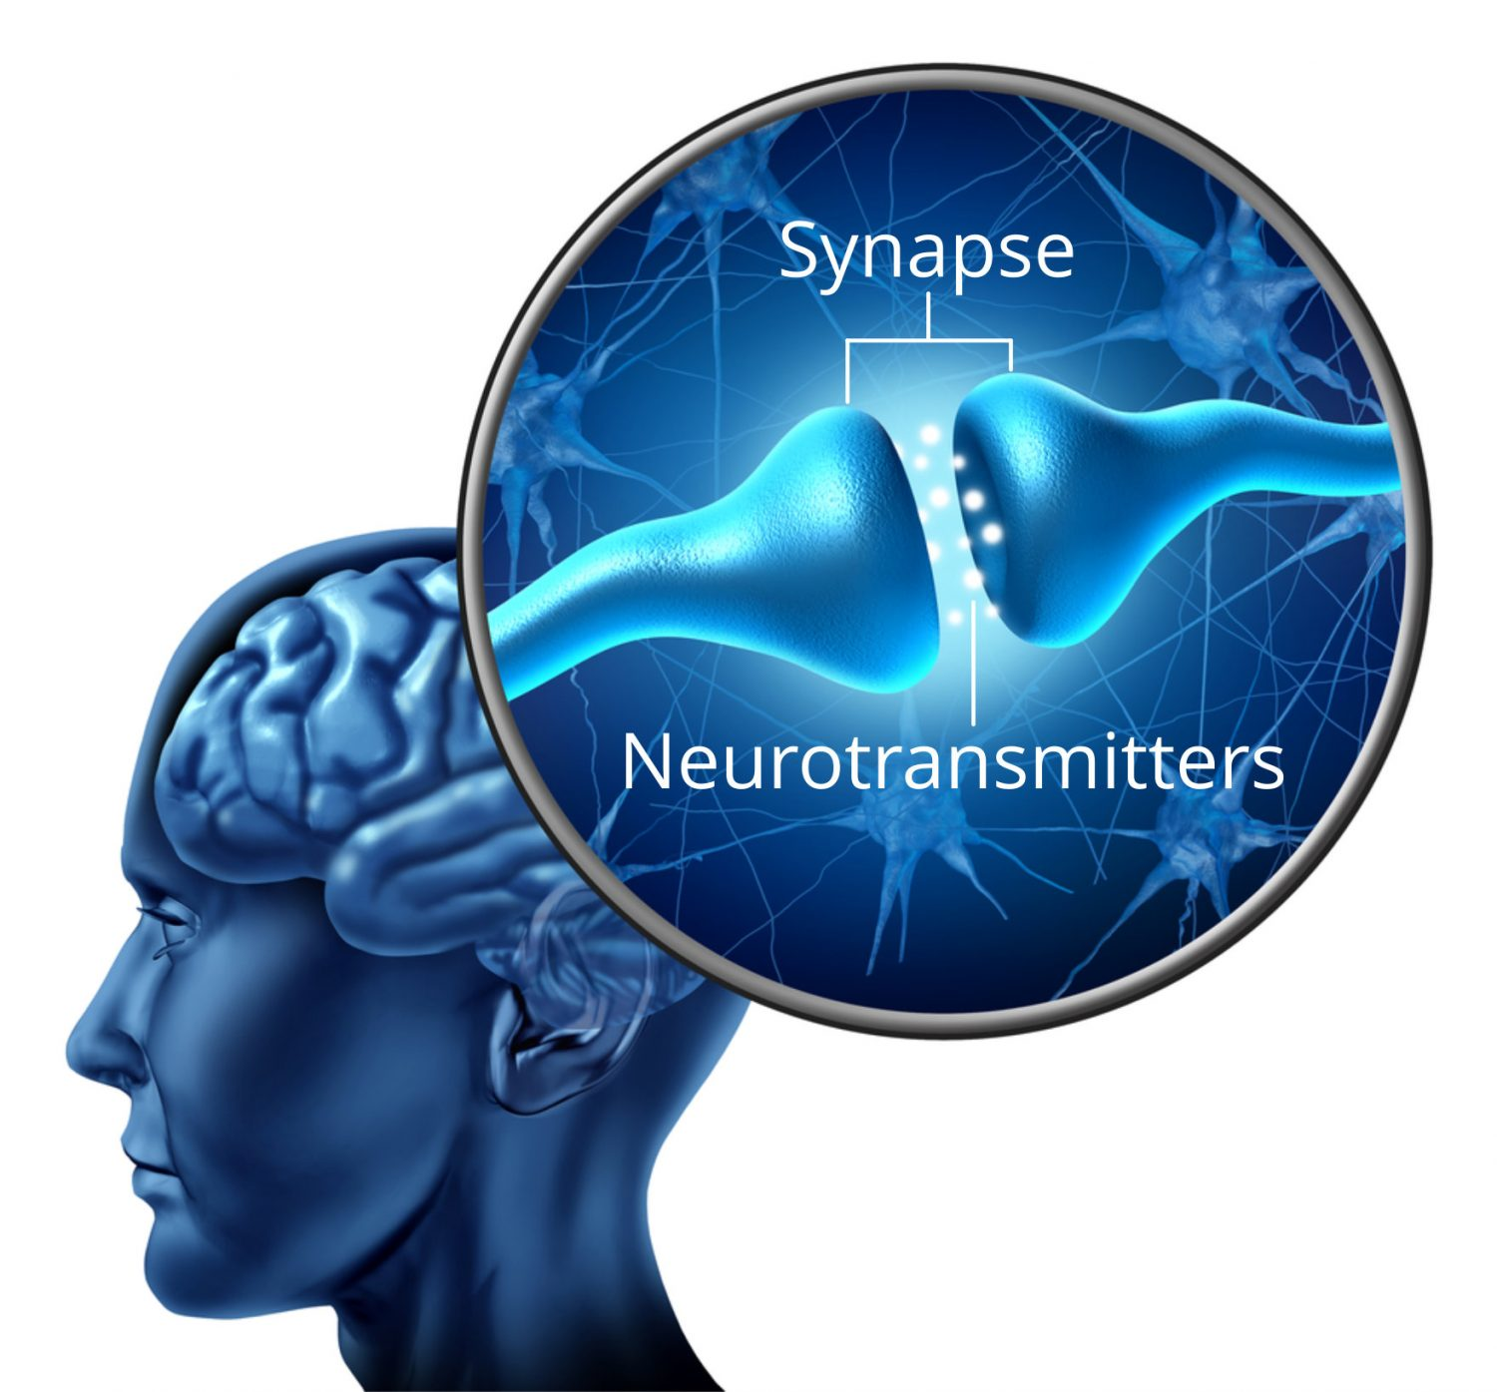
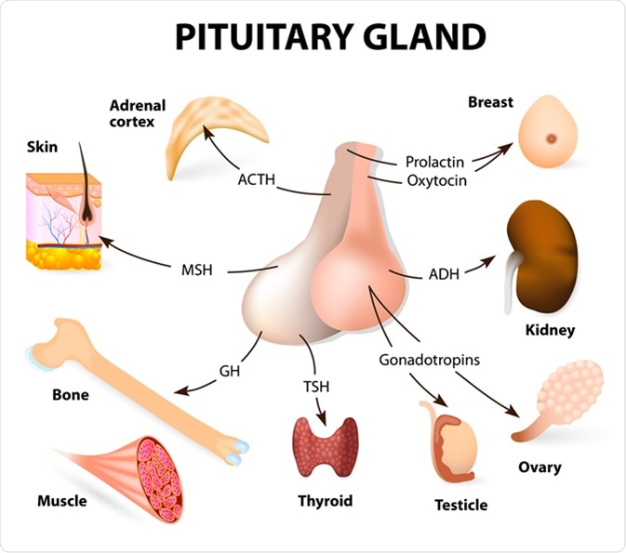
However –
in cases of anxiety or depression if the weak associated meridian muscles do not strengthen to the ESR points the problem maybe considered more biochemical.
Remember – Emotions are experienced and mediated by the neurotransmitters.
Feelings are mediated by hormones.

Slide 12
Depression is mediated mainly by low levels of the neurotransmitters –
Serotonin (the blues) Bl
Noradrenalin (lack of get up and go) SI
Dopamine (no pleasure in life) CV
Anxiety is mediated by mainly high levels of the neurotransmitters -
Serotonin (fear) Kid
Noradrenalin (not being loved) Ht
Dopamine (always wanting more) GV
Low GABA (agitated) LI

Slide 13
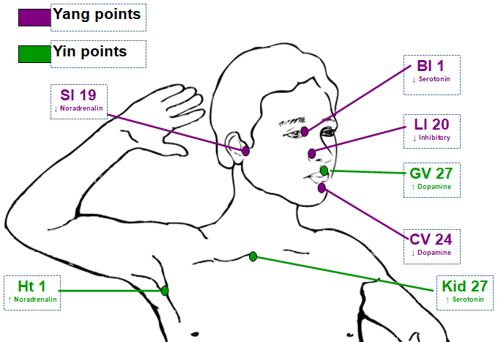
Low Neurotransmitters
High Neurotransmitters
Emotional Stress Reflexes

Slide 14
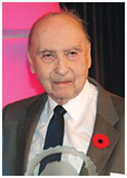
Let’s have another look at the work of Dr. Abram Hoffer so often quoted by Dr Goodheart, regarding his comments on the cause of emotional problems.
Founder member of the Orthomolecular Psychiatry Group.
Dr. Abram Hoffer 1917-2009

Slide 15
“I believe that if any person, no matter how ill, can be normal for even 5 minutes, it is possible for them to become normal forever, because those 5 minutes indicate that there is no permanent damage.*..
*Abram Hoffer Adventures in Psychiatry KOZ Publishing.
Dr. Abram Hoffer 1917-2009

Slide 16
Ever since I have been treating patients with the optimal doses of nutrition I have predicted that one day society will recognise that one of the most important factors for maintaining health is the provision of the optimal amount of the basic nutrients needed for each person.*
Dr. Abram Hoffer 1917-2009
*Abram Hoffer Adventures in Psychiatry KOZ Publishing.

Slide 17
Disease is the result of pathological changes in the body which either prevent it from properly fighting off infections or inhibit it from maintaining its own integrity or health. The origins of disease are not genetic; no genes are bad genes*.
*Abram Hoffer Adventures in Psychiatry KOZ Publishing.
Dr. Abram Hoffer 1917-2009

Slide 18
Any genes that are truly bad would destroy the individual before birth. All disease must be due to a defect in the nutrients supplied to that individual. If a person has been well until age 60years it is obvious that genes cannot be blamed for an emergent illness.
*Abram Hoffer Adventures in Psychiatry KOZ Publishing.
Dr. Abram Hoffer 1917-2009

Slide 19
The problem is not in our genes, it is the way we feed our genes.
I predict a future in which simple tests will be available which will advise which nutrients are lacking and how much of each nutrient patients need to regain and maintain their health.” *
*Abram Hoffer Adventures in Psychiatry KOZ Publishing.
Dr. Abram Hoffer 1917-2009

Slide 20
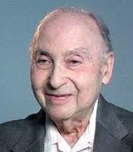
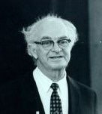
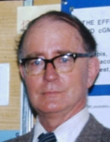
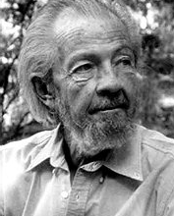
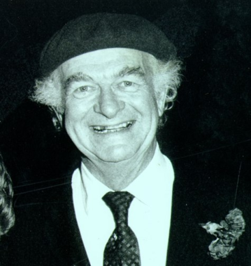
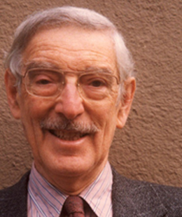
Birth of Orthomolecular Psychiatry
Abram Hoffer Humphrey Osmond John Smythies David Hawkins Linus Pauling Bruce Ames

Slide 21

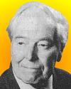
Richard Mackarness received his medical education from the Westminster Teaching Hospital. He later left general practice to become an assistant psychiatrist at Park Prewett Hospital, Basingstoke (1965-1981). Mackarness was influenced by the research of Theron Randolph on food allergies. He developed a controversial environmental approach to psychiatric disease.* His ideas were not accepted by the medical community.
Mackarness was a founding member of the Clinical Ecology Group, which later became the British Society for Allergy and Environmental Medicine. He also founded the Chemical Victims Association. Mackarness stated he was allergic to eggs and coffee so removed them from his diet. He avoided everything made from flour and processed sugar. Mackarness believed that hidden food allergies from "wrong foods" such as sugar cause violent behaviour.
*Finn, Ronald. (1996). Richard MacKarness. British Medical Journal312 (7045): 1534.

Slide 22
Pauling wrote: “The functioning of the brain is affected by the molecular concentrations of many substances that are normally present in the brain. The optimum concentrations of these substances for an individual may differ greatly from the concentrations provided by his normal diet and genetic machinery.”*
*Pauling L. Orthomolecular psychiatry. Varying the concentrations of substances normally present in the human body may control mental disease. Science. 1968;160(825):265-271.

Slide 23
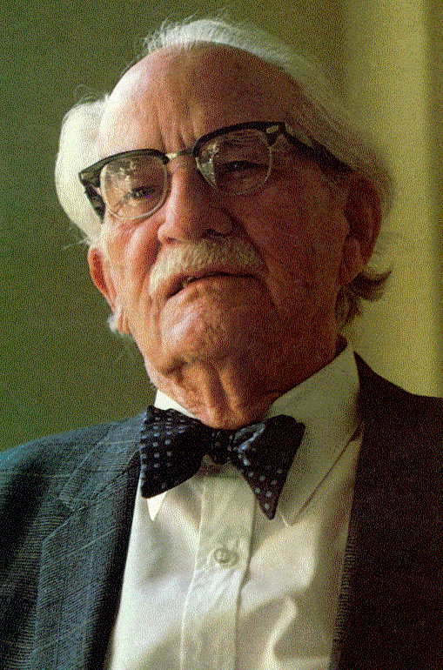
Roger Williams spoke about in the 1940s and 1950s. “Biochemical and genetic arguments support the idea that orthomolecular therapy, the provision for the individual person of the optimal concentrations of important normal constituents of the brain, may be the preferred treatment for many mentally ill patients.

Slide 24
Mental symptoms of avitaminosis sometimes are observed long before any physical symptoms appear.”
Biochemical Individuality: The Basis for the Genetotrophic Concept
1956, 1963 (softcover), John Wiley & Sons

Slide 25
It has been said that neuropsychological effects are some of the first signs of chronic vitamin intake below the levels necessary for optimal function, well before you get into the deficiency symptoms of scurvy or pellagra.*
*Pauling L. Orthomolecular psychiatry. Varying the concentrations of substances normally present in the human body may control mental disease. Science. 1968;160(825):265-271.

Slide 26
Pauling also wrote: “There is a possibility that for some persons the cerebral spinal concentrations of vital substances may be grossly low at the same time that the concentration in the blood and lymph is essentially normal.*
*Pauling L. Orthomolecular psychiatry. Varying the concentrations of substances normally present in the human body may control mental disease. Science. 1968;160(825):265-271.

Slide 27
A physiological abnormality such as a decreased permeability of the blood-brain barrier for the vital substance or increased rate of metabolism of the substance in the brain, may lead to a cerebral deficiency.*
*Pauling L. Orthomolecular psychiatry. Varying the concentrations of substances normally present in the human body may control mental disease. Science. 1968;160(825):265-271.

Slide 28
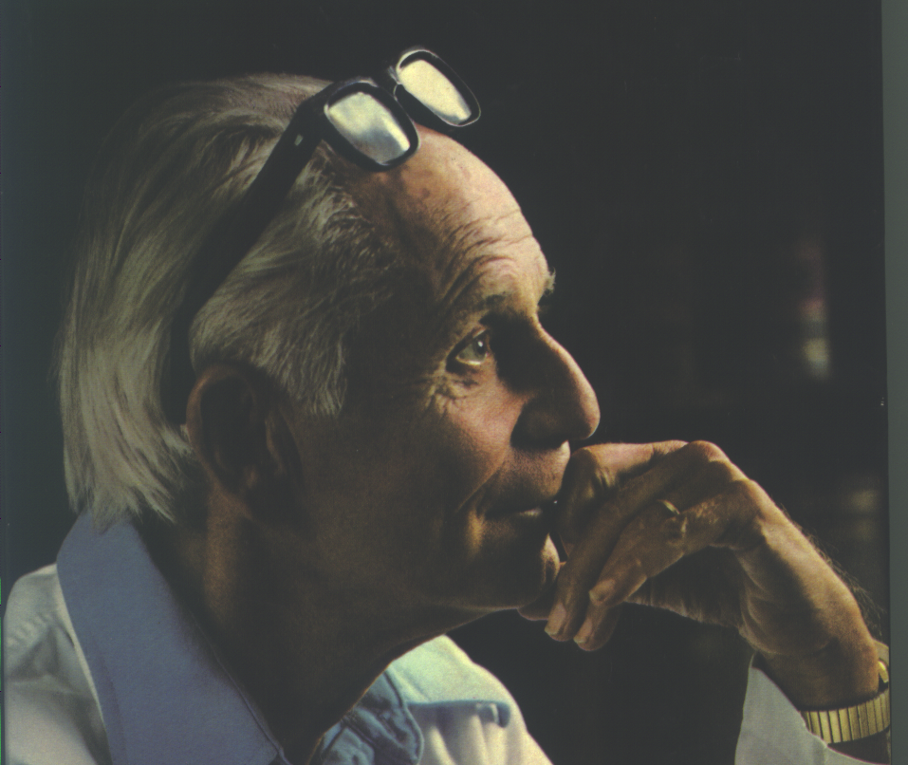
Selye’s Adaption to Stress
Normal physiology
Dysfunctioning physiology
Pathology
Death
Hans Selye 1908-1982
“General Adaption Syndrome”

Slide 29
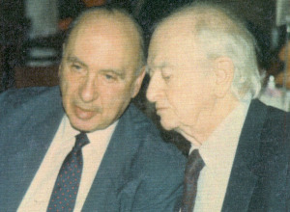
Hoffer’s Adaption to Stress
Psychiatric illness
Schizophrenia
Balanced thought
Neurotransmitter and hormonal imbalance
Anxiety / Depression
Death

Slide 30
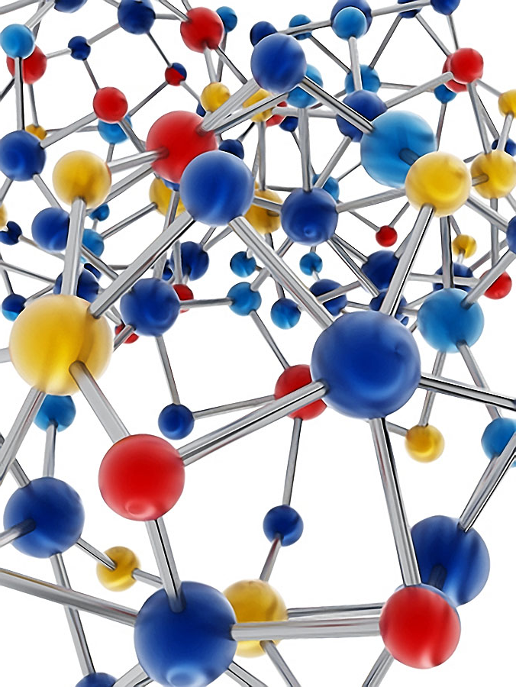
Understanding the numerous neurotransmitters, their receptors, their location, and their interactions with one another has been central to the design of medicines for mental illness and has led to the development of successful products for many brain disorders.*
*Neurotransmitters and Drugs by Z. Kruk and C. Pycock.

Slide 31
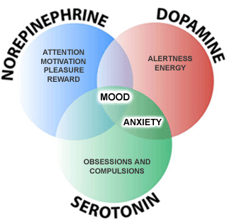
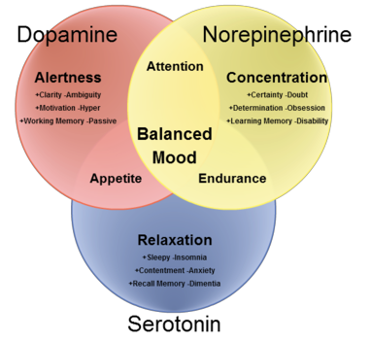
The neurotransmitters serotonin, noradrenaline and dopamine are involved in the control of many of our mental states, sometimes acting on their own and other times acting together. These, and other neurotransmitters, are likely to play a pivotal role in the pathological basis of mental illness and brain disease.*
*Neurotransmitters and Drugs by Z. Kruk and C. Pycock.

Slide 32
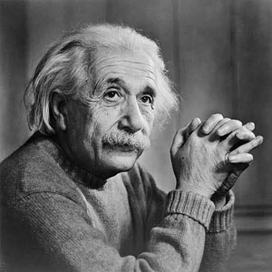
Definition of terms
Insanity is a disease of perception combined with an inability to tell whether these changes are real or not.
Dr John Conolly 1850.
Albert Einstein’s definition of insanity - “repeating the same thing over and over again and expecting a different outcome”.

Slide 33
Depression is a HYPO state of low mood and aversion to activity that can affect a person's thoughts, behaviour, feelings and sense of well-being. ↓NA, ↓Dop, ↓5HTP*
Anxiety is a HYPER feeling of worry, nervousness, or unease about something with an uncertain cause or outcome. ↑NA, ↑Dop, ↑5HTP, ↓GABA*
Note how similar the facial expressions can be
Neurotransmitters and Drugs by Z. Kruk and C. Pycock.

Slide 34
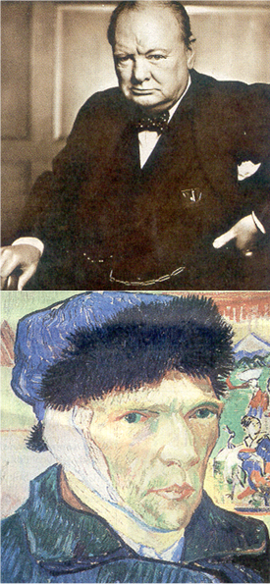
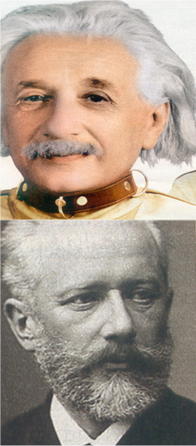
Manic depression or Bipolar disorder, is a mental disorder characterized by periods of elevated mood and periods of depression.
↓Dop - ↑ Dop*
Neurotransmitters and Drugs by Z. Kruk and C. Pycock.

Slide 35
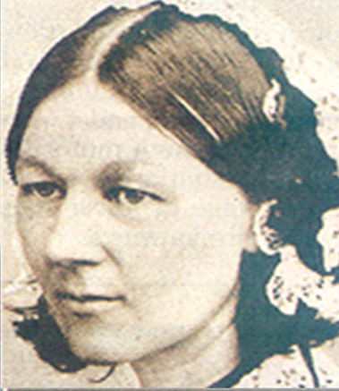
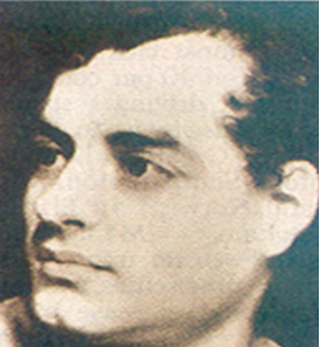
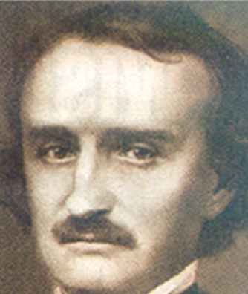
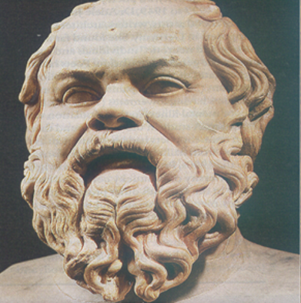
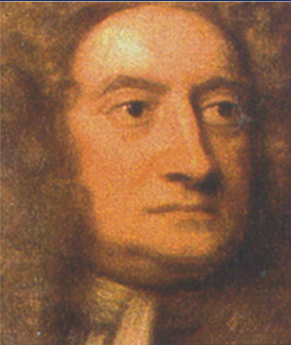
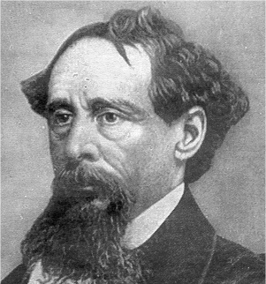
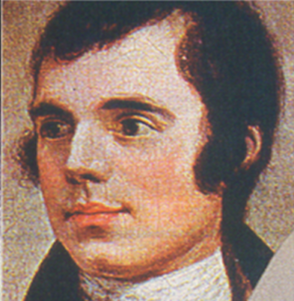
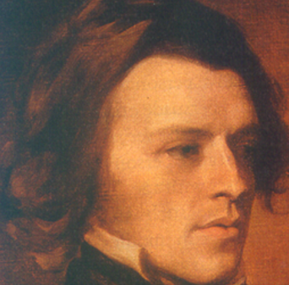
See if you can guess a few other famous Bipolar people

Slide 36
See if you can guess a few other famous Bipolar people
Florence Nightingale
Lord Byron
Edgar Allan Poe
Socrates
Issac Newton
Charles Dickens
Robert Burns
Lord Tennyson

Slide 37
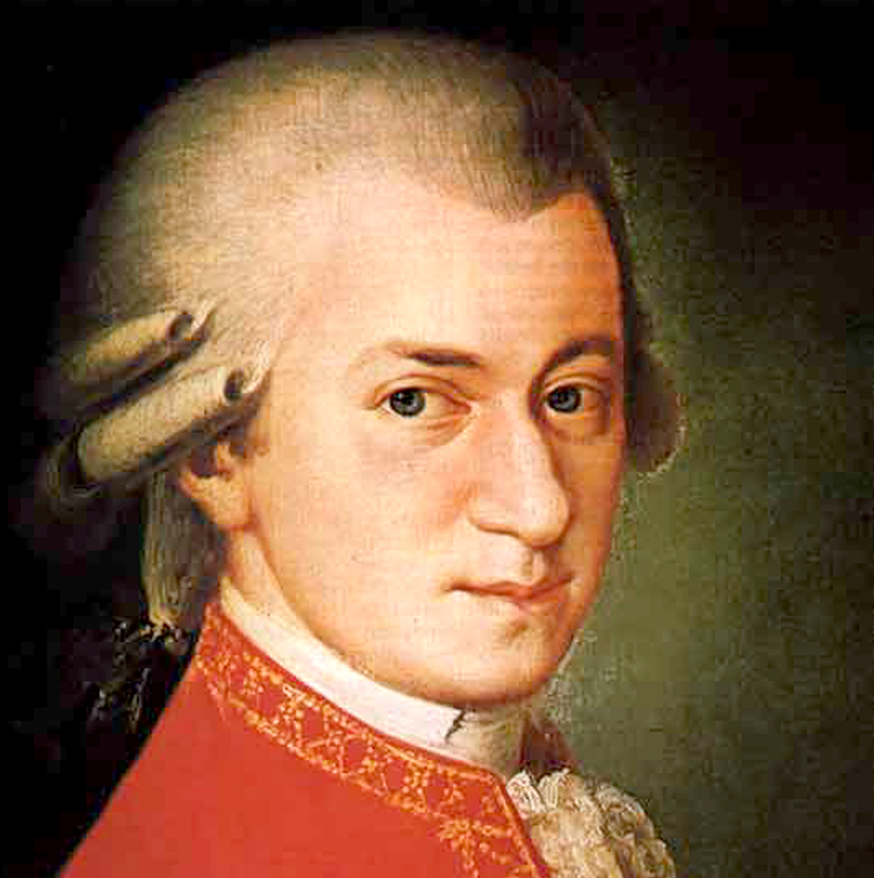
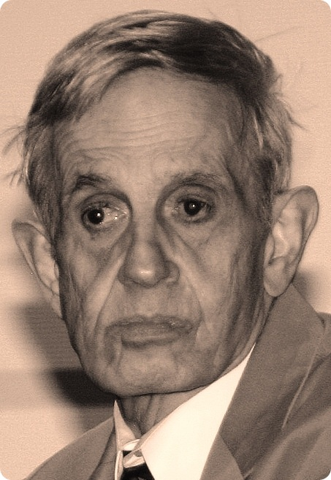
Schizophrenia is a mental disorder often characterized by abnormal social behaviour and failure to recognize what is real.*
Paranoid schizophrenia is the most common subtype of schizophrenia in which the patient has delusions that a person or some individuals are plotting against them or members of their family.*
Amadeus Mozart
John Nash 1928-2015
Neurotransmitters and Drugs by Z. Kruk and C. Pycock.

Slide 38

Psychosis is a severe mental disorder in which thought and emotions are so impaired that contact is lost with external reality.
"Psychosis". NHS. 23 December 2016. Retrieved 24 January2018.

Slide 39
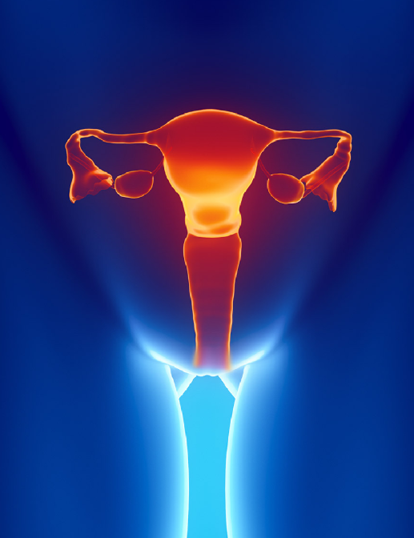
Hysteria colloquially means
ungovernable emotional excess and can refer to a temporary state of mind or emotion. The blanket diagnosis of hysteria has been fragmented into myriad medical categories such as epilepsy, histrionic personality disorder, conversion disorder, dissociative disorder, or other medical conditions.*
The word hysteria originates from the Greek word “uterus,” hystera
*Micale, Mark S. (January 15, 2019). Approaching Hysteria: Disease and Its Interpretations. Princeton University Press.

Slide 40
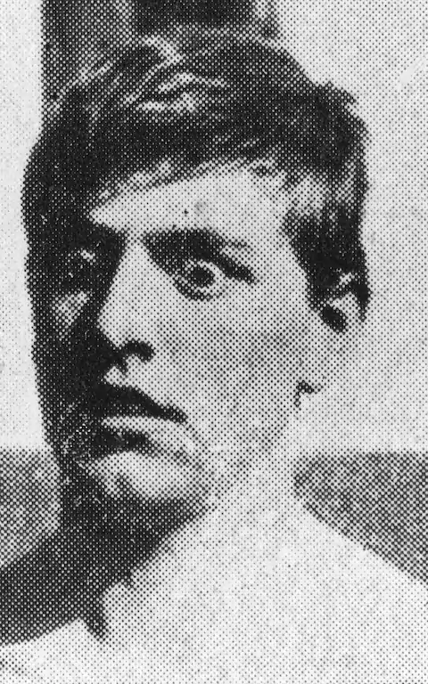
Other hysteria examples
Shell shock WW1
Combat fatigue WW11
Post traumatic stress syndrome from the Afghanistan / Iraq war
Civilian victims of trauma.*
*Micale, Mark S. (January 15, 2019). Approaching Hysteria: Disease and Its Interpretations. Princeton University Press.

Slide 41
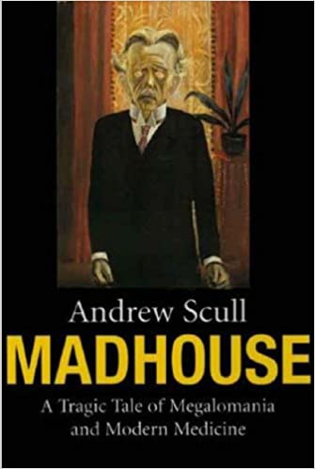
History of Mental Disorders
Biblical times – Possession
1800’s Mental (Lunatic) hospitals
Late 1800’s Biochemical illness
Early 1900’s Psychoanalysis.
1910 Septic foci operations.
1920 GUT connection
1938 Electric Convulsive Therapy
1940’s Exercise and Thyroid
1949 Lobotomy introduced
1950’s Early psychiatric medicines for psychoses e.g. Thorazine and Largactil
1960’s Psychology and Counselling
1990’s Psychoanalysis abandoned
2000’s Pharmaceutical approach
2020 GUT connection

Slide 42
The Chemistry of Emotions

Slide 43
Emotional cascade
Eventt
Your perceptiont
Mental changes due to Neurotransmitter imbalancet
Change of Feeling due to
Hormonal imbalancet
Physical symptoms due to Meridian / Muscle imbalance

Slide 44
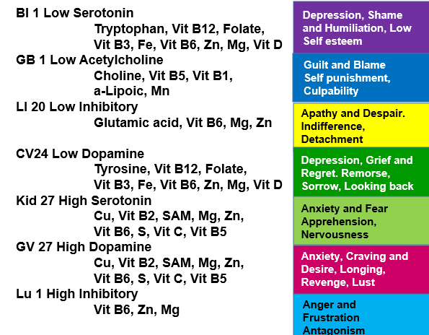
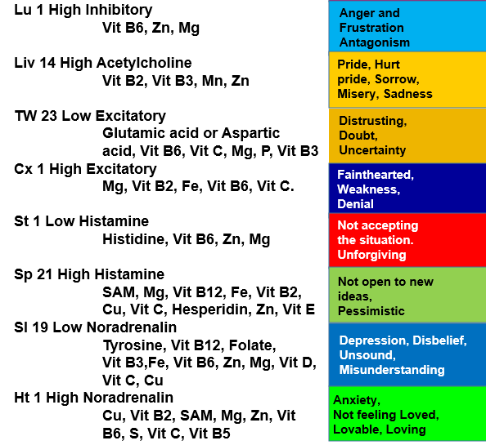
Meridian / Neurotransmitter / Emotion Relationship
Download from www.epigenetics-international.com

Slide 45
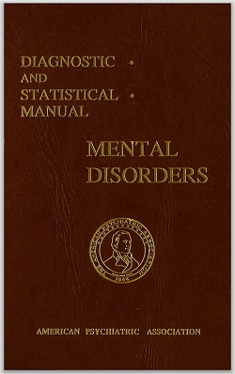
Psychiatric emotional conditions
Diagnostic and Statistical Manual of Mental Disorders (DSM-5)
Anxiety disorder
Mood disorder
Psychotic behaviour
Personality disorder
Eating disorder
Sleep disorder
Sexuality related
Others

Slide 46
Hoffer’s and Pauling’s work introduced us to the concept of Reactive intermediates and their relationship to emotional illnesses

Slide 47
From Tryptophan’s neurotransmitter Serotonin
Serotonochrome
Tryptamine
Dimethyltryptamine
From Tyrosine – Dopamine and Noradrenalin
Adrenochrome
Adrenolutein
Noradrenochrome
Dopaminochrome

Slide 48
Firstly let’s look at Reactive Intermediates
derived from Tryptophan
(All Indoles)

Slide 49
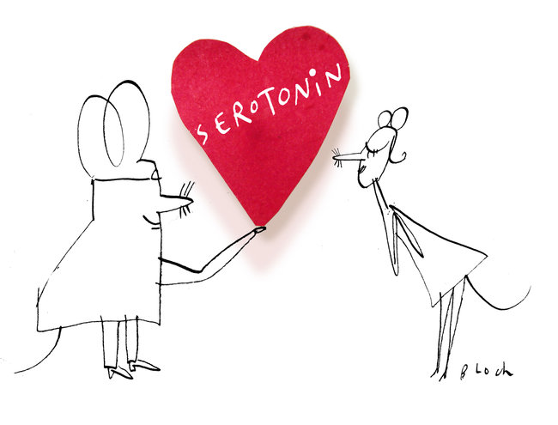
Serotonin is synthesied from the amino acid tryptophan, through metabolic conversion. These intermediary molecules in the metabolism of serotonin can be considered neurotoxins in their own right, and can have - in animals, effects on their mood and their nervous system activity.

Slide 50
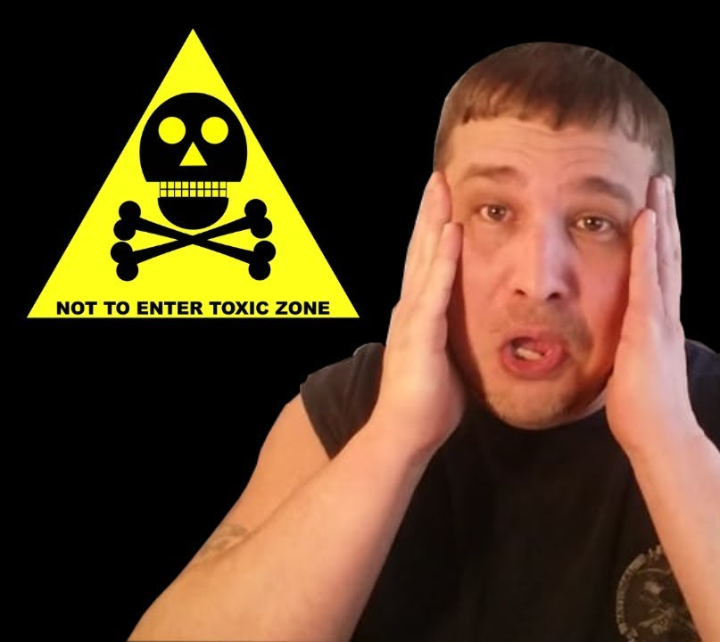
If you had an alteration in the metabolism of neurotransmitters coming up from the precursor tryptophan into serotonin and its by products, it would be possible to induce autotoxicity, which then could activate the immune system.

Slide 51
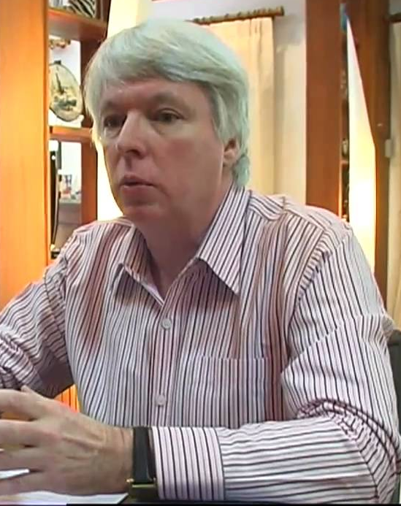
This autointoxication concept is what Dr. Michael Maes talks about as it relates to how these substances may interrelate with immune system activation and then be like a circular effect on depression, anxiety, mood changes, and inflammatory mediators all working together.
*Maes M, Mihaylova I, Ruyter MD, Kubera M, Bosmans E. The immune effects of TRYCATs (tryptophan catabolites along the IDO pathway): relevance for depression-and other conditions characterized by tryptophan depletion induced by inflammation. Neuro Endocrinol Lett. 2007;28(6):826-831.

Slide 52
It is not just in the mind; chronic fatigue syndrome, fibromyalgia, and depressive disorders all swim together and work together, through the inflammatory pathways.*
*Maes M, Mihaylova I, Ruyter MD, Kubera M, Bosmans E. The immune effects of TRYCATs (tryptophan catabolites along the IDO pathway): relevance for depression-and other conditions characterized by tryptophan depletion induced by inflammation. Neuro Endocrinol Lett. 2007;28(6):826-831.

Slide 53
This model is another part of our evolving understanding of the origin of neuropsychiatric and neurophysiological disorders. If you start looking at tryptophan metabolites along the pathway of ultimate excretion of indoleamine metabolites from the metabolism of tryptophan through the serotonergic pathway, you see there is some relevance in individuals to the autointoxication concept that was first born out of work from the middle of the last century.

Slide 54
By modulating the metabolism of these substances and improving their throughput into serotonin and their exit ultimately out of the body through detoxified intermediates, we improve the molecular milieu (the orthomolecular environment).*
*Maes M, Mihaylova I, Ruyter MD, Kubera M, Bosmans E. The immune effects of TRYCATs (tryptophan catabolites along the IDO pathway): relevance for depression-and other conditions characterized by tryptophan depletion induced by inflammation. Neuro Endocrinol Lett. 2007;28(6):826-831.

Slide 55
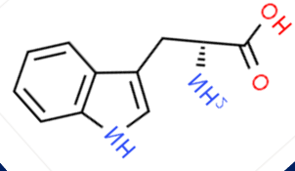
Metabolic derivatives of Tryptophan

Slide 56
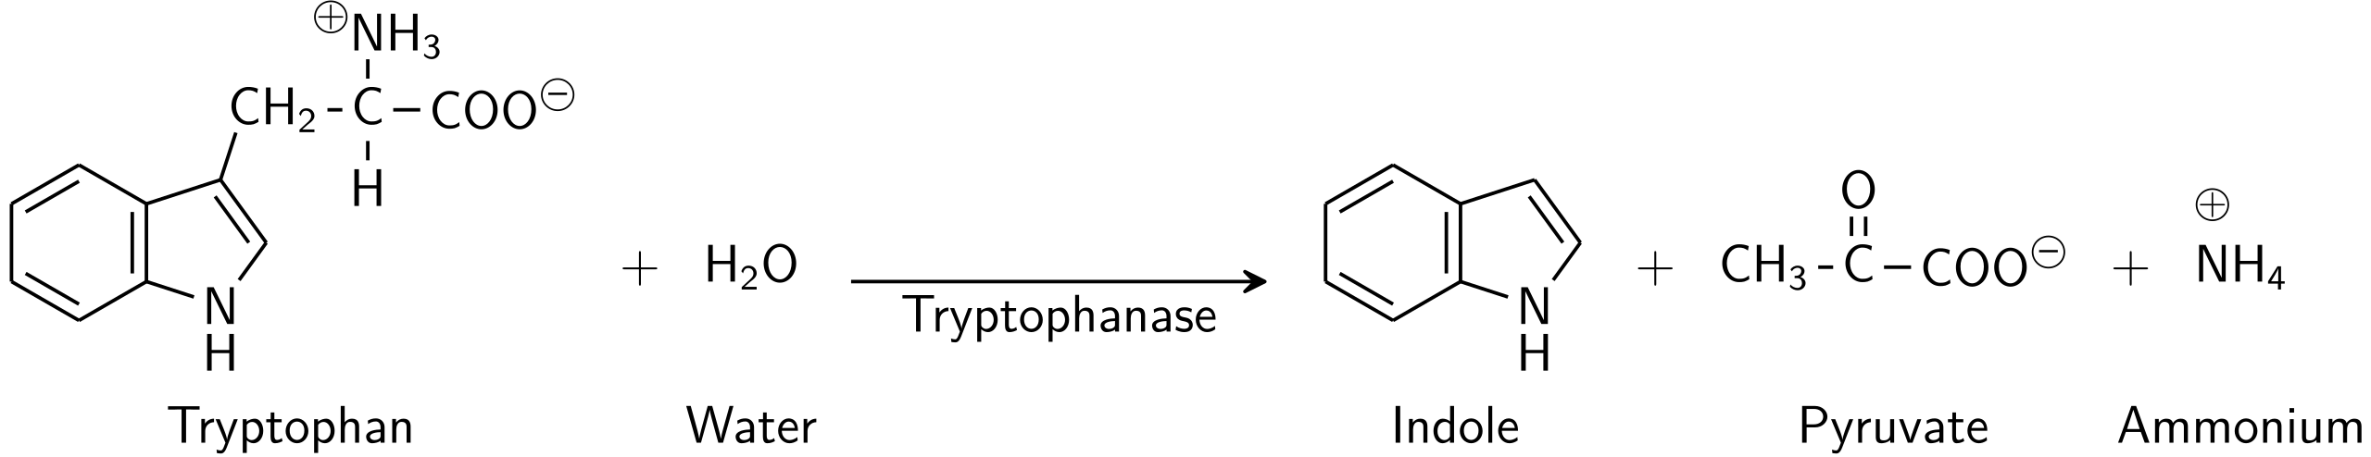
Indole is a by-product of the digestion of tryptophan and is one of the compounds that gives the faeces its characteristic odour (together with the scatol and other substances).
Ammonium causes real nasty thoughts especially at night time.
P-5-P, K

Slide 57
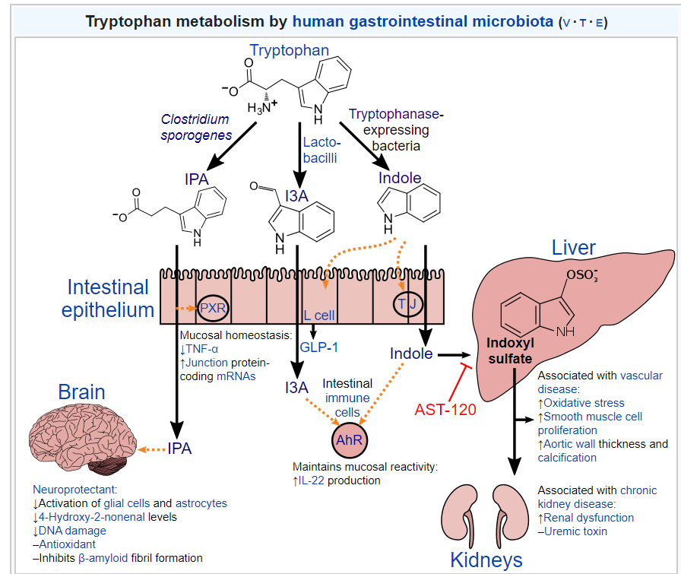
Indole can be metabolized by the liver into indoxyl sulfate, a compound that is toxic in high concentrations and associated with vascular disease and renal dysfunction.
Activated charcoal, an intestinal sorbent that is taken by mouth, absorbs indole, in turn decreasing the concentration of indoxyl sulfate in blood plasma.

Slide 58
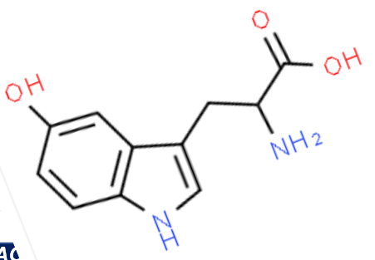




Tryptophan
Low Serotonin = Bladder
High Serotonin = Kidney
hydroxylation
H4Biopterin
5-HTP
Ammonium causes real nasty thoughts especially at night time.
decarboxylation
P-5-P
CO2
Serotonin
Hydroxyindole acetate*
acetylation
AcetylCoA
MAO
Cu, FAD
methylation
SAM, B12, 5MTHF, Zn
NH4
Methoxyindole acetate*
N. Acetylserotonin
methylation
SAM, B12, 5MTHF, Zn
Glutathione, Sulfur
Glucuronidation,
Acetylation
Melatonin
Conjugates

Slide 59



Tryptophan
Tryptamine*
decarboxylation
methylation
SAM, B12, 5MTHF, Zn
hydroxylation
H4Biopterin
N. Methyltryptamine
5-HTP
methylation
SAM, B12, 5MTHF, Zn
decarboxylation
P-5-P
Dimethyltryptamine (DMT)*
CO2
Serotonin
oxidation
Serotonochrome*
acetylation
AcetylCoA
N. Acetylserotonin
methylation
SAM, B12, 5MTHF, Zn
Melatonin

Slide 60

Tryptamine is a decarboxylation product of L-tryptophan that occurs in plants and certain foods (for example, cheese, mushrooms, cashew nuts). It.raises the blood pressure through vasoconstrictor action, by.the release.of noradrenalin at postganglionic sympathetic nerve endings.*
*Khan MZ, Nawaz W (October 2016). "The emerging roles of human trace amines and human trace amine-associated receptors (hTAARs) in central nervous system". Biomed. Pharmacother. 83: 439–449.

Slide 61
Tryptamine binds to human trace amine-associated receptor 1 (TAAR1) as an agonist
regulating neurotransmission in dopamine, noradrenalin, and serotonin neurons in the CNS. It also affects immune system and neuroimmune system function through different mechanisms.
It is primarily expressed in several peripheral organs and cells (e.g. the stomach, small intestine, duodenum, and white blood cells), astrocytes, and in the intracellular milieu within the presynaptic plasma membrane (i.e., axon terminal) of monoamine neurons in the central nervous system (CNS).*
*Maguire JJ, Davenport AP (20 February 2018). "Trace amine receptor: TA₁ receptor". IUPHAR/BPS Guide to PHARMACOLOGY. International Union of Basic and Clinical Pharmacology. Retrieved 16 July2018.

Slide 62

Other hallucinogenic compounds from Tryptophan -
Dimethyltryptamine (DMT).
Rich in Ayahuasca brew
*"Erowid DMT (Dimethyltryptamine) Vault“. Erowid.org. Retrieved 2012-09-20.

Slide 63

DMT can produce vivid "projections" of mystical experiences involving euphoria and dynamic hallucinationsof geometric forms.*
*"Erowid DMT (Dimethyltryptamine) Vault“. Erowid.org. Retrieved 2012-09-20.

Slide 64

Metabolic derivatives of Tyrosine

Slide 65






Tyrosine
Conjugates
hydroxylation
H4Biopterin
Low Noradrenalin = SI
High Noradrenalin = Heart
Glutathione, Sulfur
Glucuronidation,
Acetylation
L.DOPA
decarboxylation
P-5-P
Vanillylmandelic acid*
CO2
Dopamine
dopamine hydroxylase
Vit C, Cu
methylation
B12, 5MTHF, Zn
CH3
Dihydroxymandelic acid*
Noradrenalin
MAO
Cu, FAD
methylation
B12, 5MTHF, Zn
NH4
Adrenalin
MAO
Cu, FAD

Slide 66



Tyrosine
hydroxylation
H4Biopterin
L.DOPA
decarboxylation
P-5-P
CO2
Dopamine
dopamine hydroxylase
Vit C, Cu
Noradrenalin
Noradrenochrome*
oxidation
methylation
B12, 5MTHF, Zn
Adrenalin
Adrenochrome*
Adrenolutein*
oxidation
reduction

Slide 67
Dopamine

Slide 68
Tyrosine
Low Dopamine = CV
High Dopamine = GV
hydroxylation
H4Biopterin
L.DOPA
decarboxylation
P-5-P
CO2
Dopamine
Dihydroxyphenyl acetic acid*
MAO
Cu, FAD
NH2
methylation
SAM, B12, 5MTHF, Zn
Vanillylmandelic acid*
Glutathione, Sulfur
Glucuronidation,
Acetylation
CH3
Conjugates

Slide 69

Tyrosine derived trace amines attaching to the TAAR1 receptor are
  Phenethylamine
  N-Methylphenethylamine
  Phenylethanolamine
  Tyramine
  3-Methoxytyramine
  N-Methyltyramine
  Octopamine
  Synephrine

Slide 70






Tyrosine
Tyramine*
hydroxylation
H4Biopterin
aromatic L-amino acid decarboxylase
P-5-P
dopamine hydroxylase
Vit C, Cu
methylation
SAM, B12, 5MTHF, Zn
L.DOPA
N-Methoxytyramine*
Octopamine*
decarboxylation
P-5-P
CO2
Dopamine
3-Methoxytyramine*
methylation
SAM, B12,
5MTHF, Zn
MAO
Cu, FAD
oxidation
Synephrine*
Dopaminochrome*

Slide 71


Slide 72
Tyramine is an indirect acting catcholaminergic amine found in Bananas and Avocados, Barley grass, Mandarin, Tangerine, Orange, Lemon, Grapefruit, Tomato, Pea, Plum, Aubergine, Cacao, Potato Cheese, Sour cream, Pizzas, Chocolate.

Slide 73
Pickled Herrings, Caviar, Liver, Salamis, Broad Beans pods.
Fermented dairy products such as Yoghurt, Sauerkraut
Yeast extracts including Beer and Wine, Bovril, Oxo, Marmite, MSG and all fermented Soya Bean products.

Slide 74
Normally tyramine is completely inactivated by MAO when taken in the diet. Thus inhibition of MAO enzymes will lead to excess sympathetic activity. When these foods are eaten in the evening they often cause disrupted sleep and nightmares if high dopamine.
Neurotransmitters and Drugs by Z. Kruk and C. Pycock.

Slide 75
We know these foods because they are not permitted to be ingested when patients are taking monoamine oxidase inhibitor drugs such as
“Marplan”,
“Nardil”,
“Parnate”.

Slide 76
GABA

Slide 77




Glutamate (Glutamic acid)
glutamate decarboxalase
P5P
CO2
Low GABA = LI
High GABA = Lung
GABA
2-oxoglutarate
v
GABA transaminase
P5P
Glutamate
Succinic semialdehyde
succinic semialdehyde dehydrogenase
NAD, Mg
Succinic acid

Slide 78



Slide 79


Slide 80



Slide 81
Let’s have a closer look at the Adrenalin derivatives

Slide 82

Adrenalin when oxidised turns pink in colour. Adrenalin is colourless.
This oxidised pink adrenalin was identified to contain adrenochrome.
*Abram Hoffer Adventures in Psychiatry KOZ Publishing.

Slide 83
This compound formed by the loss of one electron from the adrenalin molecule is very unstable and can rapidly change back to adrenalin if that electron is replaced.
*Abram Hoffer Adventures in Psychiatry KOZ Publishing.

Slide 84

Significantly if the electron is not recaptured or if this cannot occur because of a deficiency in the nicotinamide adenine dinucleotide (NAD – NADH) system, oxidised adrenalin will lose another electron and become adrenochrome.
*Abram Hoffer Adventures in Psychiatry KOZ Publishing.

Slide 85
Adrenochrome cannot be changed back into adrenalin. Adrenochrome is very reactive and promptly forms adrenolutein and a large variety of other oxidised indoles.
Pink adrenalin contains a mixture of these various oxidised derivatives.
*Abram Hoffer Adventures in Psychiatry KOZ Publishing.

Slide 86

(462nm)

Slide 87
462nm Adrenochrome

Slide 88
In my clinical experience using Applied Kinesiology this spectroscopic emission acetate will weaken a person who has a higher than optimal level of adrenochrome.

Slide 89
The same sequence occurs with other catecholamine hormones such as noradrenalin and dopamine becoming indoles in structure.*
e.g. Noradrenochrome
Dopaminochrome
*Abram Hoffer Adventures in Psychiatry KOZ Publishing.

Slide 90

Vernon Woodford found that adrenochrome slows the Kreb’s cycle and could in the brain lead to symptoms of mental illness.*
Probably due to damaging the mitochondrial DNA and by its inhibition of certain heme synthesising enzymes.
*Abram Hoffer Adventures in Psychiatry KOZ Publishing.

Slide 91
Reduced Heme synthesis will lead to low levels of
Hemoglobin and Myoglobin (hypoxia)
Cytochrome c (low ATP)
Cytochrome c oxidase (low ATP)
Cytochrome P450 (low detoxification)
Myeloperoxidase and Nitric oxide (low immune system)
Catalase (low reduction of ROS > inflammation)
Sulfite oxidase (sulfite sensitivity)
Thyroid peroxidase* (low thyroid)
Harpers Biochemistry

Slide 92

The classical symptoms of Vitamin B3 (NAD – NADH) deficiency are
Pellagra
Dementia
Dermatitis
Diarrhoea
*Abram Hoffer Adventures in Psychiatry KOZ Publishing.

Slide 93

Symptoms include inflammed skin, diarrhea, dementia, and sores in the mouth. Areas of the skin exposed to either sunlight or friction are typically affected first. Over time affected skin may become darker, stiff, begin to peel, or bleed.*
*Ngan, Vanessa (2003). "Pellagra". DermNet New Zealand. Archived from the original on 9 April 2017. Retrieved 10 June 2017.

Slide 94

Symptoms are often indistinguishable from schizophrenia with symptoms peaking in the spring / summer when sufferers were more exposed to the sun.* (note here links to porphyria).
*Abram Hoffer Adventures in Psychiatry KOZ Publishing.

Slide 95


Vitamin B3 also acts as a methyl group acceptor. The resulting compound being N-Methylnicotinamide, which is excreted.
Thus it can decrease the formation of adrenalin from noradrenalin and thus decrease the formation of adrenochrome.*
Nicotinamide
*Abram Hoffer Adventures in Psychiatry KOZ Publishing.
N-Methylnicotinamide

Slide 96

Professor Robert Beamish in 1989 showed that adrenochrome is primarily synthesised in the heart muscle.*
But can bind to the mitochondrial DNA in any cell.*
*Abram Hoffer Adventures in Psychiatry KOZ Publishing.

Slide 97

Studies in the mid-twentieth century have indicated that adrenochrome is metabolized into one of two other substances,
Dihydroxyindole or Adrenolutin.
*Abram Hoffer Adventures in Psychiatry KOZ Publishing.

Slide 98
Defective processing of adrenochrome, however, primarily produces the toxic adrenolutin instead, which combines with adrenochrome.
*Abram Hoffer Adventures in Psychiatry KOZ Publishing.

Slide 99

The adrenochrome-adrenolutin combination is hypothesized by Dr. Abram Hoffer and Humphrey Osmond to result in disruption of the brain's normal chemical processes. This disruption, according to their hypothesis, could in part be responsible for the symptomatology of schizophrenia.*
Dr Humphrey Osmond
*Abram Hoffer Adventures in Psychiatry KOZ Publishing.

Slide 100

Stress increases the secretion of adrenalin and therefore adrenochrome in Vitamin B3 deficient people.*
*Abram Hoffer Adventures in Psychiatry KOZ Publishing.

Slide 101

This hypothesis has long been opposed by proponents of the establishment pharmaceutical medical industry.
(Bit like Vit D and the corona virus)

Slide 102
Diagnosis
Patient weakens to one of the B&E points.
Weakness does not cross TL to the Emotional Stress Reflex points.
Low Neurotransmitters
High Neurotransmitters
Emotional Stress Reflexes

Slide 103
Treatmentt
Low Serotonin Bl 1
Tryptophan, B12, Folate, B3, Fe, B6, Zn, Mg, Vitamin D.
High Serotonin Kid 27
Cu, Vitamin B2, SAM (B12, Folate), Mg, Zn, Vitamin B6, S, Vitamin C, Vitamin B5.
Low Dopamine CV 24
Tyrosine, B12, Folate, B3, B6, Fe, Zn, Mg, Vitamin D.
High Dopamine GV27
Cu, Vitamin B2, SAM (B12, Folate), Mg, Zn, Vitamin B6, S, Vitamin C, Vitamin B5.
Low Noradrenalin Ht 1
Tyrosine, B12, Folate, B3, B6, Fe, Zn, Mg, Cu, Vitamin D, Vitamin C.
High Noradrenalin Ht 1
Cu, Vitamin B2, SAM (B12, Folate), Mg, Zn, Vitamin B6, S, Vitamin C, Vitamin B5.
Low GABA LI 20
Glutamic acid, B6, Zn, Mg
Best to test with the activated co-enzyme vitamins where applicable.

Slide 104
Meridian / Neurotransmitter / Emotion Relationship
Download from www.epigenetics-international.com

Slide 105

The GUT / Brain Connection

Slide 106
The GUT connection
The rise of bacteriological models of disease in early 1900’s postulated that the gut became very suspect, not just among some psychiatrists. A lot of other fields of medicine looked at this, and particularly the notion of what was called focal sepsis: chronic, low-grade, untreated infections producing illness at a distance.

Slide 107

Suspect a GUT / Brain Connection when the positive B&E point is an intestinal one
i.e.
Small Intestine19
Large Intestine 20

Slide 108
Additional Endogenous GUT chemicals* produced in the intestines may show on the Liver meridian. All highly neurotoxic -
Acetaldehyde - Yeast
Ammonia – Parasites, Gram negative bacteria
Formaldehyde - Fungus
Methanol - Fungus
Phenol - Parasites
Propionic acid – Gram negative bacteria
*All available in the Epigenetics GUT kit

Slide 109

Endogenous GUT chemicals from pancreatic Protease deficiency*
Agmatine - Arginine
Cadaverine - Lysine
Ethanolamine - Serine
Ethylmercaptan - Cysteine
Indole- Tryptophan
Methylindole - Tryptophan
Methylmercaptan - Methionine
Phenylethylamine - Phenylalanine
Putrascine - Ornithine
Tryptamine - Tryptophan
*All available in the Epigenetics GUT kit

Slide 110
Optimal Treatments
Digestive enzymes
Betaine HCl
Betaine HCl + Pepsin
Bile salts
Amylase
Lipase
Protease
Inulin
Lactulose
Psyllium husk
Probiotics
Lactobacillus Acidophilus
Lactobacillus Bulgaricus
Lactobacillus Brevis
Lactobacillus Casei
Lactobacillus Gasseri
Lactobacillus Lactis
Lactobacillus Paracasei
Lactobacillus Pentosis
Lactobacillus Ruterii
Lactobacillus Rhamnosus
Lactobacillus Salivarius
Probiotics
Streptococcus thermophilis
Saccromyces Boulardii
Bifido Animalis lactis
Bifido Bifidus
Bifido Brevis
Bifido Infantis
Bifido Lactis
Bifido Longus
B. Subtilis

Slide 111

Therapy Localisation point with pressure for Probiotics
Root of the mesentery

Slide 112

Treatment – The 6 R program
1. Remove- Allergens / Pathogens
2. Replace – Digestive enzymes
3. Re inoculate- Pre & Probiotics
4. Repair- Glutamine, Zn, Omega 3, Vitamin A, Biotin.
5. Regeneration – Folate, Turmeric
6. Roughage (Fibre)
Jeffrey Bland PhD

Slide 113
Key Orthomolecular Psychiatry Nutrients
GABA / Glutamic acid (for GABA)
Glutathione (detox)
Tryptophan (for 5-HTP)
Tyrosine (for NA and Dop)
Ornithine to metabolise ammonia
SAMe (for methylation)
Copper
Iodine
Iron
Magnesium
Selenium
Zinc
Thiamine pyrophosphate
Riboflavin-5-phosphate
Niacin / Niacinamide
NAD / NADH
Acetyl CoA
Pyridoxal-5-phosphate
Folinic acid
5-MTHF
Adenosylcobalamin
Methylcobalamin
Biotin
Vitamin C
Vitamin D2 and D3
DHA
Flaxseed oil
Omega 3
Phosphatidylcholine
Phosphatidylserine
Turmeric
Probiotics
Prebiotics (Inulin)

Slide 114

So, a lot of information.
But actually a simple way of applying your knowledge of B&E points into the possible biochemical causes of common emotional / functional psychiatric problems so prevalent at this time.

Slide 115

Remember the famous saying of Dr Sidney Baker with treating all patients -
“Remove the things that are a stress to the patient and supply what they are deficient in”.

Slide 116
So remove intolerant foods, endogenous toxins, pathogenic foci.
Supply the necessary nutrients and co-factors to optimise neurotransmitter synthesis and metabolism.
Can’t go wrong if you follow the 6 R Program for all health problems.

Slide 117
I really hope you have enjoyed this presentation.
The PowerPoint handout notes are available from ICAK-USA or from our website
www.epigenetics-international.com

